Slide 1



Small and long RNA-Seq pipelines
in the Genboree Workbench
NIH Extracellular RNA Communication Consortium
2nd Investigators’ Meeting
May 19th, 2014
Sai Lakshmi Subramanian – sailakss@bcm.edu (Primary Contact)
Kevin Riehle – riehle@bcm.edu
Bioinformatics Research Laboratory, Baylor College of Medicine, Houston, TX
Data Coordination Component (DCC) of exRNA Communication Consortium
Robert Kitchen - rob.kitchen@yale.edu
Department of Molecular Biophysics and Biochemistry, Yale University, New Haven, CT
Data Integration and Analysis Component (DCC) of exRNA Communication Consortium

Slide 2
Outline
Introduction to Genboree
Genboree Workbench Basics
Data analysis tools
  RNA-Seq data – RSEQtools
  Setting up long RNA-Seq data analysis in the Genboree Workbench
    Small RNA-Seq data – smallRNA-seq Pipeline
    Setting up small RNA-Seq data analysis in the Genboree Workbench

Slide 3
Genboree Workbench Basics
Genboree URL - http://www.genboree.org/
Watch Video Tutorial – Introduction to Genboree Workbench
https://docs.google.com/file/d/0Bz3_YiJBA_j3Tk1uOFlIazdMbkk/edit
How do I create a new account in Genboree? http://genboree.org/theCommons/ezfaq/show/public-commons?faq_id=493
How to find Help within the Genboree Workbench? http://genboree.org/theCommons/ezfaq/show/public-commons?faq_id=497
  Help >> Getting Started
  Help >> Tool Map
  Help >> Tool Help Resources

Slide 4
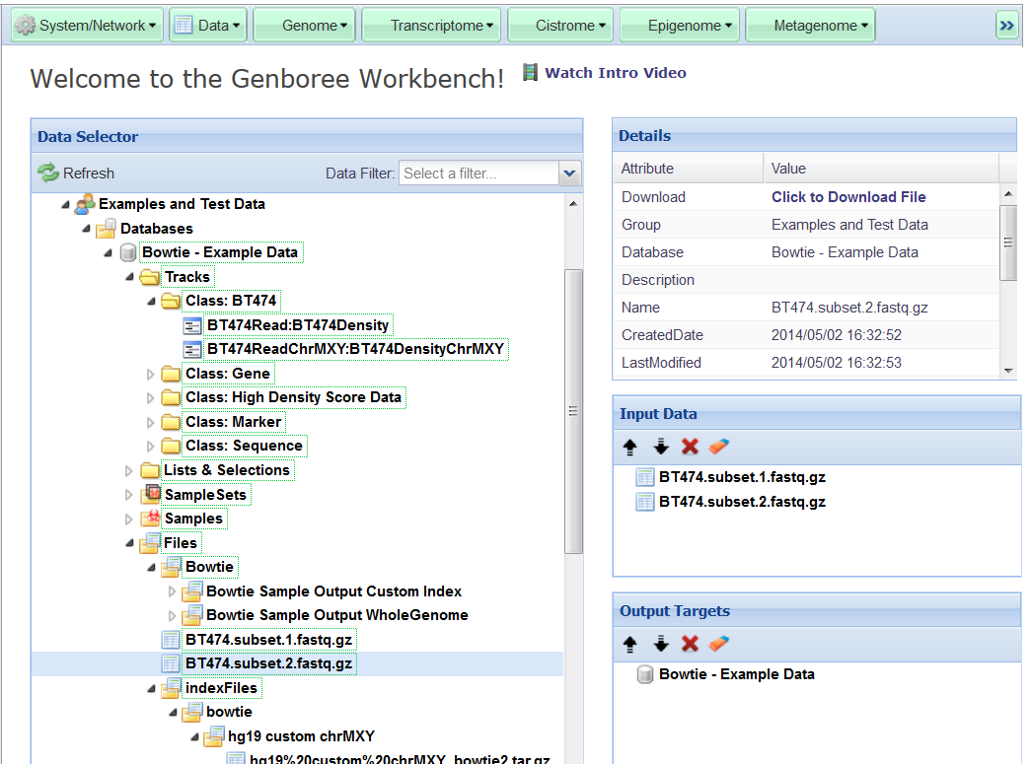
Genboree Core Services
• Authorization & access
• User data repository management
Toolset Menus
Genboree User
Data Services
Genome-Based Tables
• Genomic annotations
• High-density score data
Drag & drop INPUT ENTITIES to Input Data Panel
Drag & drop OUTPUT DESTINATIONS to Output Targets Panel
Generic Entity Tables
• Loosely typed metadata
• AVP based

Slide 5
Genboree Workbench Basics
Create Group http://genboree.org/theCommons/ezfaq/show/public-commons?faq_id=489
Create Database http://genboree.org/theCommons/ezfaq/show/public-commons?faq_id=491
Create Project http://genboree.org/theCommons/ezfaq/show/public-commons?faq_id=492
Upload Data Files http://genboree.org/theCommons/ezfaq/show/public-commons?faq_id=495

Slide 6
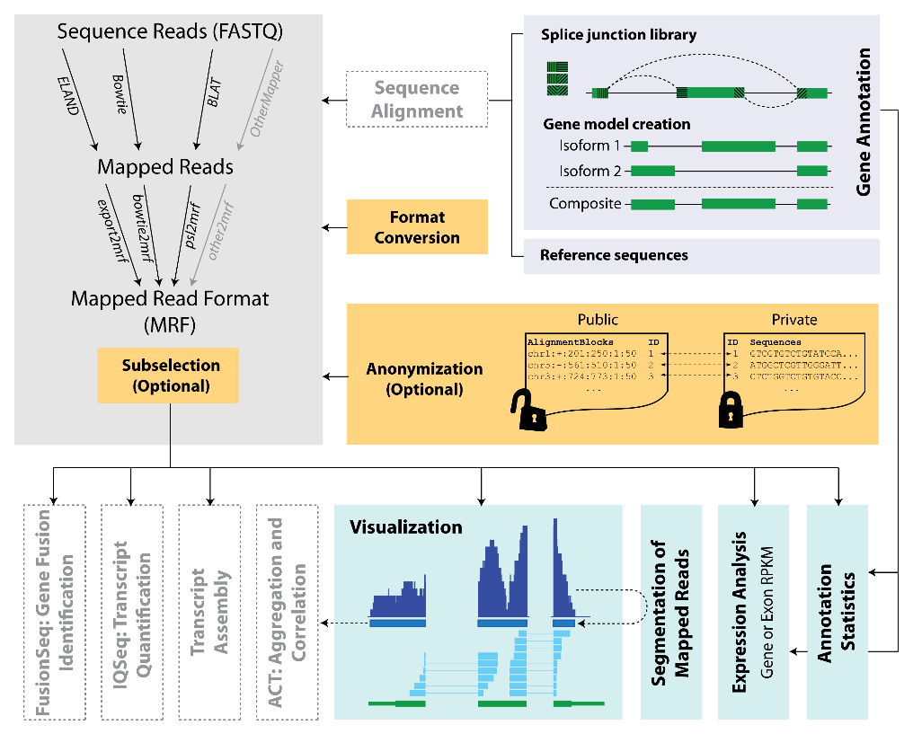
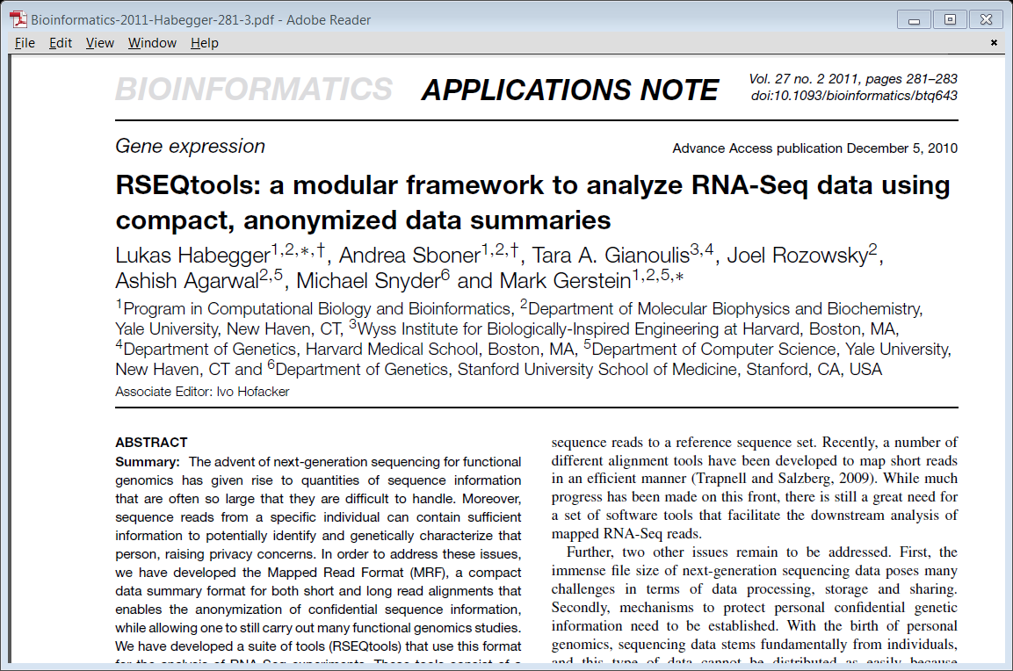
exRNA Data analysis tools
RSEQtools
A modular and flexible framework to perform common RNA-Seq analysis tasks
Current implemented pipeline
Generates genome-wide signal maps (hg18/19) as well as gene level expression quantifications (RPKM) for UCSC known genes.
Developed by Gerstein Lab – DIAC, exRNA consortium

Slide 7
RNA-Seq Analysis using RSEQtools
INPUT: Takes 1 or 2 FASTQ sequences
Gene Annotations: UCSC KnownGene for hg18, hg19
OUTPUT:
  Alignments in SAM and BAM formats - compressed in AnalysisName_alignments.tar.gz
  All result files compressed in AnalysisName_results.tar.gz
  Key result files for quick access (also found in AnalysisName_results.tar.gz):
    File with gene expression values
    Mapping bias file
    Annotation Coverage File
  Signal Tracks of mapped reads (for visualization in genome browsers) - Uploaded as signal track in user db (if specified in the UI)
  FastQC Output Plots
  Custom Bowtie2 index, if generated

Slide 8
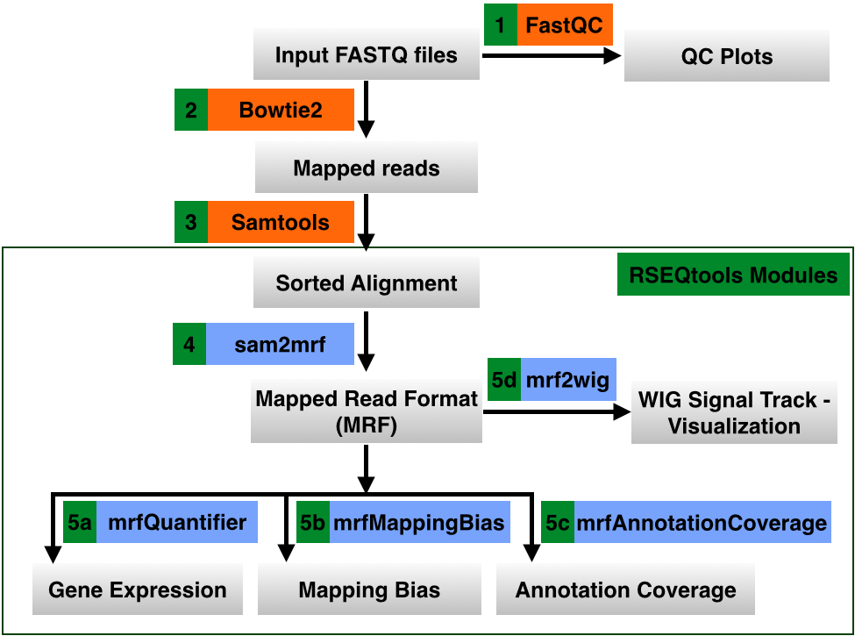
RNA-Seq Analysis pipeline in the Genboree Workbench

Slide 9
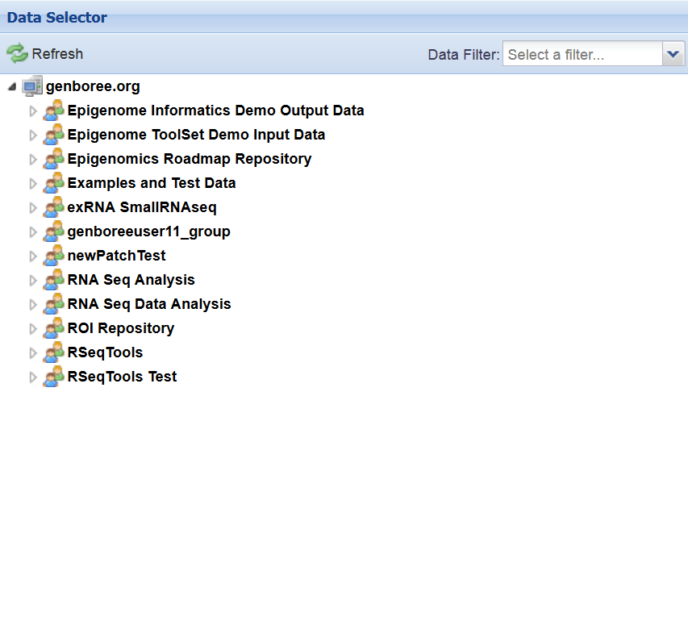
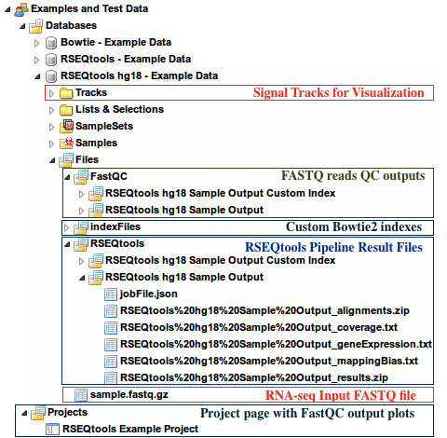
Example Dataset for RNA-Seq analysis using RSEQtools

Slide 10
exRNA Data analysis tools
smallRNA-seq Pipeline
pre-processing: remove adapter & primer sequences
contaminants: no poly-A purification leaves rRNAs, etc
mapping: small reads tend to multi-map to large genomes
diversity: many species of small RNA (not just miRNAs!)
quantification: different normalization
Developed by Gerstein Lab – DIAC, exRNA consortium

Slide 11
smallRNA-seq Pipeline
INPUT: Takes a single-end FASTQ sequence file
Supported Genome build: hg19
OUTPUT:
  All result files compressed in AnalysisName_results.tar.gz
    Read length distribution
    Endogenous Mapping results – rRNA, miRNA, tRNA, snoRNA, piRNA, Rfam
    Exogenous Mapping results – Plant and virus miRNAs in miRBase
    4 files containing sequence reads following
      Adapter removal
      rRNA removal
      Endogenous mapping
      Exogenous mappins

Slide 12
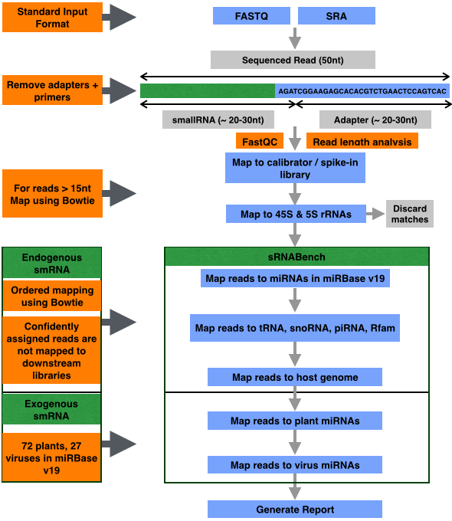
smallRNA-seq pipeline in the Genboree Workbench

Slide 13
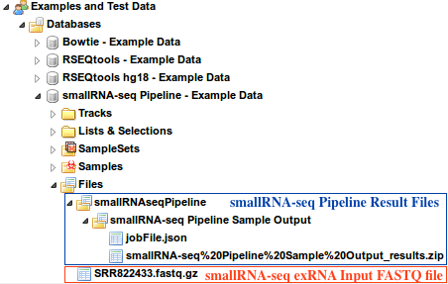
Example Dataset for smallRNA-seq Pipeline

Slide 14
Live Demo of long and small RNA-seq pipelines in the Genboree Workbench
Tutorial Screencasts to setup your analysis in the Genboree Workbench
Long RNA-Seq data analysis - https://docs.google.com/file/d/0Bz3_YiJBA_j3WHBpQmp2S0ljb0U/edit
small RNA-Seq data analysis - https://docs.google.com/file/d/0Bz3_YiJBA_j3b1EzR3ZEWGFEam8/edit

