Slide 1


ERCC Data Analysis Workshop
Use Case 3: Circulating miRNA Changes
Associated with Alzheimer’s and
Parkinson’s Diseases
Organized and Hosted by the Data Management
and Resource Repository (DMRR)
Thursday, 23 April, 2015
7:30 pm
Data and disease background slides kindly provided by
Kendall Jensen, Translational Genomics Research Institute
Burgos K., et al. (2014) Profiles of Extracellular miRNA in Cerebrospinal Fluid and Serum from Patients with Alzheimer’s and Parkinson’s Diseases Correlate with Disease Status and Features of Pathology. PLoS ONE 9: e94839.

Slide 2
Use Case 3: miRNA Changes
in Alzheimer’s and Parkinson’s Disease
The goal of this use case is to show that the Genboree Workbench and the exceRpt small RNA-seq analysis pipeline can replicate the results of Burgos et al. We have developed these pipelines because as the Extracellular RNA Communication Consortium (ERCC) begins to generate more datasets, it is vital that they be analyzed in a reproducible and comparable way.
Burgos K., et al. (2014) Profiles of Extracellular miRNA in Cerebrospinal Fluid and Serum from Patients with Alzheimer’s and Parkinson’s Diseases Correlate with Disease Status and Features of Pathology.
PLoS ONE 9: e94839.

Slide 3
Use Case 3: miRNA Changes
in Alzheimer’s and Parkinson’s Disease
Biological Question of Interest
Alzheimer’s and Parkinson’s are two neurodegenerative diseases that are difficult to assess by biopsy, since the affected tissue is inaccessible.
In their study, Burgos et al. assessed the miRNA content in cerebrospinal fluid (CSF) and serum from postmortem subjects with full neuropathology evaluations. The goal of the study was to identify extracellular miRNA biomarkers that correlate with disease status and progression.
In this use case, we focus on biomarkers that correlate with disease status by replicating the differential expression analysis in Burgos et al.
Burgos K., et al. (2014) Profiles of Extracellular miRNA in Cerebrospinal Fluid and Serum from Patients with Alzheimer’s and Parkinson’s Diseases Correlate with Disease Status and Features of Pathology.
PLoS ONE 9: e94839.

Slide 4
345 Biological Samples to Be Analyzed
Use Case 3: miRNA Changes
in Alzheimer’s and Parkinson’s Disease
Number of Samples | Disease | Biofluid
62 | Alzheimer’s | CSF
52 | Alzheimer’s | Serum
57 | Parkinson’s | CSF
50 | Parkinson’s | Serum
62 | Control | CSF
62 | Control | Serum
The dataset analyzed in this use case is available from dbGap,
accession phs000727.v1.p1.

Slide 5
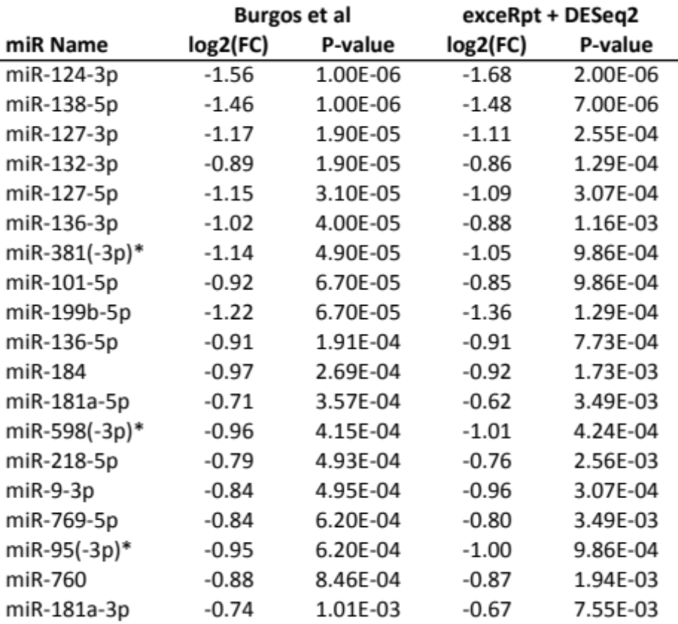
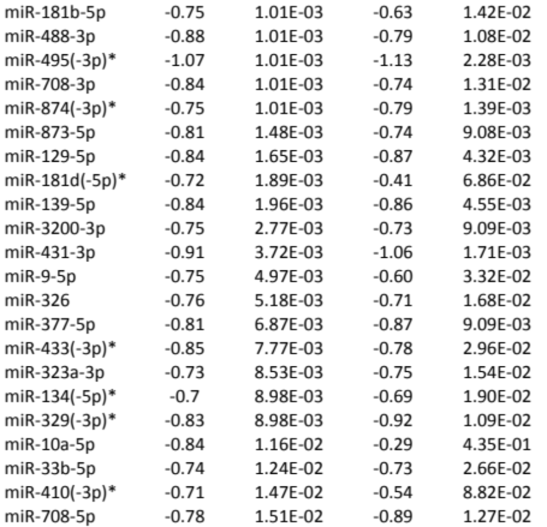
Differential Expression of miRNAs
in Cerebrospinal Fluid (CSF) – Control vs. AD
Burgos K., et al. (2014) Profiles of Extracellular miRNA in Cerebrospinal Fluid and Serum from Patients with Alzheimer’s and Parkinson’s Diseases Correlate with Disease Status and Features of Pathology.
PLoS ONE 9: e94839.

Slide 6
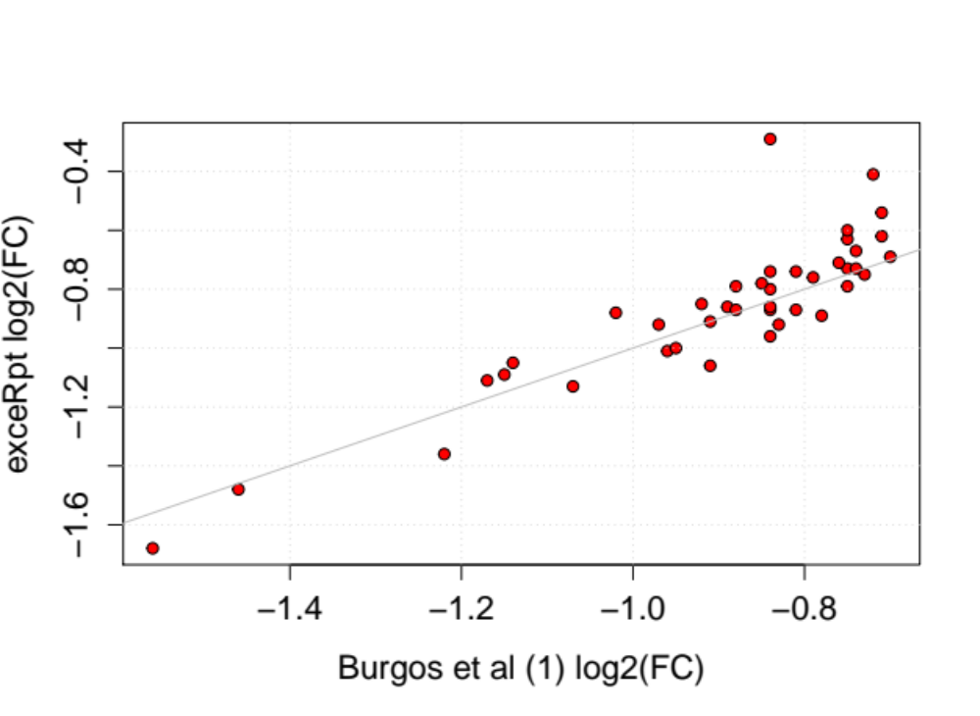
Differential Expression of miRNAs
in Cerebrospinal Fluid (CSF) – Control vs. AD
Comparison of Differential Expression Results
The plot to the left compares the differential expression results from Burgos et al. (x-axis) and the exceRpt pipeline (y-axis). miRNAs with absolute log₂ fold changes < 0.7 were not reported in the article.
Burgos K., et al. (2014) Profiles of Extracellular miRNA in Cerebrospinal Fluid and Serum from Patients with Alzheimer’s and Parkinson’s Diseases Correlate with Disease Status and Features of Pathology.
PLoS ONE 9: e94839.

Slide 7
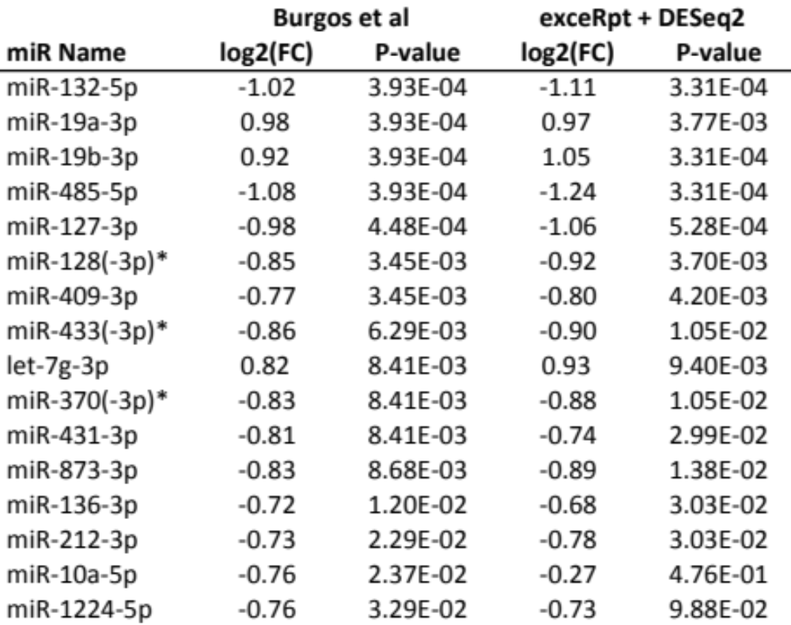
Differential Expression of miRNAs
in Cerebrospinal Fluid (CSF) – Control vs PD
*In some cases, Burgos et al reports results for the parent form of a miRNA. The sRNAbench tool used by exceRpt always estimates which mature product of the miRNA is most likely expressed based on the position of reads in the miRNA sequence.
Burgos K., et al. (2014) Profiles of Extracellular miRNA in Cerebrospinal Fluid and Serum from Patients with Alzheimer’s and Parkinson’s Diseases Correlate with Disease Status and Features of Pathology.
PLoS ONE 9: e94839.

Slide 8
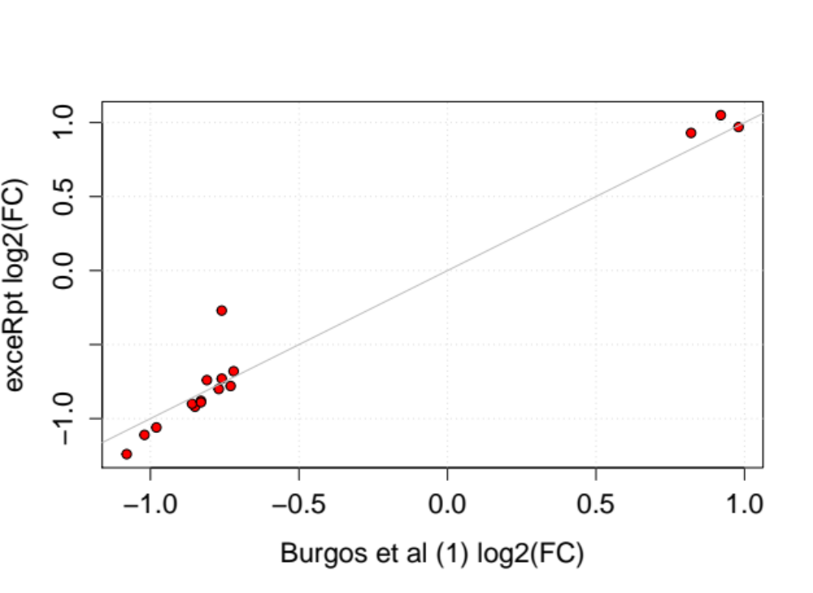
Differential Expression of miRNAs
in Cerebrospinal Fluid (CSF) – Control vs PD
Comparison of Differential Expression Results
The plot at left compares the differential expression results from Burgos et al (x axis) and the exceRpt pipeline (y axis). miRNAs with absolute log₂ fold changes < 0.7 were not reported in the article.
miR-10a-5p
Burgos K., et al. (2014) Profiles of Extracellular miRNA in Cerebrospinal Fluid and Serum from Patients with Alzheimer’s and Parkinson’s Diseases Correlate with Disease Status and Features of Pathology.
PLoS ONE 9: e94839.

Slide 9
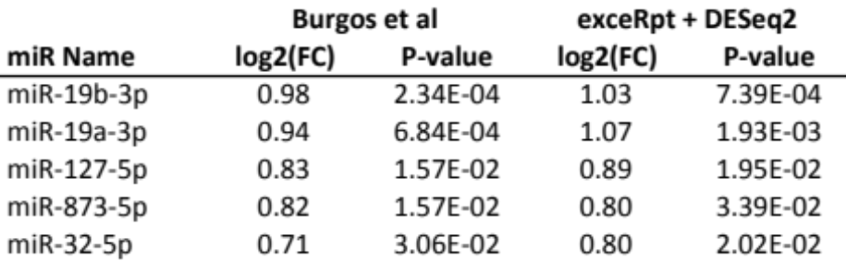
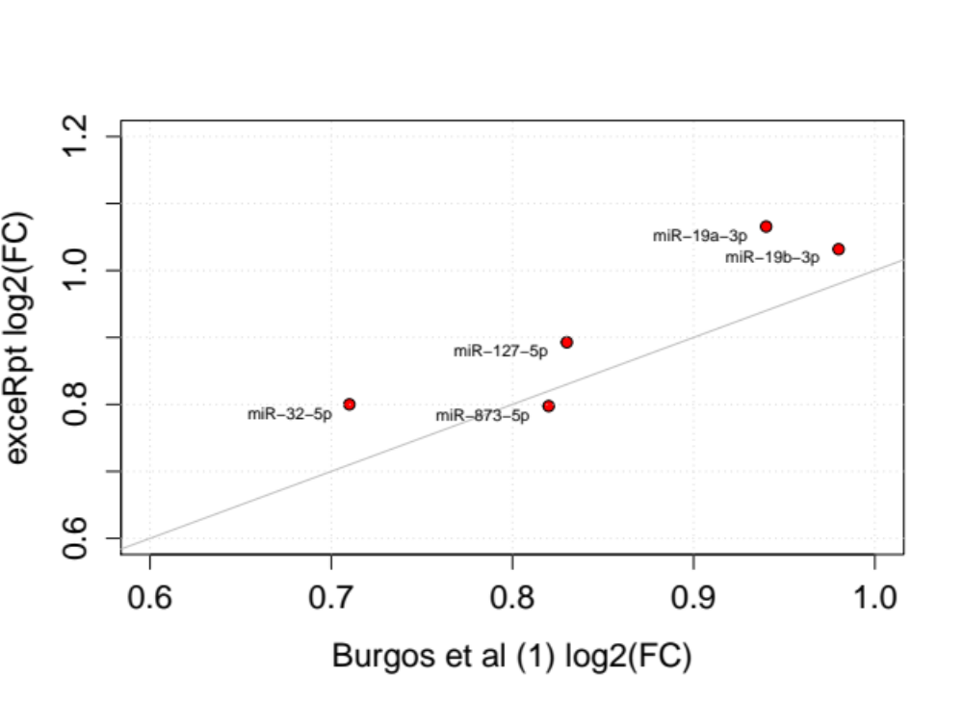
Differential Expression of miRNAs
in Cerebrospinal Fluid (CSF) – AD vs PD
Burgos K., et al. (2014) Profiles of Extracellular miRNA in Cerebrospinal Fluid and Serum from Patients with Alzheimer’s and Parkinson’s Diseases Correlate with Disease Status and Features of Pathology.
PLoS ONE 9: e94839.

Slide 10
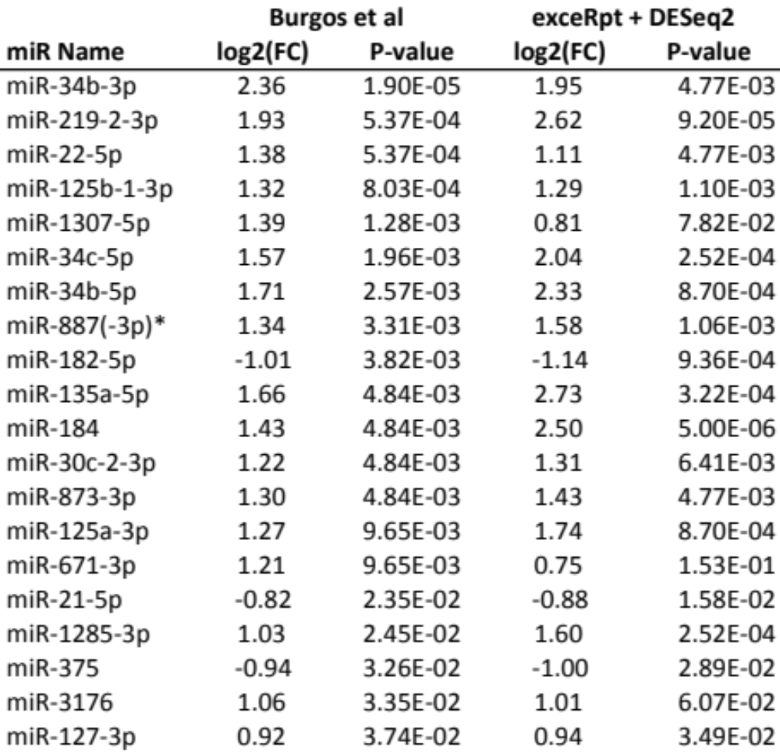
Differential Expression of miRNAs
in serum – Control vs Alzheimer’s
Burgos K., et al. (2014) Profiles of Extracellular miRNA in Cerebrospinal Fluid and Serum from Patients with Alzheimer’s and Parkinson’s Diseases Correlate with Disease Status and Features of Pathology.
PLoS ONE 9: e94839.

Slide 11
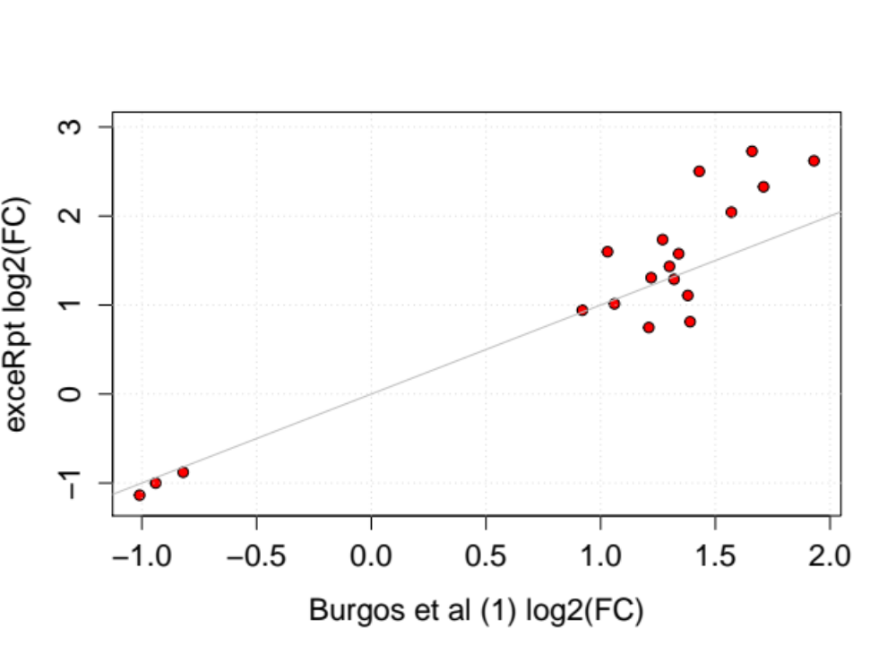
Differential Expression of miRNAs
in serum – Control vs Alzheimer’s
Comparison of Differential Expression Results
The plot at left compares the differential expression results from Burgos et al (x axis) and the exceRpt pipeline (y axis). miRNAs with absolute log₂ fold changes < 0.7 were not reported in the article.
Burgos K., et al. (2014) Profiles of Extracellular miRNA in Cerebrospinal Fluid and Serum from Patients with Alzheimer’s and Parkinson’s Diseases Correlate with Disease Status and Features of Pathology.
PLoS ONE 9: e94839.

Slide 12
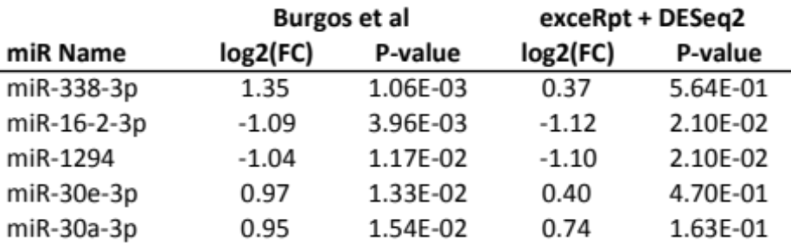
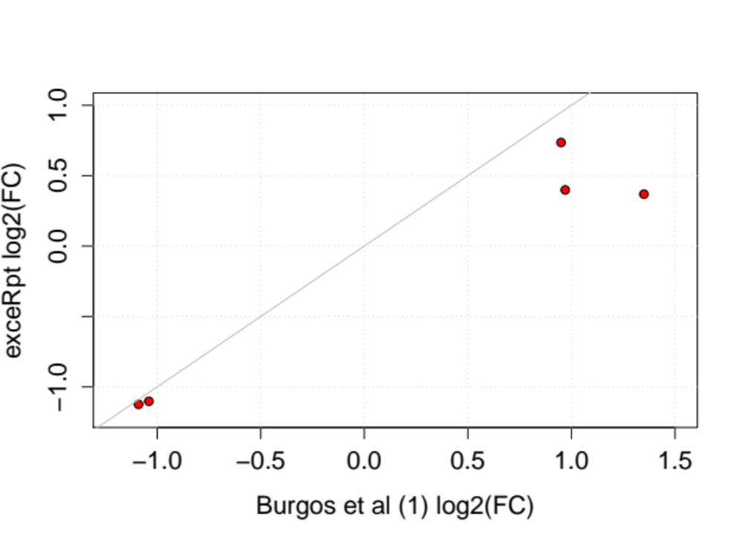
Differential Expression of miRNAs
in serum – Control vs Parkinson’s
Burgos K., et al. (2014) Profiles of Extracellular miRNA in Cerebrospinal Fluid and Serum from Patients with Alzheimer’s and Parkinson’s Diseases Correlate with Disease Status and Features of Pathology.
PLoS ONE 9: e94839.

Slide 13
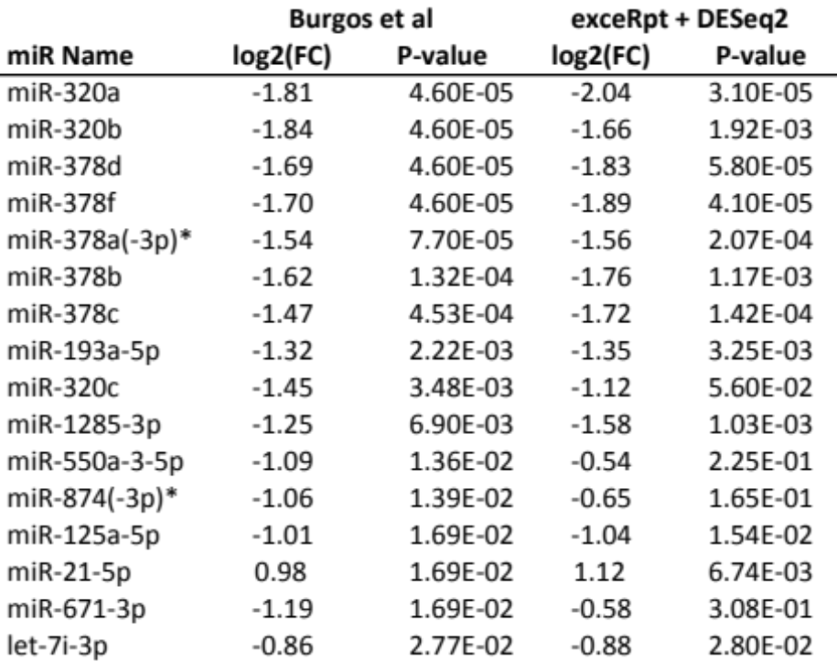
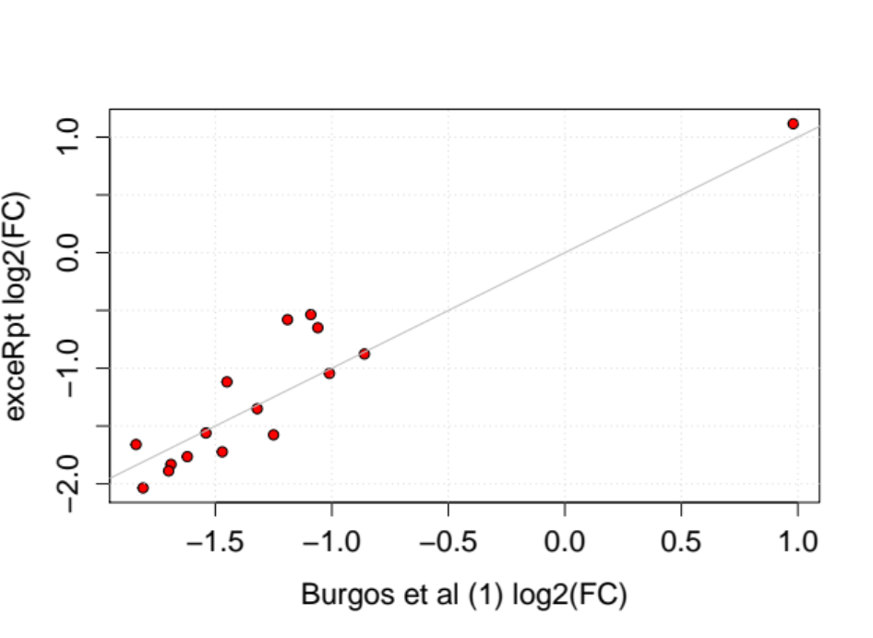
Differential Expression of miRNAs
in serum – Alzheimer’s vs Parkinson’s
Comparison of
Differential Expression Results
Burgos K., et al. (2014) Profiles of Extracellular miRNA in Cerebrospinal Fluid and Serum from Patients with Alzheimer’s and Parkinson’s Diseases Correlate with Disease Status and Features of Pathology.
PLoS ONE 9: e94839.

Slide 14
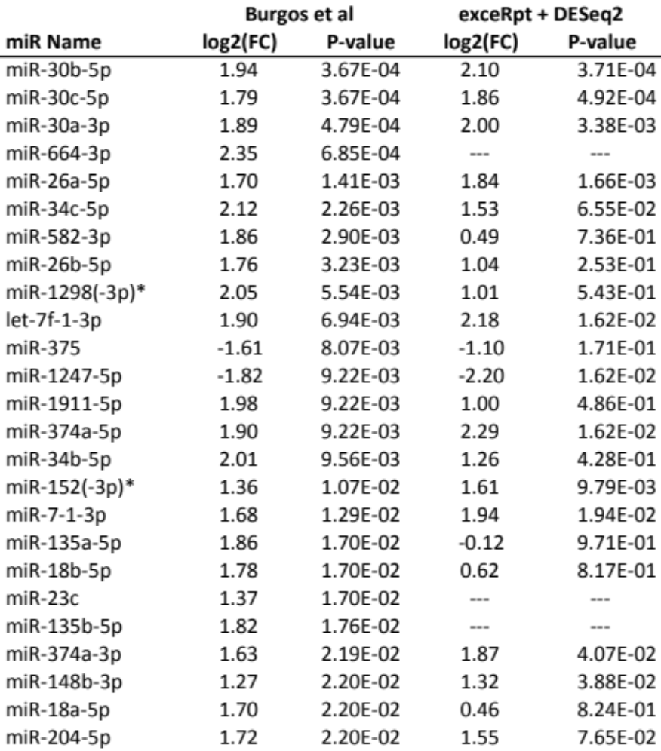
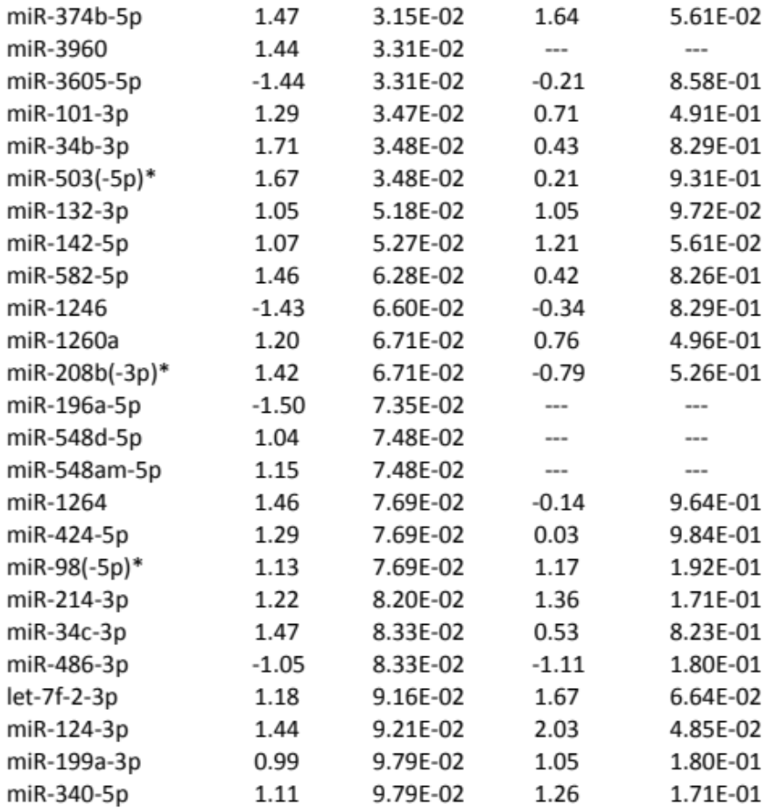
Digging Deeper:
Parkinson’s vs. Parkinson’s with Dementia
… … … … …
Burgos K., et al. (2014) Profiles of Extracellular miRNA in Cerebrospinal Fluid and Serum from Patients with Alzheimer’s and Parkinson’s Diseases Correlate with Disease Status and Features of Pathology.
PLoS ONE 9: e94839.
Notes:
For the PD vs PDD comparison, Burgos et al reported complete results of the DESeq2 analysis in Table S3, not filtering out |log2(fold change)| <= 0.7, so we chose this comparison for our downstream pathway analysis.

Slide 15
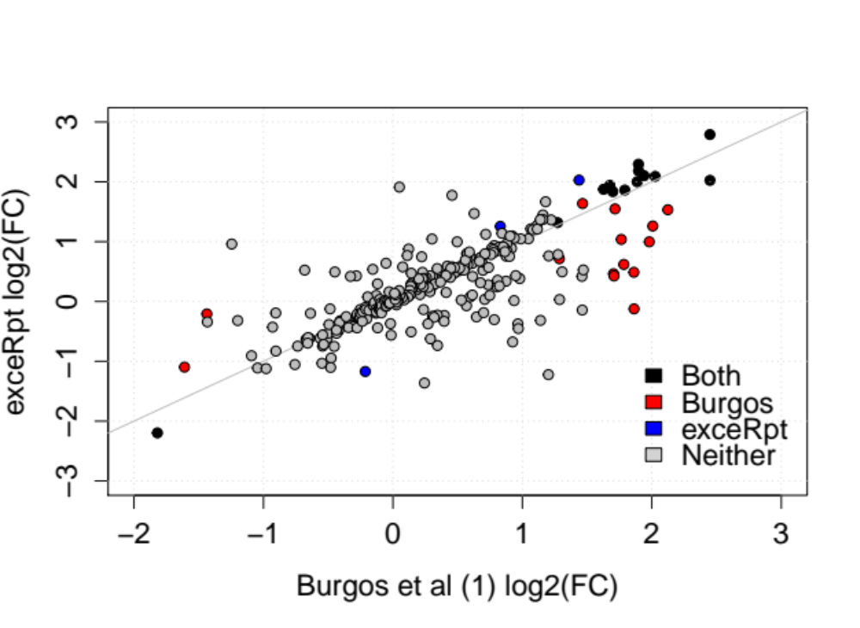
Digging Deeper:
Parkinson’s vs. Parkinson’s with Dementia
Comparison of Differential Expression Results
Significant in
Burgos K., et al. (2014) Profiles of Extracellular miRNA in Cerebrospinal Fluid and Serum from Patients with Alzheimer’s and Parkinson’s Diseases Correlate with Disease Status and Features of Pathology.
PLoS ONE 9: e94839.

Slide 16




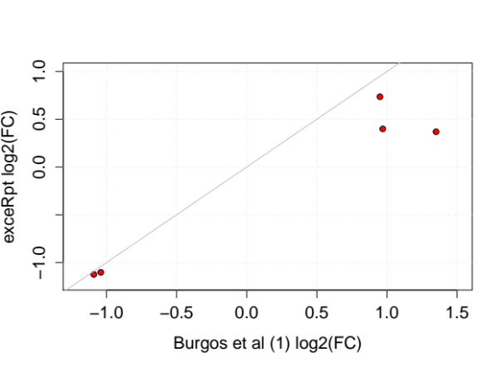

Differential expression analysis of all pairwise comparisons shows that the exceRpt pipeline does a good job of reproducing the results from Burgos et al.
Use Case 3: Summary
AD vs control in CSF
PD vs control in CSF
AD vs PD in CSF
r_{Pearson} = 0.89
r_{Pearson} = 0.98
r_{Pearson} = 0.90
AD vs control in Serum
PD vs control in Serum
AD vs PD in Serum
r_{Pearson} = 0.93
r_{Pearson} = 0.97
r_{Pearson} = 0.93

Slide 17
Alzheimer’s CSF vs control: all 41 of the miRNAs identified in Burgos et al as significantly differentially expressed were also so identified by exceRpt.
Pearson correlation of log₂(fold change) for those top 41 miRNAs between exceRpt and Burgos et al is 0.89.
30 / 41 (~75%) of the miRNAs have been identified in the literature as deregulated in Alzheimer’s.
Thus, this set of miRNAs represent useful candidates for further study and development into clinical biomarkers of AD disease status.
See Burgos et al. for discussion of the other comparisons: AD vs PD and PD vs Control in CSF, and all serum cases.
Use Case 3: Summary
Burgos K., et al. (2014) Profiles of Extracellular miRNA in Cerebrospinal Fluid and Serum from Patients with Alzheimer’s and Parkinson’s Diseases Correlate with Disease Status and Features of Pathology.
PLoS ONE 9: e94839.

Slide 18

Acknowledgements
Baylor College of Medicine, Houston, TX
Aleksandar Milosavljevic
Matthew Roth
Genboree Team at Baylor
Andrew Jackson
Sai Lakshmi Subramanian
William Thistlethwaite
Sameer Paithankar
Neethu Shah
Aaron Baker
Yale University, New Haven, CT
Mark Gerstein
Joel Rozowsky
Rob Kitchen
Fabio Navarro
Gladstone Institute
Alexander Pico
Anders Riutta
Pacific Northwest Diabetes Research Institute, Seattle, WA
David Galas
Roger Alexander
TGen, Phoenix, AZ
Kendall Van Keuren-Jensen
Sean Allen
Ashish Yeri
NIH
John Satterlee
Lillian Kuo
Dena Procaccini

Slide 19
Use Case 3: References
Burgos K., Malenica I., Metpally R., Courtright A., et al. (2014) Profiles of extracellular miRNA in cerebrospinal fluid and serum from patients with Alzheimer's and Parkinson's diseases correlate with disease status and features of pathology. PLoS ONE 9:e94839.
Barturen et al. (2014) sRNAbench: profiling of small RNAs and its sequence variants in single or multi-species high-throughput experiments. Methods in Next Generation Sequencing. Volume 1, Issue 1
Ben Langmead, Cole Trapnell, Mihai Pop and Steven L Salzberg (2009) Ultrafast and memory-efficient alignment of short DNA sequences to the human genome. Genome Biology 10(3):R25.
Kozomara A, Griffiths-Jones S. (2011) miRBase: integrating microRNA annotation and deep-sequencing data. NAR 39 (Database Issue)
Langmead B, Salzberg SL. (2012) Fast gapped-read alignment with Bowtie 2. Nature Methods. 9 : 357-359.
Love M.I., Huber W., and Anders S. (2014) Moderated estimation of fold change and dispersion for RNA-seq data with DESeq2. Genome Biology 15: 550.
Shannon P, Markiel A, Ozier O, Baliga NS, Wang JT, et al. (2003) Cytoscape: a software environment for integrated models of biomolecular interaction networks. Genome Research 13(11):2498-504
ExRNA Portal Software Resources
(http://exrna.org/resources/software)

Slide 20
Useful Links
exRNA Portal Software Resources http://exrna.org/resources/software
exRNA Atlas – http://genboree.org/java-bin/exRNAAtlas.jsp
Genboree Workbench - http://genboree.org/java-bin/workbench.jsp
Data Coordination Center Wiki - http://genboree.org/theCommons/projects/exrna-mads/wiki
exRNA Data Analysis Tools Wiki - http://genboree.org/theCommons/projects/exrna-tools-may2014/wiki
Use Case Tutorials – exRNA Portal Data Resource http://exrna.org/resources/data/

