Slide 1


ERCC Data Analysis Workshop
exRNA Data Analysis Tools in the Genboree Workbench
Organized and Hosted by the Data Management
and Resource Repository (DMRR)
Sai Lakshmi Subramanian
Data Management and Resource Repository (DMRR) – ERCC
Baylor College of Medicine
Houston, TX, USA
Thursday, 23rd April, 2015
7:30 pm

Slide 2

Summary of Genboree Services
DCC - Genboree Services for the ERCC (www.genboree.org)
exRNA Data Analysis Tools - Genboree Workbench http://genboree.org/java-bin/workbench.jsp
exRNA Document Sharing & Discussion Forums – Genboree Commons http://genboree.org/theCommons
exRNA Metadata
Tracking System –
GenboreeKB
http://genboree.org/genboreeKB
Use the same user name and password for all of these Genboree Services

Slide 3
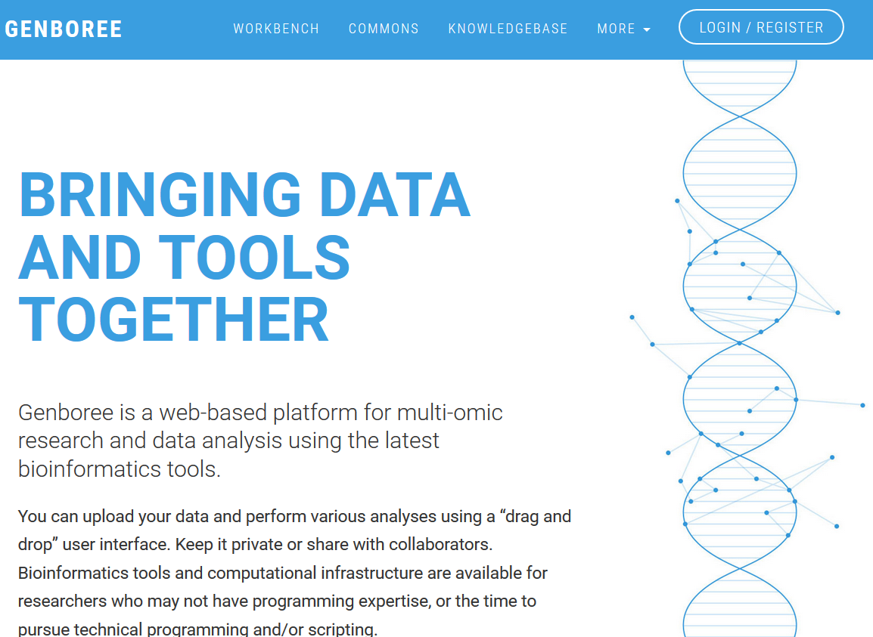
Genboree Services at genboree.org
Data Analysis Tools
exRNA Metadata,
exRNA Virtual Biorepository
New account in Genboree

Slide 4
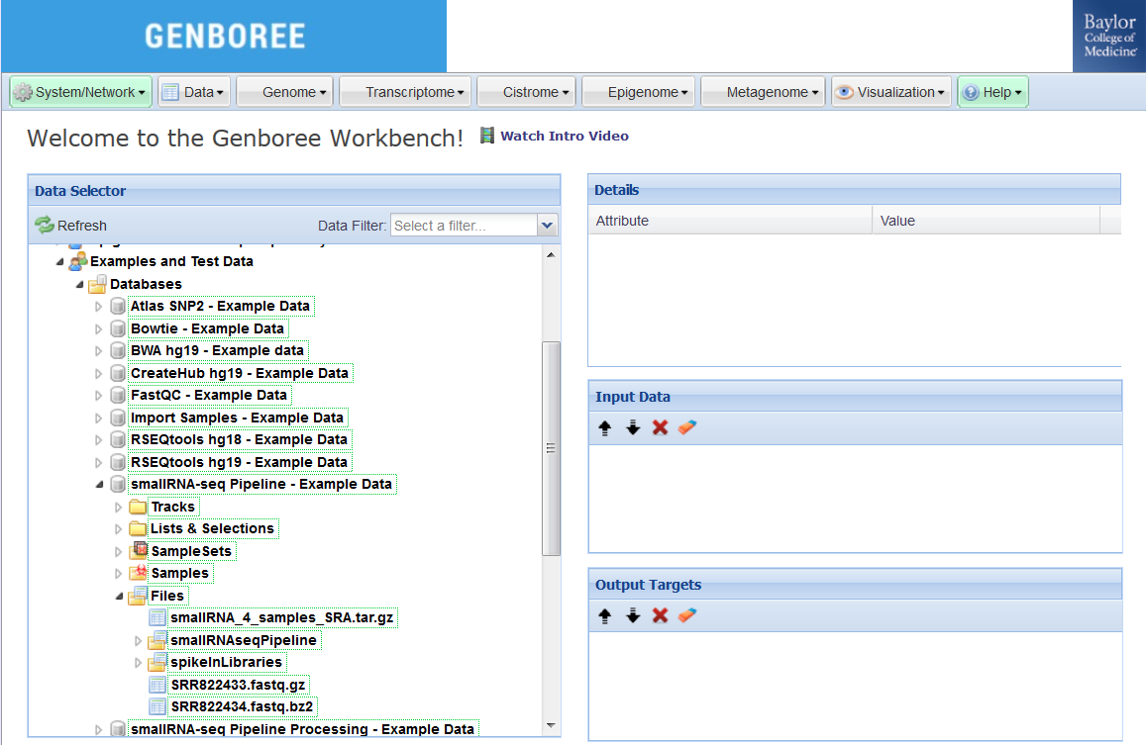
Genboree Workbench
Toolset Menus
Input Data Panel to drag & drop INPUT ENTITIES
Output Targets Panel to drag & drop OUTPUT DESTINATIONS

Slide 5
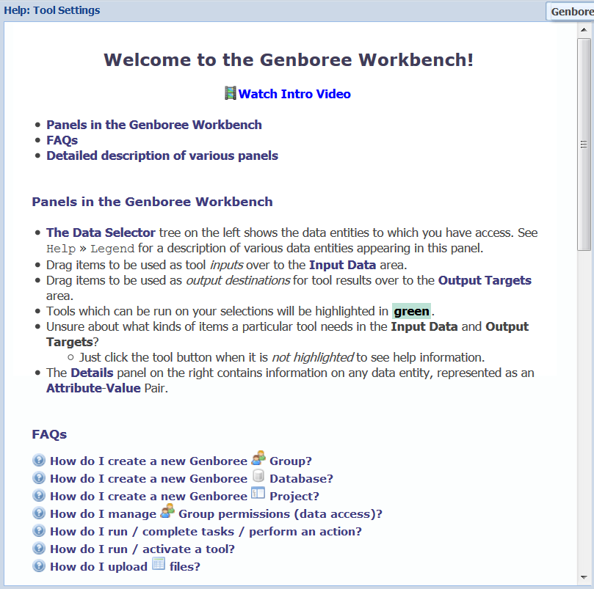
Genboree Workbench – Getting Started
Introduction to Genboree Workbench - Watch Video Tutorial
https://docs.google.com/file/d/0Bz3_YiJBA_j3Tk1uOFlIazdMbkk/
Find Help within the Genboree Workbench
http://genboree.org/theCommons/ezfaq/show/public-commons?faq_id=497
  Help » Getting Started
  Help » Tool Map
  Help » Tool Help Resources

Slide 6
Tools in the Genboree Workbench
exRNA Data Analysis Tools available
Long RNA-seq - Transcriptome » Analyze RNA-Seq Data » Analyze RNA-Seq data by RSEQtools
Small RNA-seq - Transcriptome » Analyze Small RNA-Seq Data » smallRNA-seq Pipeline
Tutorials:
http://genboree.org/theCommons/projects/exrna-tools-may2014/wiki

Slide 7
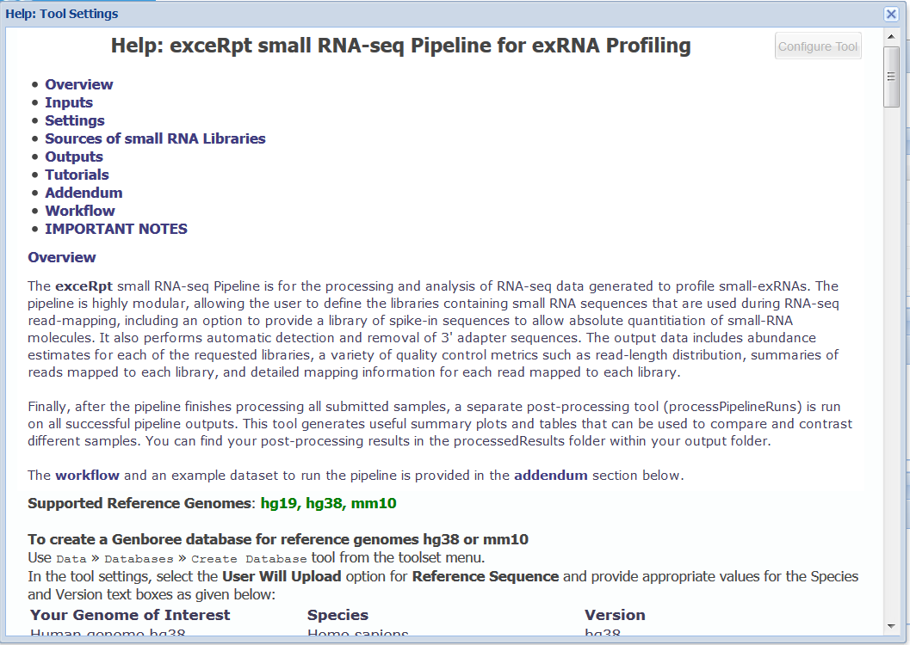
exceRpt small RNA-seq tool in the Genboree Workbench

Slide 8
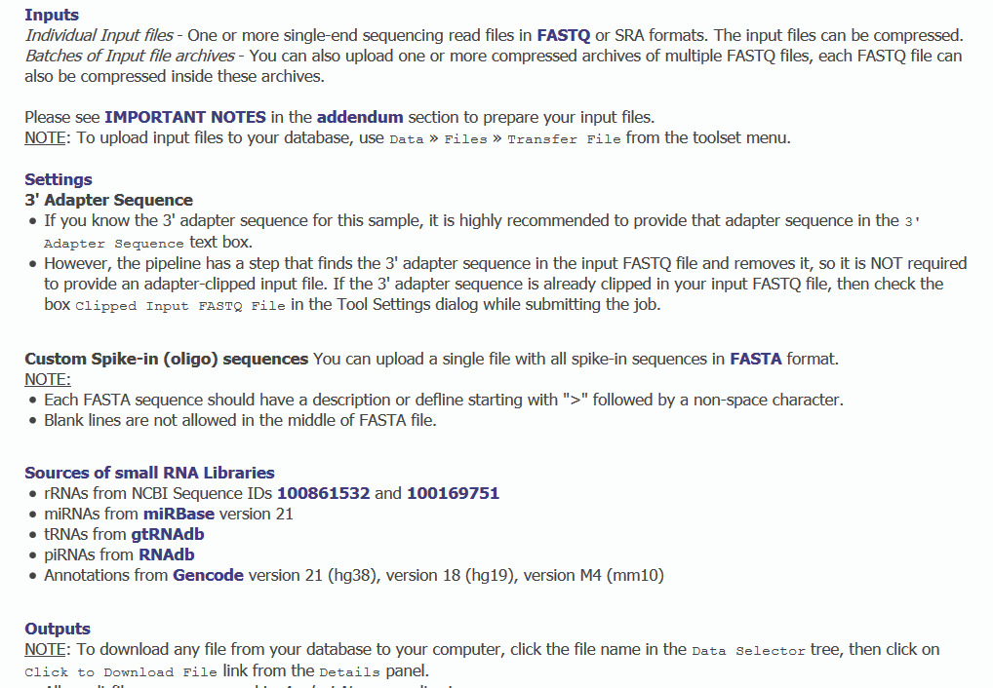
exceRpt small RNA-seq tool in the Genboree Workbench

Slide 9
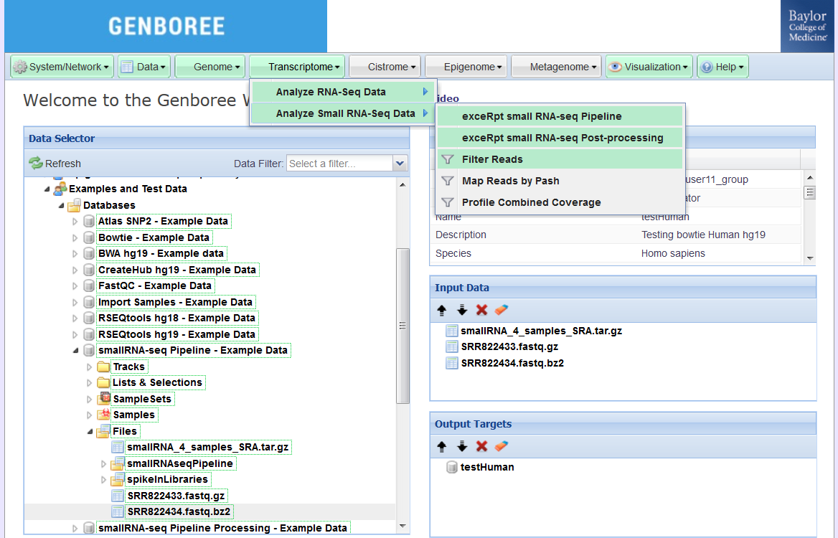
exRNA Tools in the Genboree Workbench
Toolset Menus
Group
Database
Input Data Panel with your input FASTQ files
Output Targets Panel with your own database for results from analysis tools
Files

Slide 10
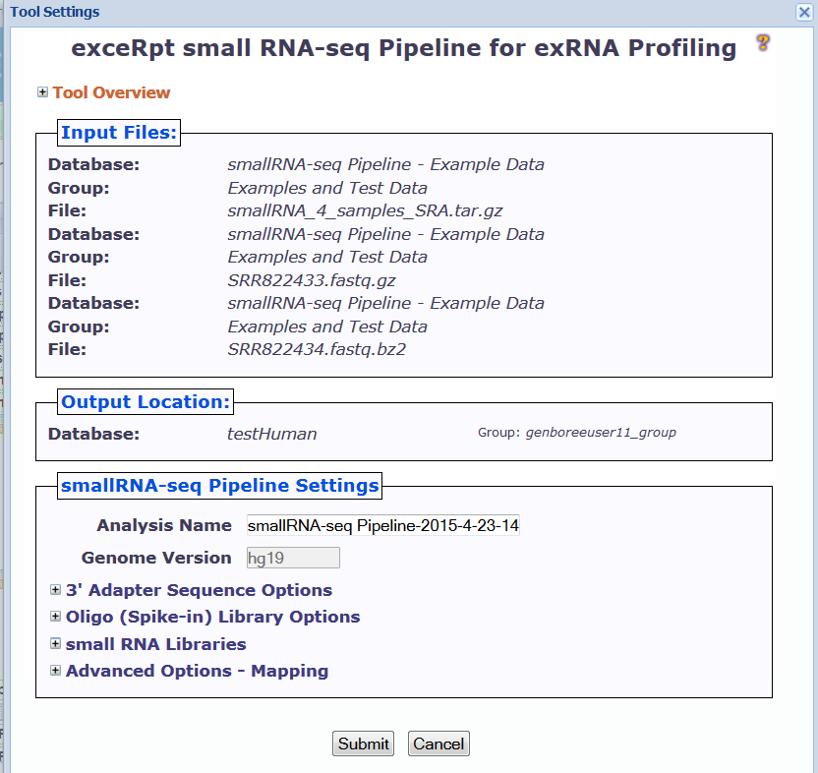
exceRpt small RNA-seq Analysis Pipeline

Slide 11
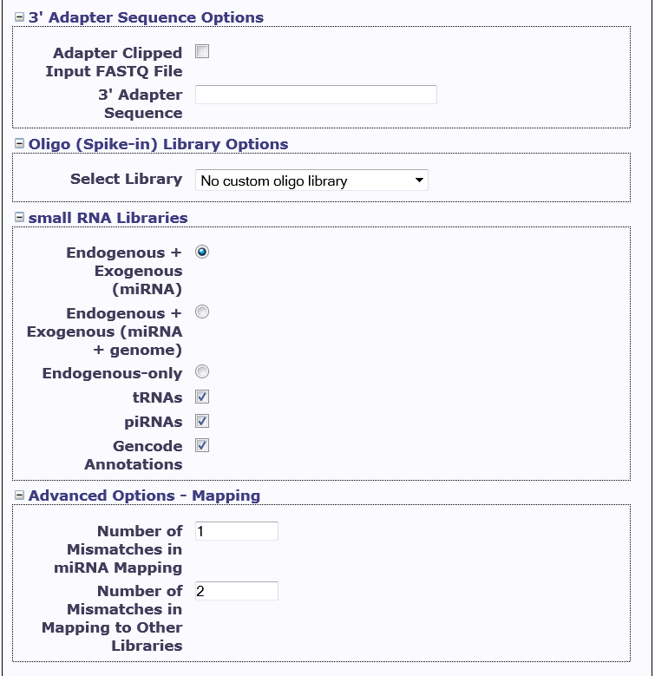
exceRpt Analysis Pipeline – Tool settings

Slide 12
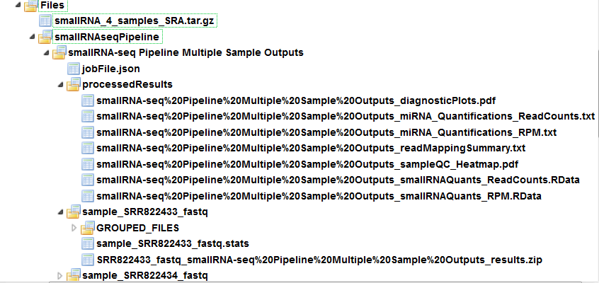
exceRpt Analysis Pipeline – Results
OUTPUT FILES:
Read length distribution, quantifications, read counts
Endogenous Mapping results
Exogenous Mapping results
Files containing sequence reads following Adapter removal, rRNA/contaminant/repetitive sequence removal, Endogenous mapping & Exogenous mapping

Slide 13
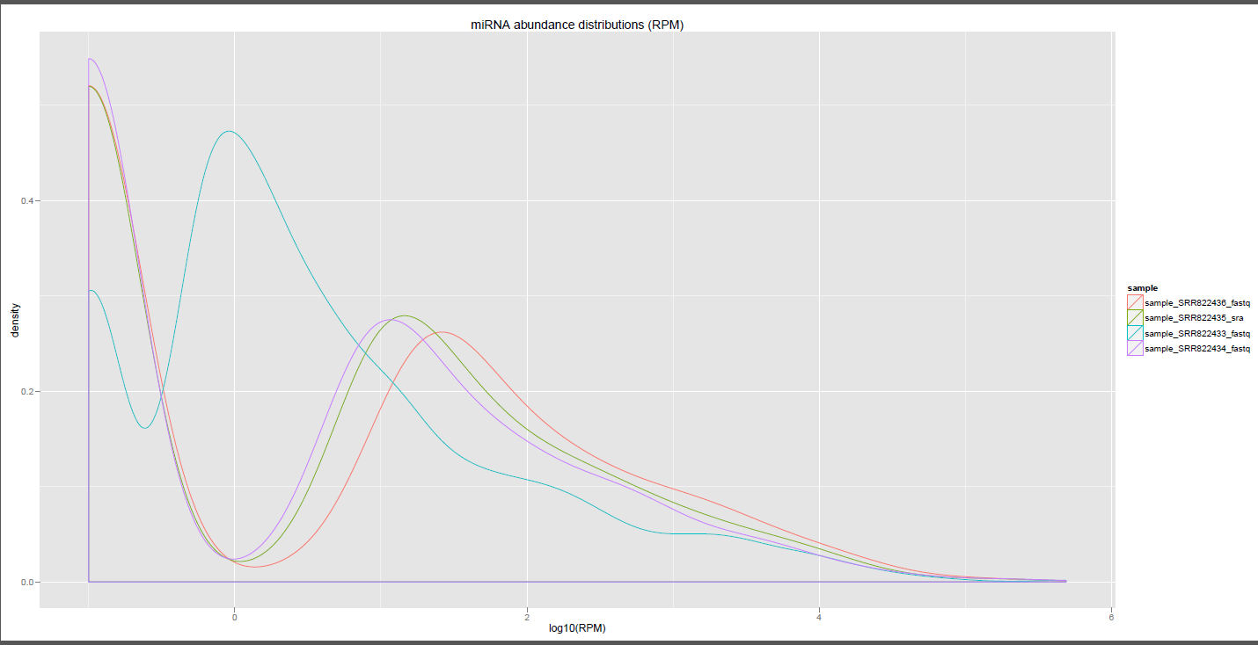
exceRpt Analysis Pipeline – Plots

Slide 14
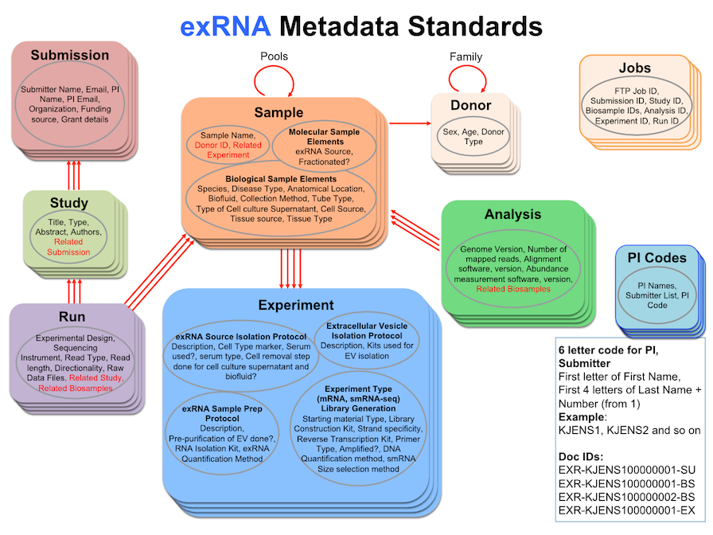
exRNA Metadata Standards

Slide 15
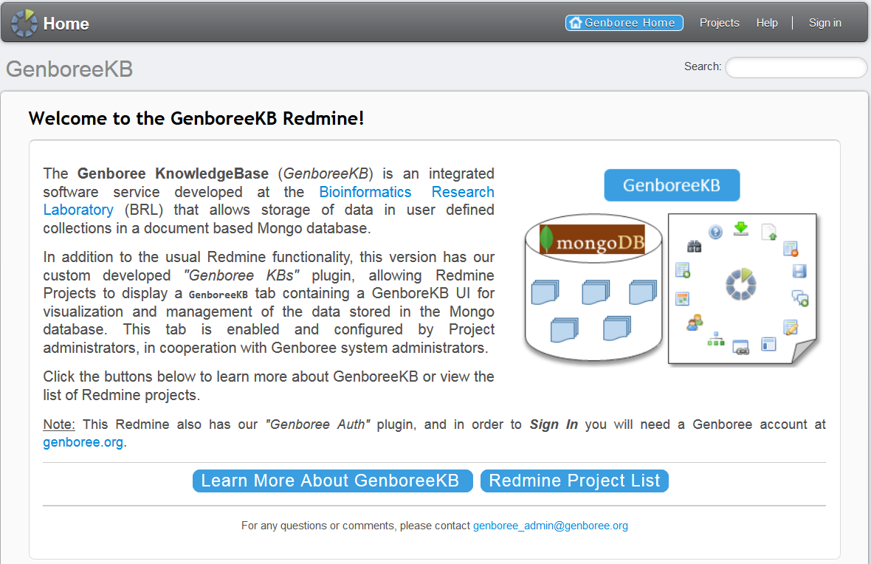
exRNA Metadata Tracking - GenboreeKB

Slide 16
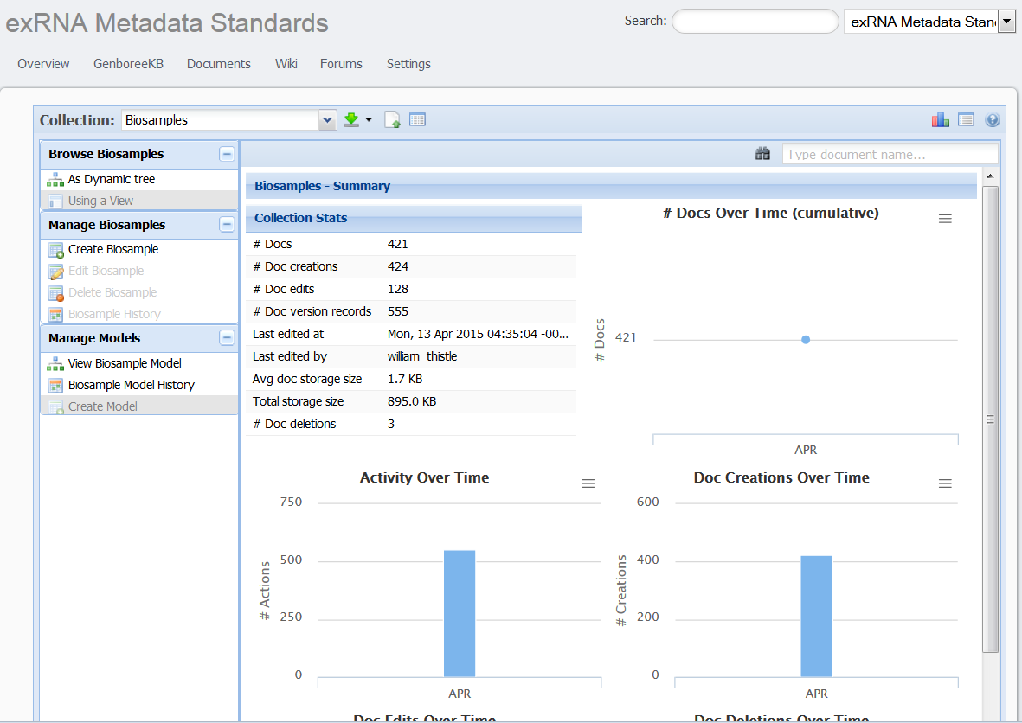
exRNA Metadata Tracking - GenboreeKB

Slide 17
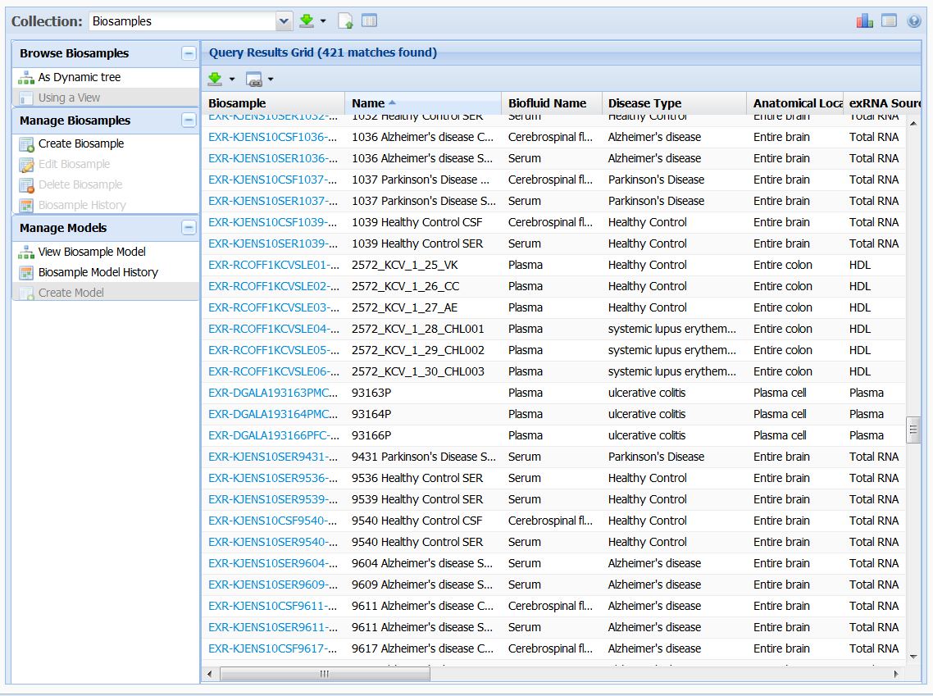
exRNA Metadata Tracking - Biosamples

Slide 18
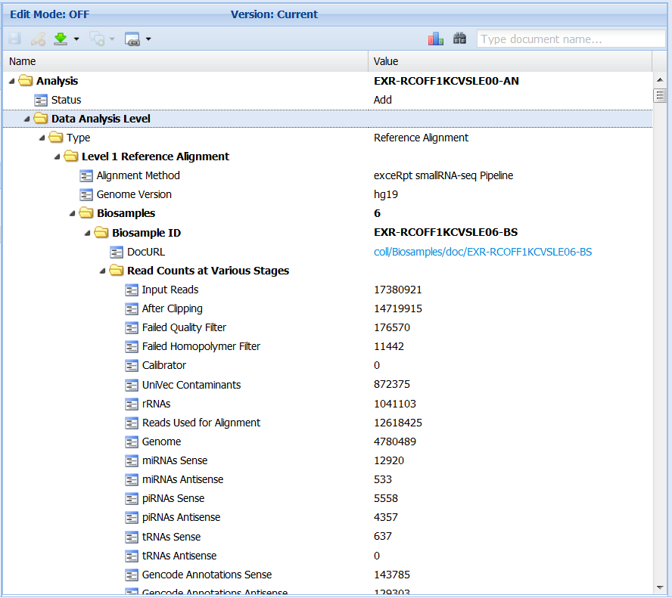
exRNA Metadata Tracking - Analysis

Slide 19
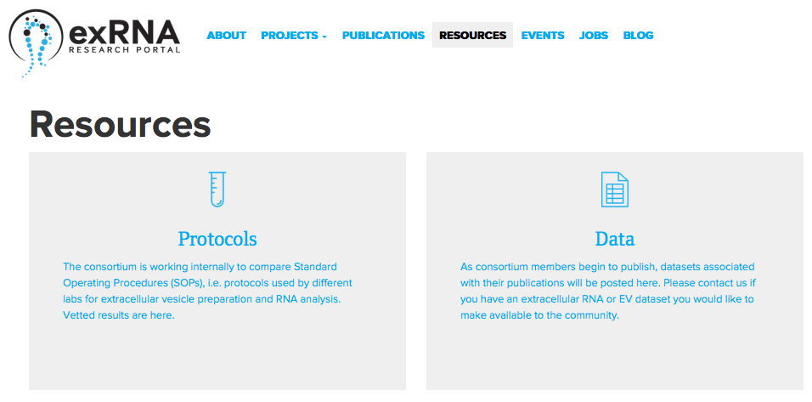
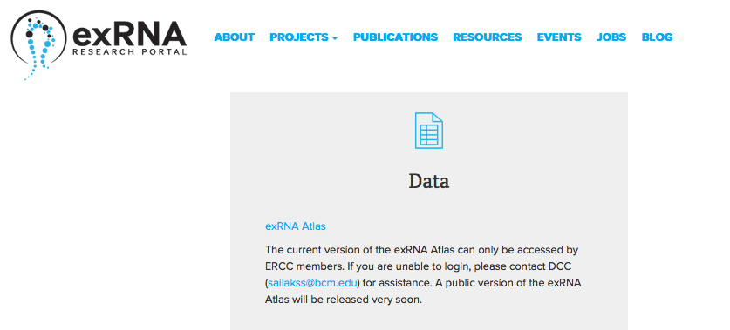
exRNA Atlas – Link from exrna.org

Slide 20
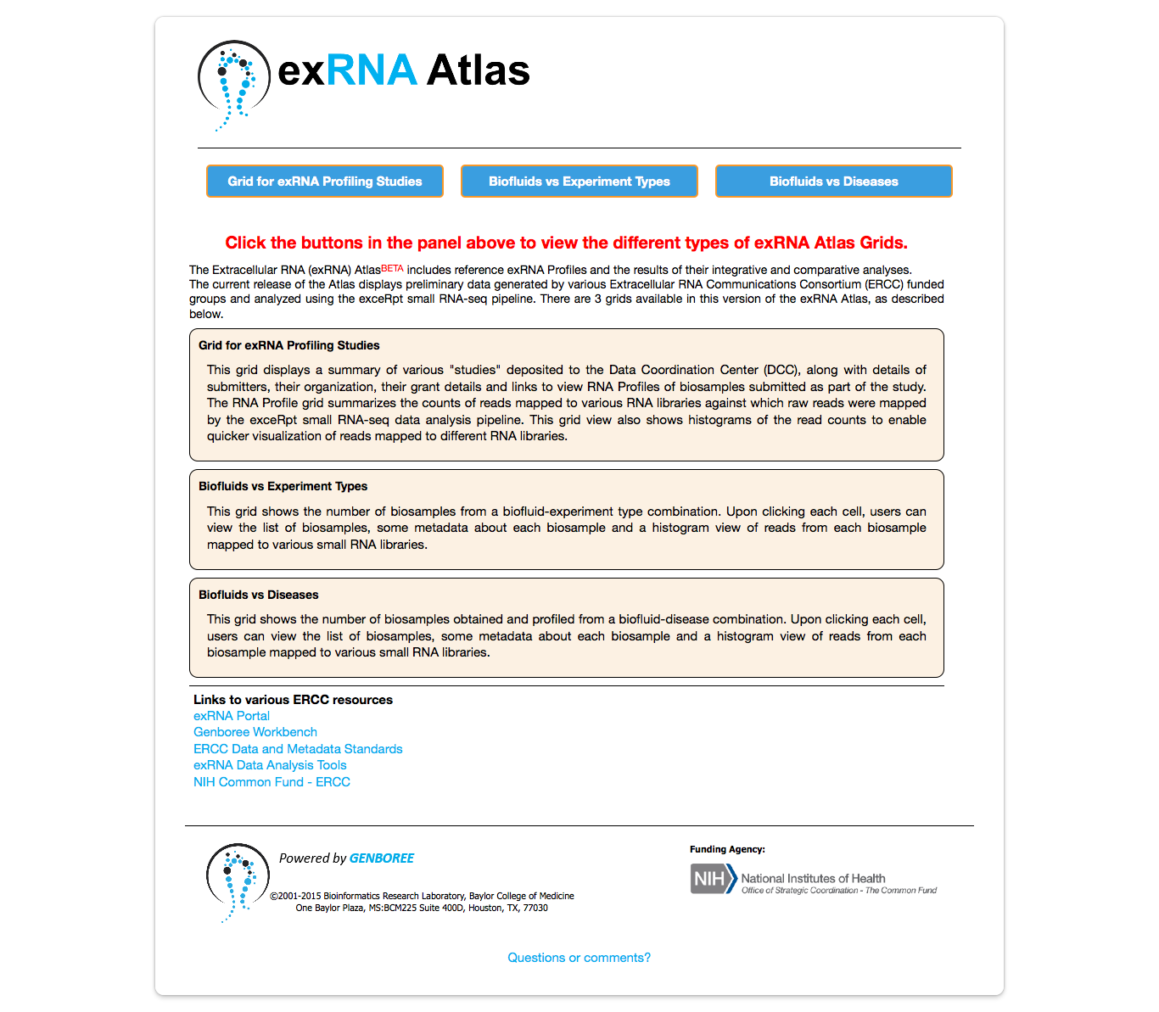
exRNA Atlas – BETA version
Buttons to view 3 types of exRNA grids
Description about exRNA grids
ERCC resources – Useful links

Slide 21
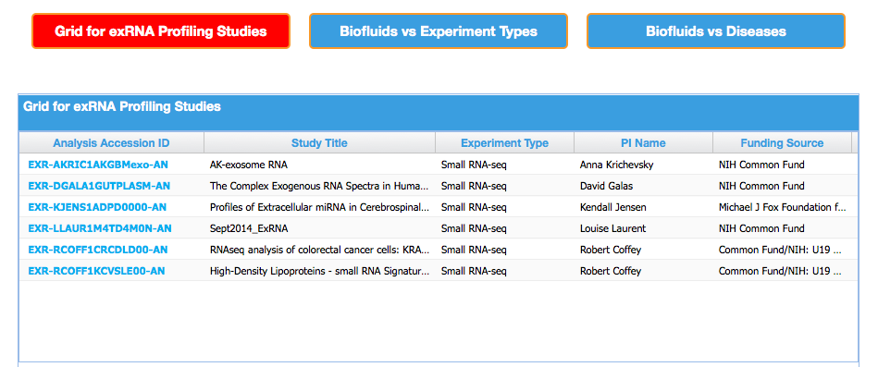
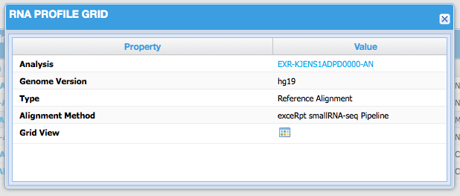
exRNA Atlas – Grid for Profiling Studies
Click to view grid view of read counts mapped to various RNA libraries

Slide 22
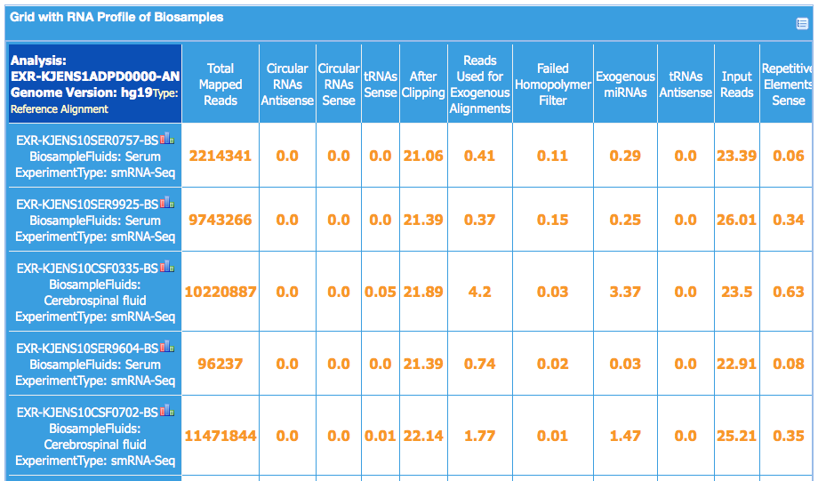
exRNA Atlas – RNA Profiling Grid View
Click to view histogram view of read counts mapped to various RNA libraries

Slide 23
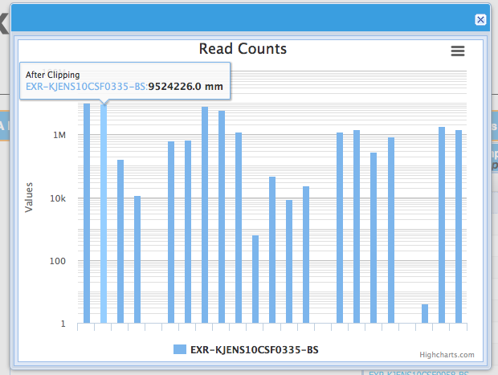
exRNA Atlas – RNA Profiling Histogram View
Histogram view of read counts mapped to various RNA libraries at various stages of exceRpt small RNA-seq pipeline

Slide 24
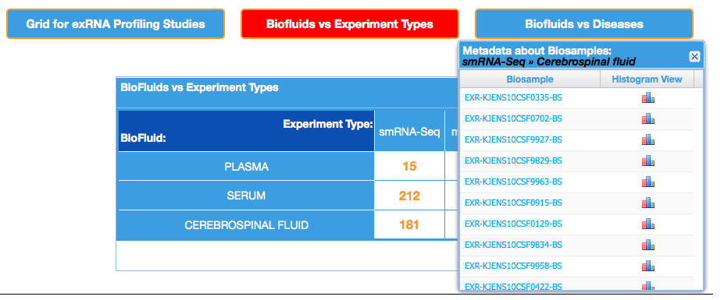
exRNA Atlas – Biofluids vs Experiment Types
Click each cell to view names of Biosamples from the selected biofluid-experiment type combination and links to view each biosample in GenboreeKB

Slide 25
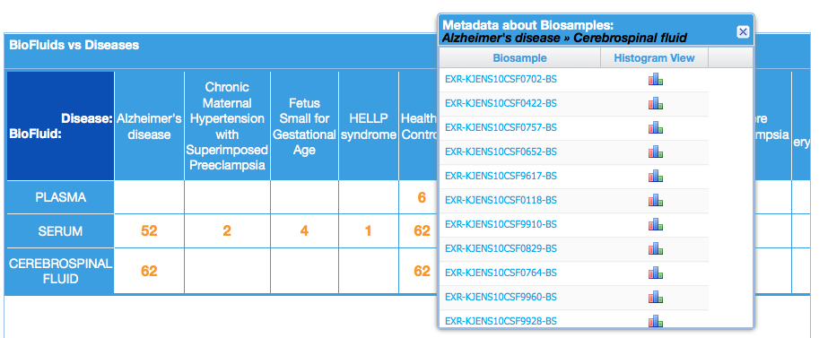
exRNA Atlas – Biofluids vs Diseases
Click each cell to view names of Biosamples from the selected biofluid-disease combination and links to view each biosample in GenboreeKB.

Slide 26
exRNA Atlas – Features Coming Soon
Filter samples based on metadata
Select samples of interest -
  Analyze using downstream analysis tools in the Genboree Workbench
  Download processed results
Generate other types of grids using metadata for sub-selecting samples of interest

Slide 27

Useful Links
http://genboree.org/theCommons/projects/exrna-tools-may2014/wiki
exRNA Data Analysis Tools Wiki
http://genboree.org/theCommons/projects/exrna-mads/wiki
ERCC Data Coordination Center Wiki
http://genboree.org/java-bin/workbench.jsp
Genboree Workbench
exRNA Atlas
http://genboree.org/java-bin/exRNAAtlas.jsp
http://genboree.org/genboreeKB
GenboreeKB
exRNA Portal Resources
http://exrna.org/resources/

Slide 28
Questions?

