Slide 1


CIBR RNA-Seq Data Analysis Workshop
Small RNA-Seq Data Analysis Tools in the Genboree Workbench
Sai Lakshmi Subramanian
Lab of Prof. Aleksandar Milosavljevic
Bioinformatics Research Laboratory
Baylor College of Medicine
Houston, TX, USA
Thursday, 14th May, 2015

Slide 2
Outline of the Demo
Genboree Services
Genboree Workbench
  Getting Started
  RNA-Seq Tools
Extracellular RNA
exceRpt small RNA-seq Data Analysis Tool
  Workflow
  Analysis in the Genboree Workbench
  Results

Slide 3

Summary of Genboree Services
  http://genboree.org/
Data Analysis Tools
  Genboree Workbench
  http://genboree.org/java-bin/workbench.jsp
Document Sharing, Tutorials & Discussion Forums
  Genboree Commons
  http://genboree.org/theCommons
Structured Data Storage and Visualization
  Genboree KnowledgeBase (GenboreeKB)
  http://genboree.org/genboreeKB
Use the same user name and password for all Genboree Services.

Slide 4
Summary of Genboree Services
  http://genboree.org/
Data Analysis Tools
  Genboree Workbench
  http://genboree.org/java-bin/workbench.jsp
Document Sharing, Tutorials & Discussion Forums
  Genboree Commons
  http://genboree.org/theCommons
Structured Data Storage and Visualization
  Genboree KnowledgeBase (GenboreeKB)
  http://genboree.org/genboreeKB
Use the same user name and password for all Genboree Services.

Slide 5
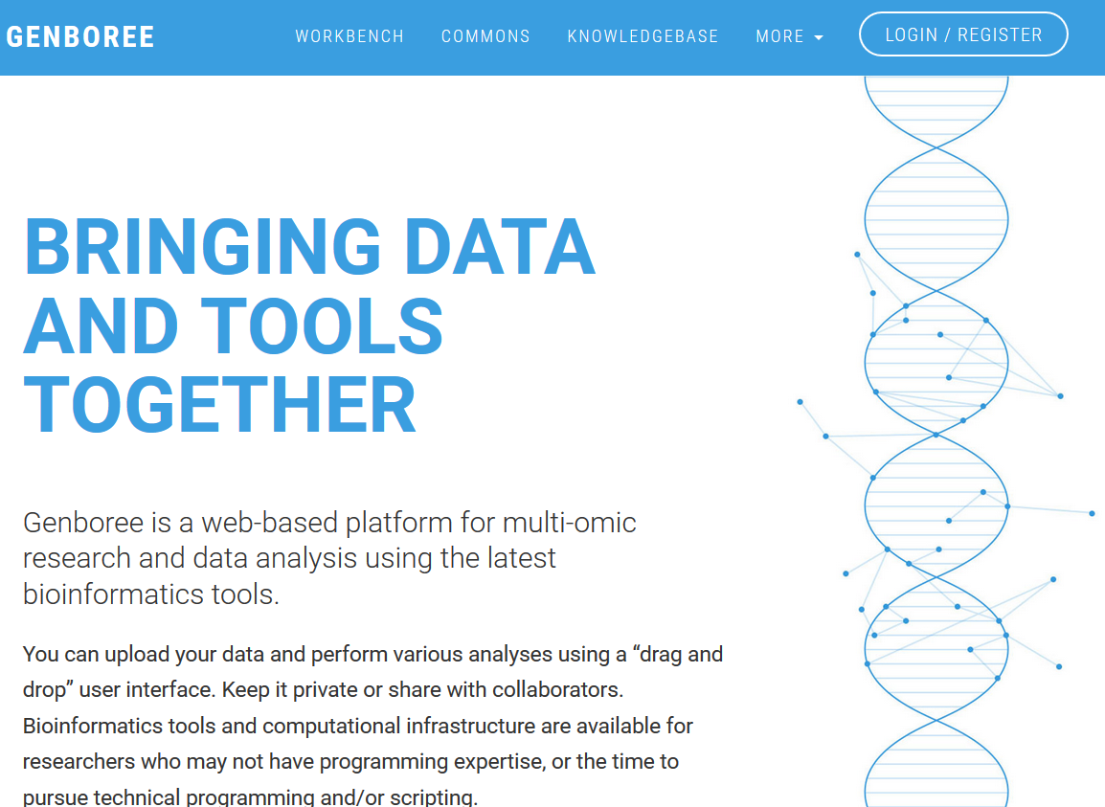
Genboree Services at genboree.org
TIP: To find these slides, search for CIBR in the Commons
Data Analysis Tools
Tutorials
New account in Genboree

Slide 6
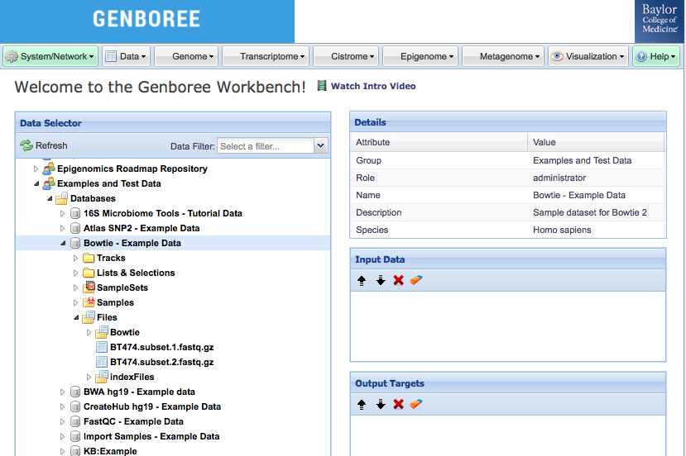
Genboree Workbench
Toolset Menus
Input Data Panel to drag & drop INPUT ENTITIES
Output Targets Panel to drag & drop OUTPUT DESTINATIONS

Slide 7
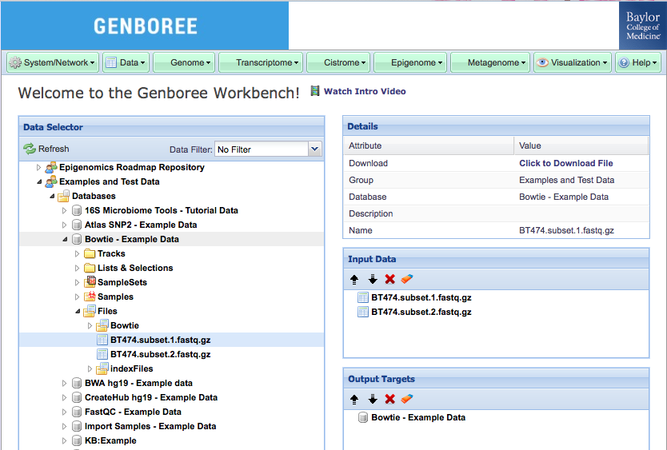
Genboree Workbench
Menu items turned GREEN -> Tool is ACTIVATED
Input Data
Output Database

Slide 8
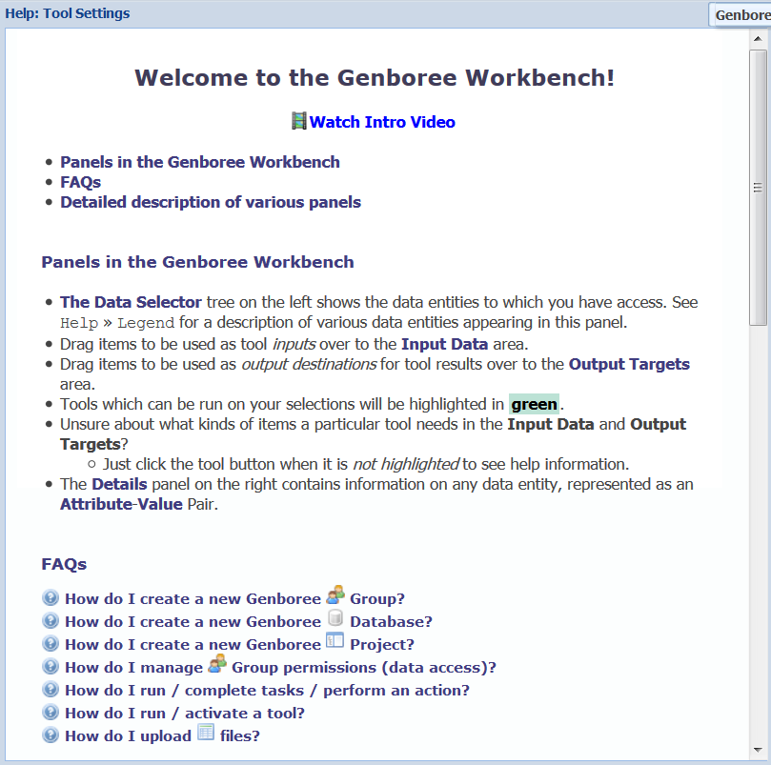
Genboree Workbench – Getting Started
Introduction to Genboree Workbench - Watch Video Tutorial
https://docs.google.com/file/d/0Bz3_YiJBA_j3Tk1uOFlIazdMbkk/
Find Help within the Genboree Workbench
http://genboree.org/theCommons/ezfaq/show/public-commons?faq_id=497
  Help » Getting Started
  Help » Tool Map
  Help » Tool Help Resources

Slide 9
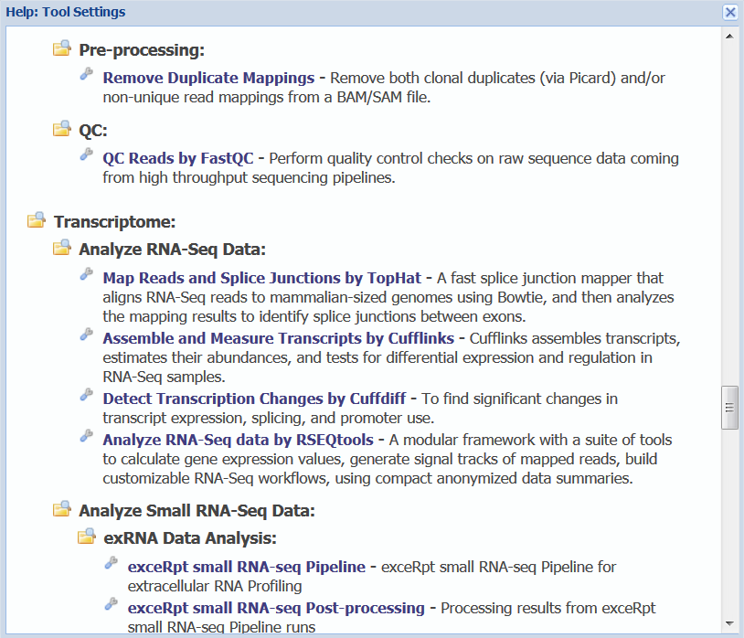
Genboree Workbench – Getting Started
Introduction to Genboree Workbench - Watch Video Tutorial
https://docs.google.com/file/d/0Bz3_YiJBA_j3Tk1uOFlIazdMbkk/
Find Help within the Genboree Workbench
http://genboree.org/theCommons/ezfaq/show/public-commons?faq_id=497
  Help » Getting Started
  Help » Tool Map
  Help » Tool Help Resources

Slide 10
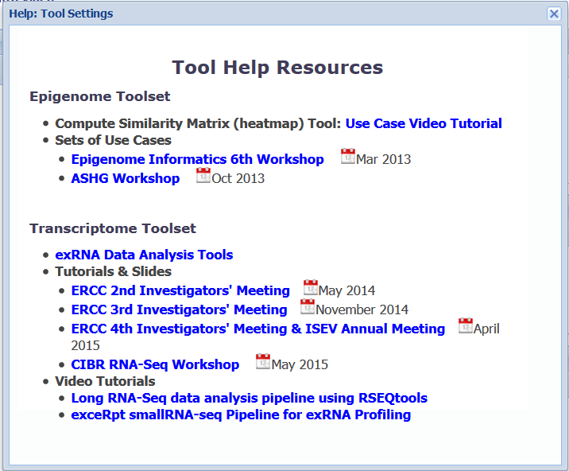
Genboree Workbench – Getting Started
Introduction to Genboree Workbench - Watch Video Tutorial
https://docs.google.com/file/d/0Bz3_YiJBA_j3Tk1uOFlIazdMbkk/
Find Help within the Genboree Workbench
http://genboree.org/theCommons/ezfaq/show/public-commons?faq_id=497
  Help » Getting Started
  Help » Tool Map
  Help » Tool Help Resources

Slide 11
RNA-Seq Tools in Genboree Workbench
Transcriptome
Genome
Analyze RNA-Seq Data
Analyze Small RNA-Seq Data
Map Sequenced Reads
Index Sequences
QC
Analyze RNA-Seq data by RSEQtools
exceRpt smallRNA-seq Pipeline
Bowtie2
Bowtie2
FastQC
TopHat
exceRpt smallRNA-seq Post-processing
BWA
BWA
Cufflinks
Cuffdiff
Visualization
Target Interaction Finder
View Tracks in UCSC Genome Browser
View Track Hub in Genome Browsers

Slide 12

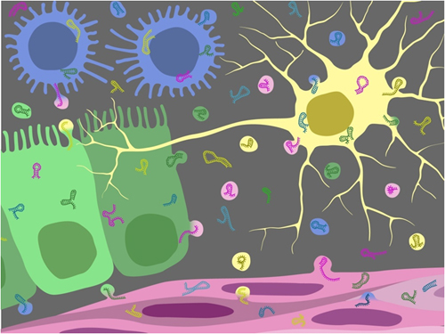
extracellular RNA - exRNA
RNA that is exported from cells in extracellular vesicles (EVs) or bound to lipids or proteins
Circulate through the body and affect cells at a great distance
May also be absorbed from food, microbes, or the environment
EVs are the intercellular carriers of DNA and RNA and potentially inter-species information exchange
10⁸-10¹² EV/mL body fluid (CSF, plasma, bile, serum, etc)
Number and cellular origin are disease dependent

Slide 13

Extracellular RNA Communication Consortium
DCC-Admin Core
RFA RM-12-011
Reference Profiles
RFA RM-12-012 Biogenesis, Biodistr, Uptake, and Effector Function
RFA RM-12-013
Clinical Utility
for Biomarkers
RFA RM-12-014
Clinical Utility for
Therapy Development
RFA-RM-12-010
Data Management & Resource Repository
Scientific Outreach Component
Data Integration & Analysis Component
Data Coordination Component

Slide 14
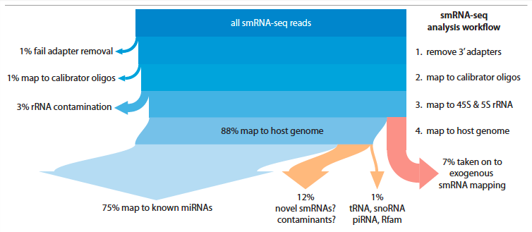
extracellular RNA Processing Tool – exceRpt
For a typical cellular sample…
exRNA samples typically are much noisier
Cascade of read-alignment steps mitigates contamination

Slide 15
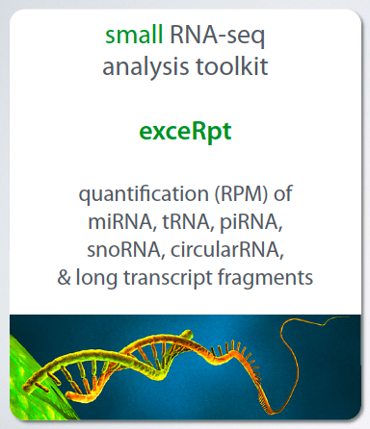
exceRpt Pipeline – Workflow
Developed by Rob Kitchen at the Gerstein Lab, Yale University

Slide 16
exceRpt small RNA-seq Pipeline – Overview
Standard inputs – FASTQ, SRA – can be compressed
Identifies and removes 3’ adapter
Automatic preprocessing and QC of sequence reads
Absolute quantitation by quantification of exogenous spike-in sequences
Explicit rRNA filtering & QC
Quantify many different smallRNA types
Genboree Implementation
Automated linear workflow
Versioned – Currently Release 2.2.2
Choice of 3 end-points
Easy to use GUI – computational/processing power, data storage

Slide 17
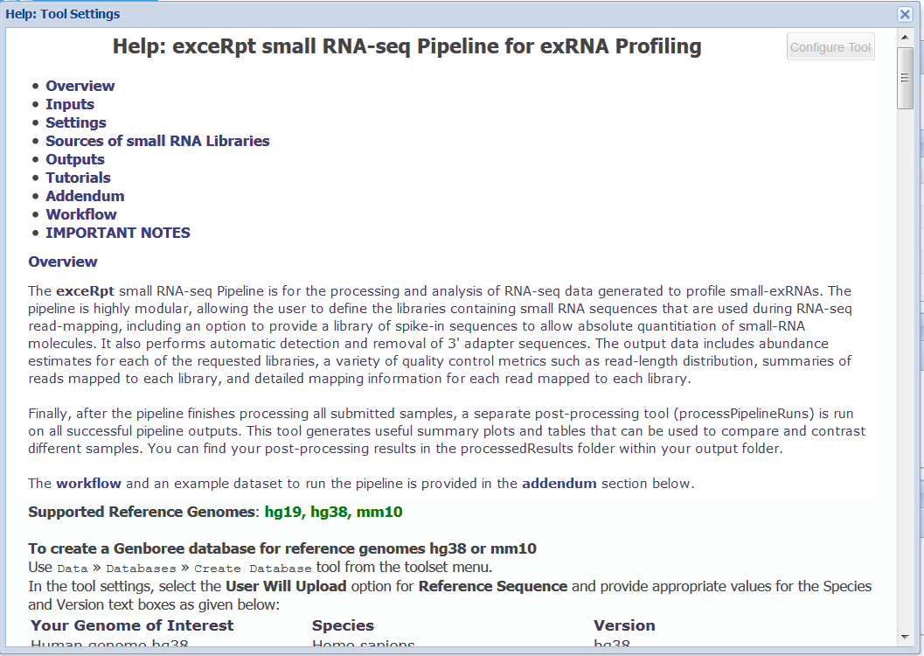
exceRpt small RNA-seq tool

Slide 18
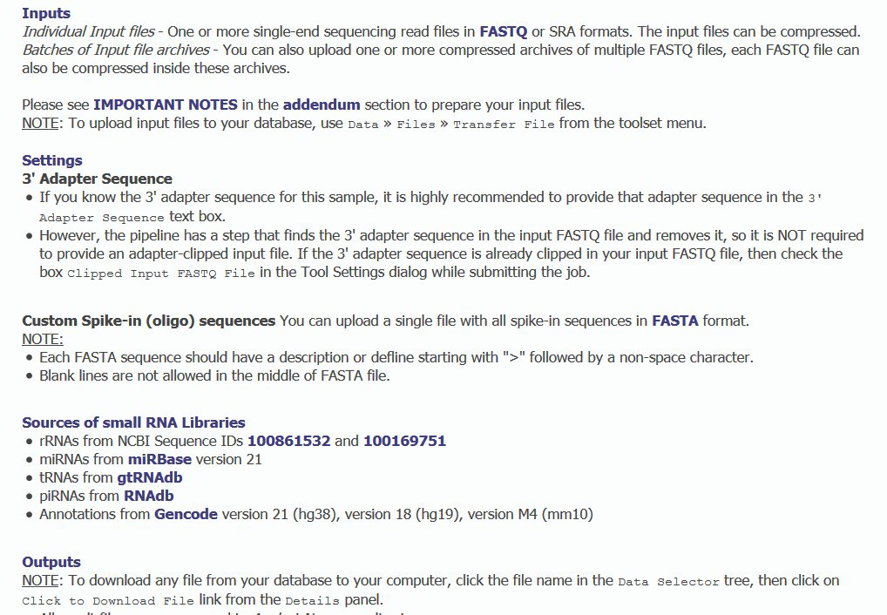
exceRpt in the Genboree Workbench - Help

Slide 19
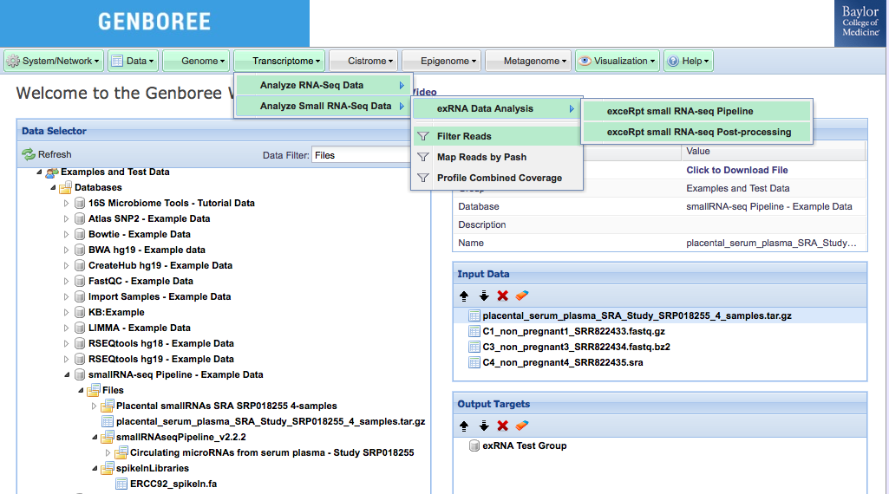
exceRpt small RNA-seq Data Analysis
Toolset Menus
Group
Input Data Panel with your small RNA-seq reads
Database
Files
Output Targets Panel with your own database for results from analysis tools

Slide 20
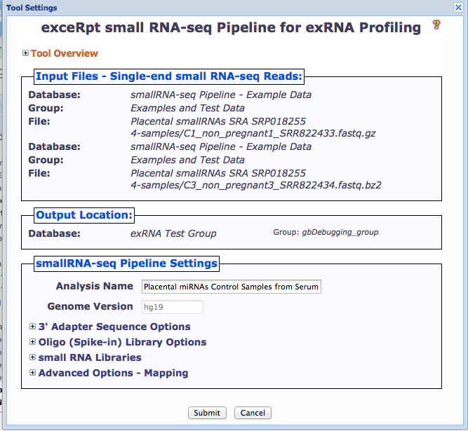

Slide 21
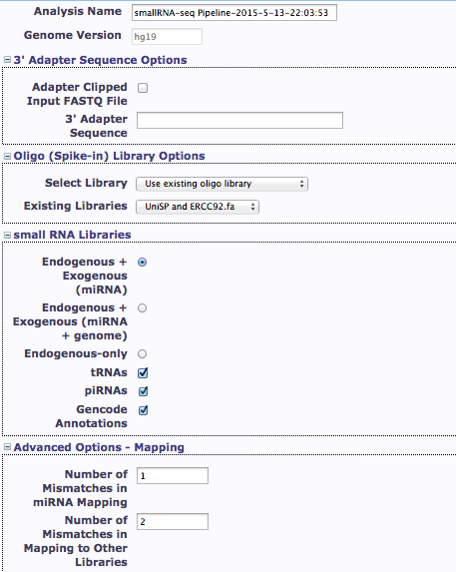
exceRpt Pipeline
Tool settings
Provide 3’ adapter sequence, if known
Upload custom oligo sequences or use previously uploaded oligo sequences
Select RNA libraries for mapping
Set mapping options

Slide 22
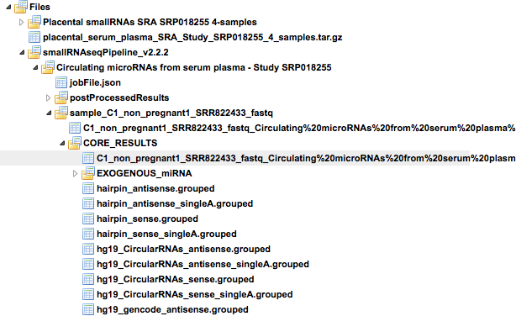
exceRpt Analysis Pipeline – Results
OUTPUT FILES:
Read length distribution, quantifications, read counts
Endogenous Mapping results
Exogenous Mapping results
Files containing sequence reads following Adapter removal, rRNA/ contaminant/ repetitive sequence removal, Endogenous mapping & Exogenous mapping

Slide 23
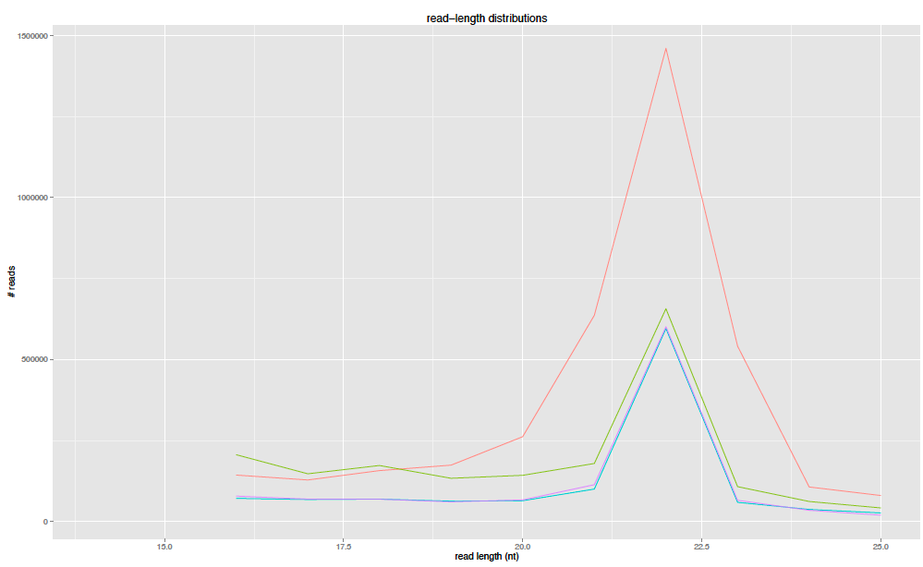
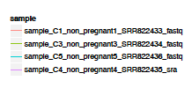
exceRpt Analysis Pipeline – Plots

Slide 24
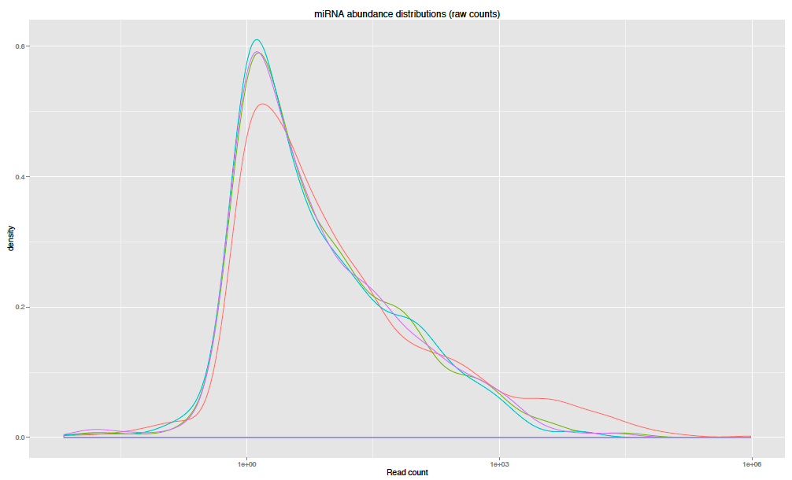

exceRpt Analysis Pipeline – Plots

Slide 25




Acknowledgements
Bioinformatics Research Laboratory (BRL), Baylor College of Medicine, Houston, TX
Aleksandar Milosavljevic, Director
Matthew Roth, Co-Director
Andrew Jackson
Sameer Paithankar
Neethu Shah
William Thistlethwaite
Aaron Baker
Kevin Riehle
Ronak Patel
Piotr Pawliczek
Xin Feng
Viren Amin
Vitor Onuchic
Elke Norwig-Eastaugh
Yale University, New Haven, CT
Mark Gerstein
Joel Rozowsky
Rob Kitchen
Fabio Navarro
Gladstone Institutes, San Francisco, CA
Alexander Pico
Anders Riutta
Sponsored/Supported by:
Grant 1U54DA036134-01 from the NIH Common Fund, through the Office of Strategic Coordination/Office of the NIH Director
BRL Core - Advanced Technology Core program, Office of Research, Baylor College of Medicine

Slide 26
References & Useful Links
Barturen et al. (2014) sRNAbench: profiling of small RNAs and its sequence variants in single or multi-species high-throughput experiments. Methods in Next Generation Sequencing. Volume 1, Issue 1
Ben Langmead, Cole Trapnell, Mihai Pop and Steven L Salzberg (2009) Ultrafast and memory-efficient alignment of short DNA sequences to the human genome. Genome Biology 10(3):R25.
Kozomara A, Griffiths-Jones S. (2011) miRBase: integrating microRNA annotation and deep-sequencing data. NAR 39 (Database Issue)
Langmead B, Salzberg SL. (2012) Fast gapped-read alignment with Bowtie 2. Nature Methods. 9 : 357-359.
Genboree Workbench - http://genboree.org/java-bin/workbench.jsp
Small RNA-seq Data Analysis Tools - TUTORIALS http://genboree.org/theCommons/projects/exrna-tools-may2014/wiki

Slide 27
Questions?

