Slide 1
exRNA Profiling Data Submission & Analysis Infrastructure for the
ERC Consortium
Sai Lakshmi Subramanian
ERC Consortium Data Management & Resource Repository (DMRR)
Baylor College of Medicine, Houston, TX
5th NIH ERCC Investigators’ Meeting
November 9th and 10th, 2015
Bethesda, MD

Slide 2
Conflicts of Interest Disclosure
I have no conflicts of interest to disclose.

Slide 3
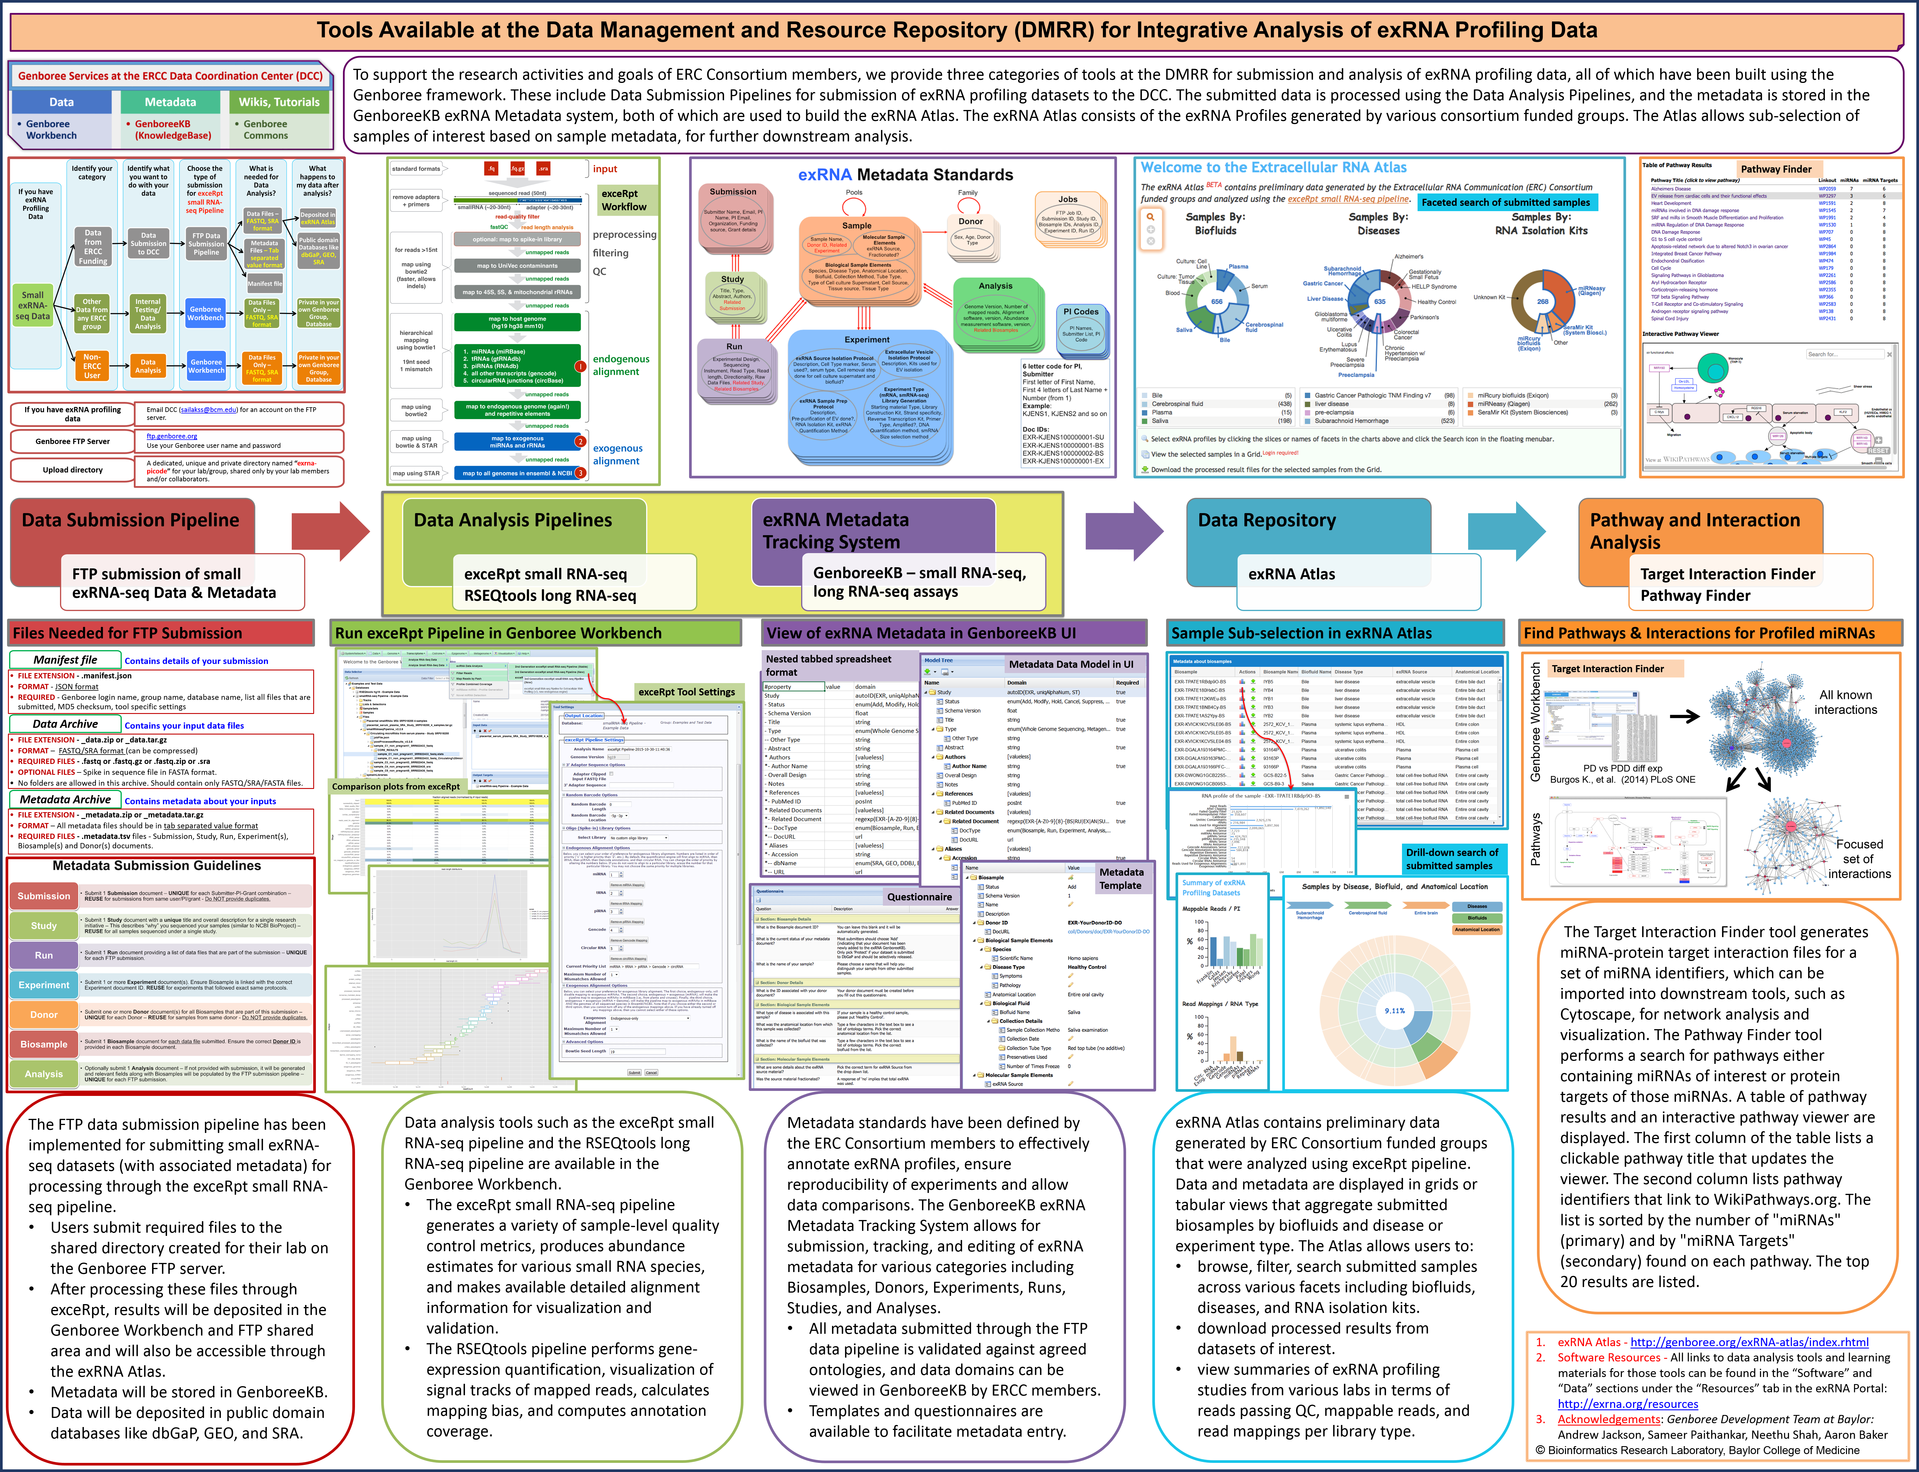
Overview
Poster Board 1

Slide 4
Tools available at the DMRR
Data Analysis Pipelines & Tools
  exceRpt small RNA-seq Pipeline – Genboree Workbench & FTP Submission
  RSEQtools long RNA-seq Pipeline – Genboree Workbench
  Target Interaction Finder – Genboree Workbench
  Pathway Finder – Genboree Workbench
Data Submission Pipelines
  exRNA FTP data submission pipeline for small RNA profiling data
  Long RNA-seq data submission pipeline ^{Coming Soon}
  qPCR Assay data submission ^{Coming Soon}
exRNA Metadata Tracking - GenboreeKB
  Small RNA-Seq Assays
  Long RNA-Seq Assays
  qPCR Assays ^{Coming Soon}

Slide 5
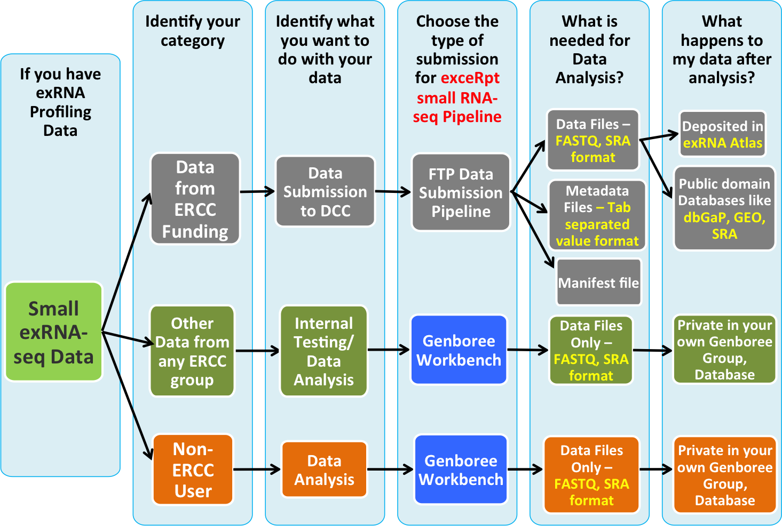
Small exRNA-seq Data Submission

Slide 6
exRNA Profiling Data Flow
Data Submission Pipeline
  FTP submission of small exRNA-seq Data & Metadata
Data
Metadata
Data Analysis Pipelines
exRNA Metadata Tracking System
  exceRpt small RNA-seq
  GenboreeKB – small RNA-seq assays
Data Repository
  exRNA Atlas
Pathway and Interaction Analysis
  Target Interaction Finder
  Pathway Finder

Slide 7
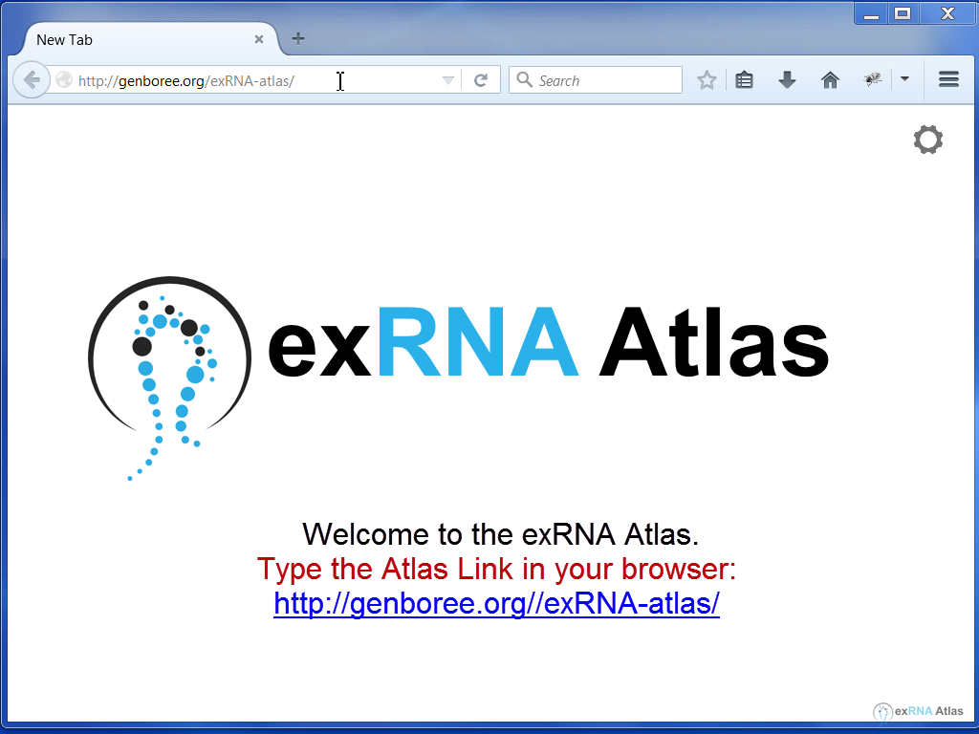
exRNA Atlas
View Tutorial Video at:
http://genboree.org/theCommons/projects/exrna-mads/wiki/exRNA%20Atlas#Introduction-to-the-exRNA-Atlas

Slide 8
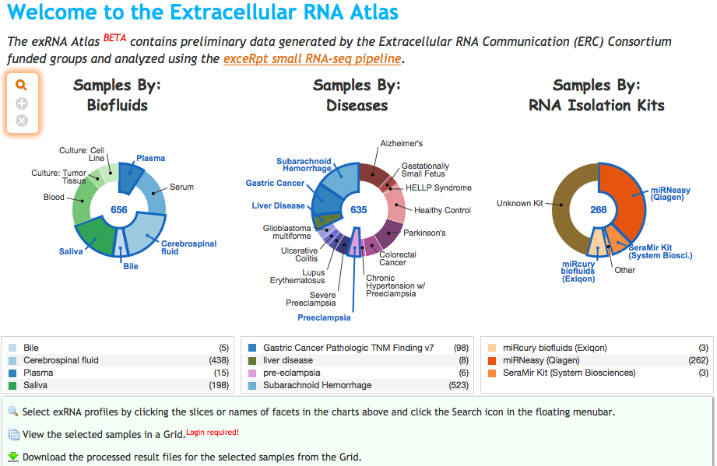
exRNA Atlas
Faceted search of submitted samples

Slide 9
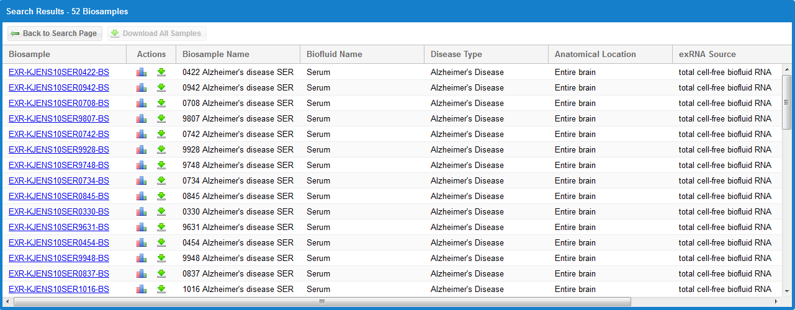
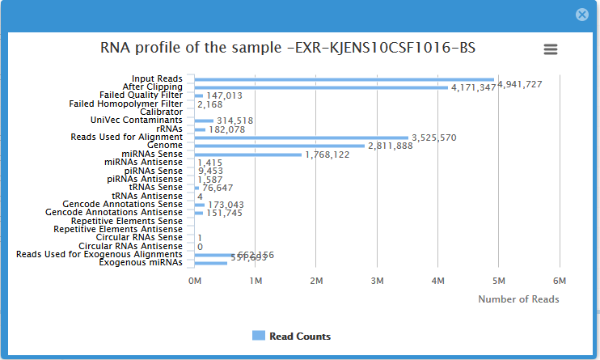
Sample Subselection in exRNA Atlas

Slide 10
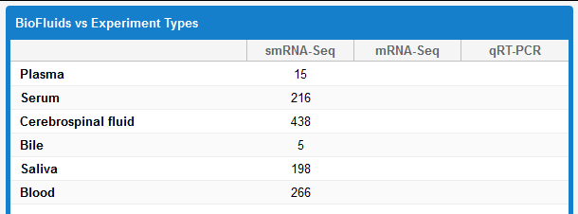
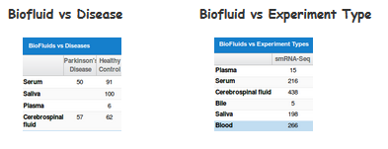
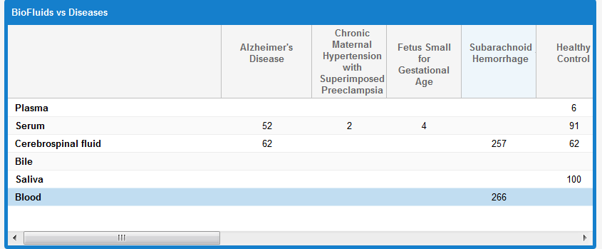
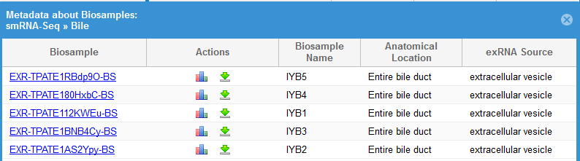
Grids in exRNA Atlas

Slide 11
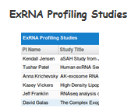
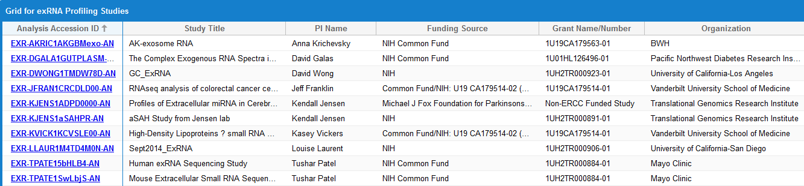
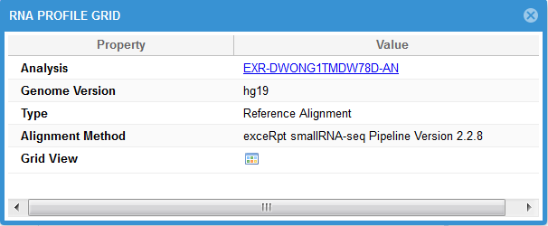
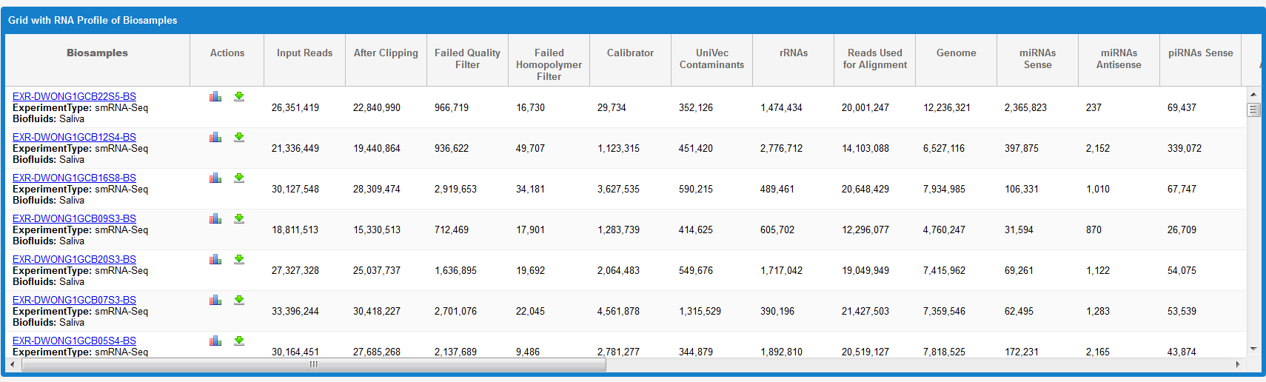
Submission Summaries in Atlas

Slide 12
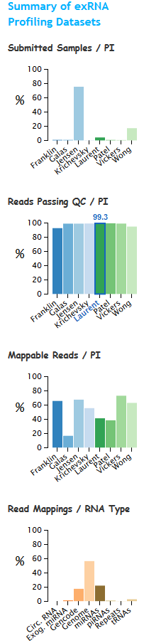
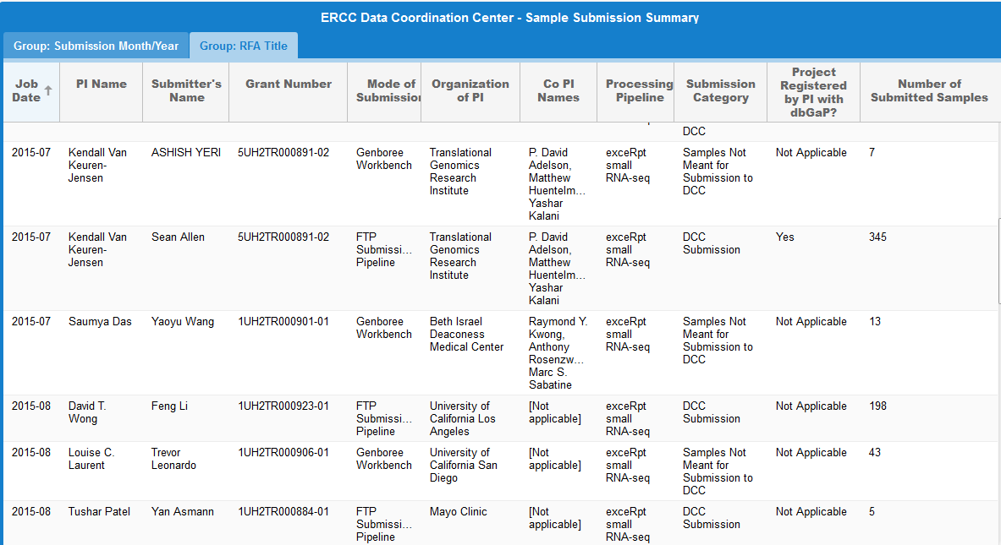
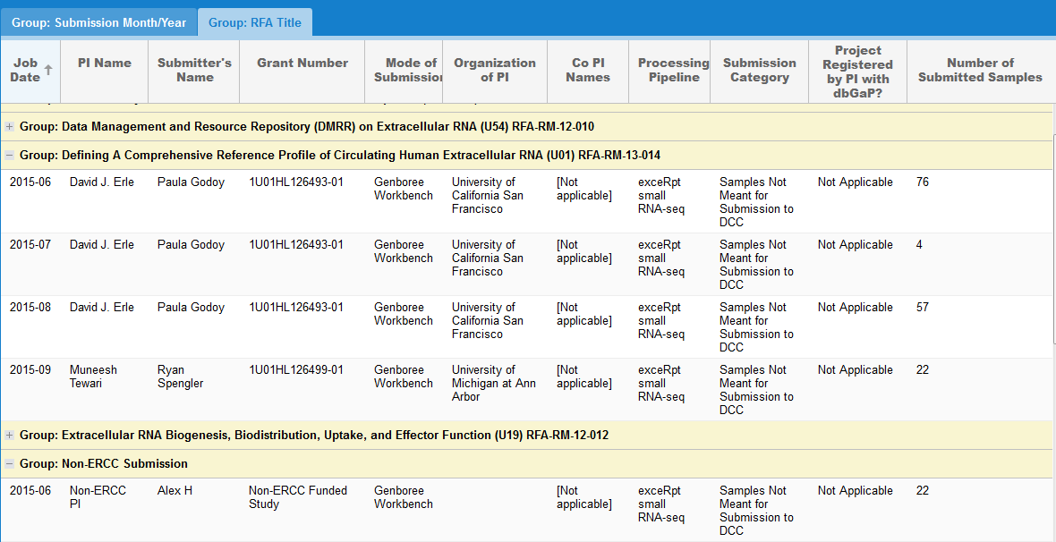
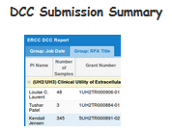
Submission Summaries in Atlas

Slide 13
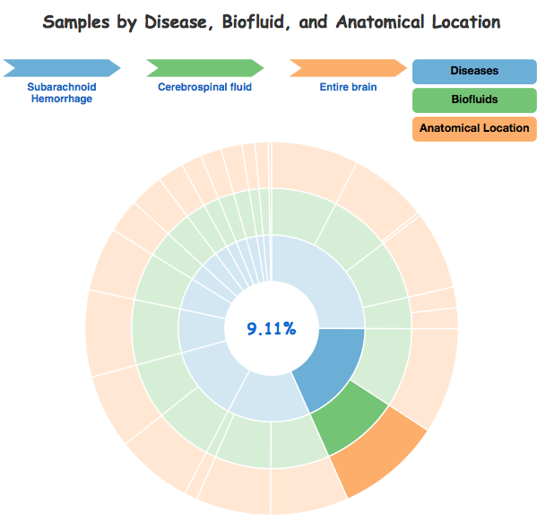
Drill-down search in exRNA Atlas
Use the circular partition diagram (or "sunburst" diagram) to interactively drill down into different subsets of biosamples.
If you hover over a colored segment, you will see the Disease » Biofluid » Anatomical Location values for the biosamples in that subset.
The percentage of samples falling into that subset will also be displayed.
If you click a specific segment, you will zoom into that subset.
This drill-down tactic is the best approach for low-population subsets that are hard to select when zoomed out.
Clicking the Search icon in the floating menubar will open the tabular view of your biosample subset.
Click the center circle to zoom out to the previous level.
Your last hovered path is always visible. To clear it, click outside the circle.

Slide 14
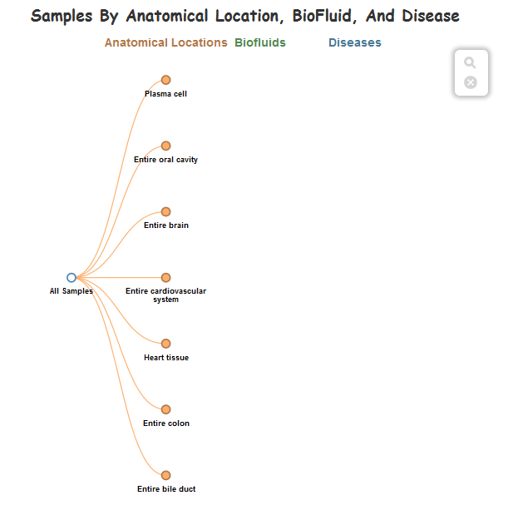
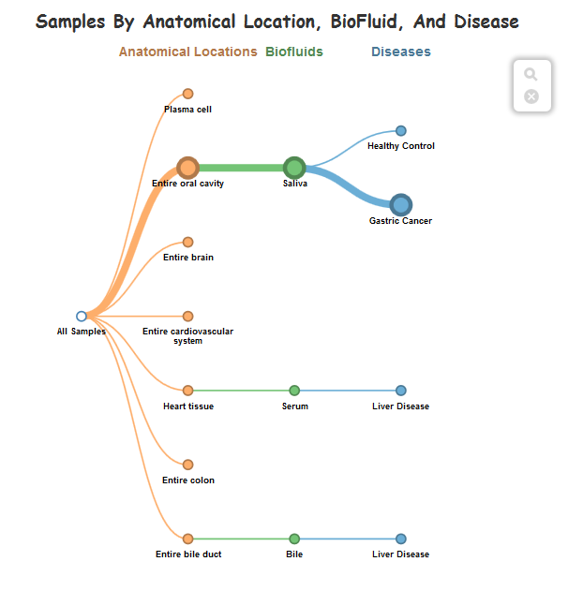
Drill-down search in exRNA Atlas

Slide 15
Genboree FTP Data Submission Pipeline
Step 0
Step 1
Step 2
Step 3
Step 4
Step 5
Create an FTP account
Prepare your data archive
Prepare your metadata archive
Prepare your manifest file
Upload your submission to the FTP server
Download your results, perform pathway analysis
If you have exRNA profiling data
  Email DCC (sailakss@bcm.edu) for an account on the FTP server.
Genboree FTP Server
  ftp.genboree.org
  Use your Genboree user name and password
Upload directory
  A dedicated, unique and private directory named “exrna-picode” for your lab/group, shared only by your lab members and/or collaborators.
Notes:
Click to add notes

Slide 16
Files to Submit
Data Archive File
Contains your input data files
  FILE EXTENSION - _data.zip or _data.tar.gz
  FORMAT – FASTQ/SRA format (can be compressed)
  REQUIRED FILES - .fastq or .fastq.gz or .fastq.zip or .sra
  OPTIONAL FILES – Spike in sequence file in FASTA format.
Metadata Archive File
Contains metadata about your inputs
  FILE EXTENSION - _metadata.zip or _metadata.tar.gz
  FORMAT – All metadata files should be in tab separated value format
  REQUIRED FILES - .metadata.tsv files - Submission, Study, Run, Experiment(s), Biosample(s) and Donor(s) documents.
Manifest file
Contains details of your submission
  FILE EXTENSION - .manifest.json
  FORMAT - JSON format
  REQUIRED - Genboree login name, group name, database name
  List all files that are submitted, MD5 checksum
  Tool specific settings
All three files must have the same basic file name: Example:
samples_data.zip
samples_metadata.zip
samples.manifest.json

Slide 17
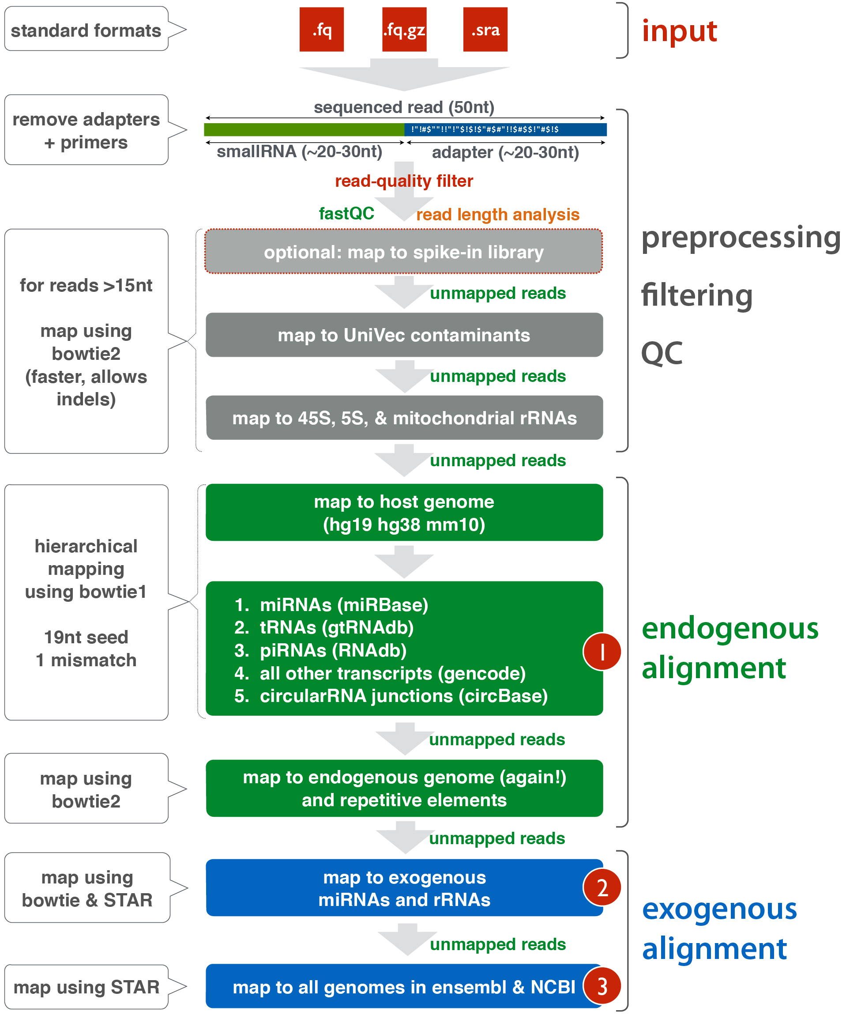
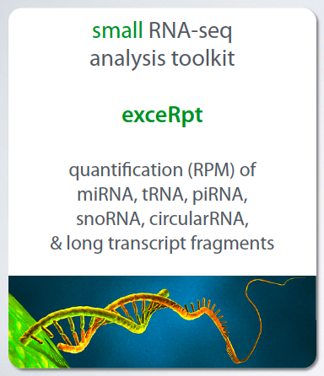
exceRpt v3.1.9 Workflow
Developed by Rob Kitchen at the Gerstein Lab, Yale University

Slide 18
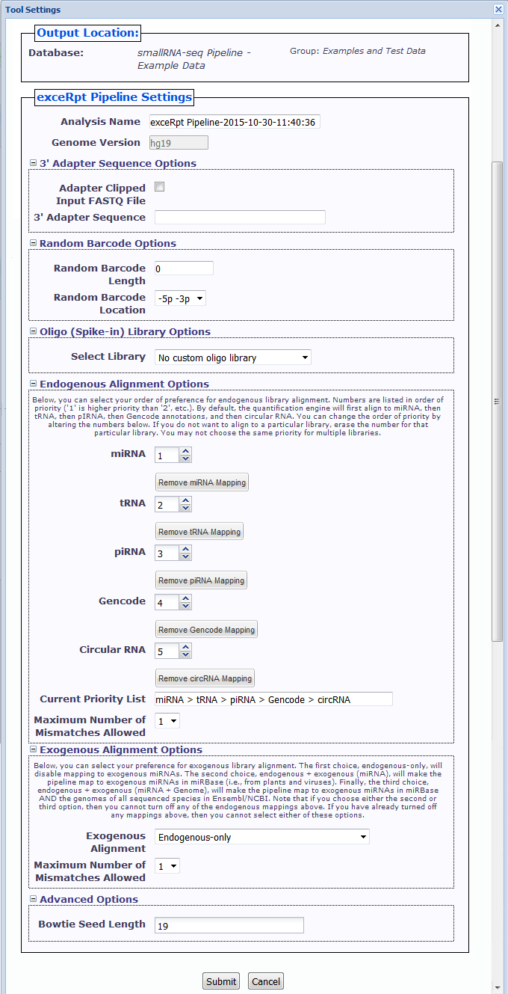
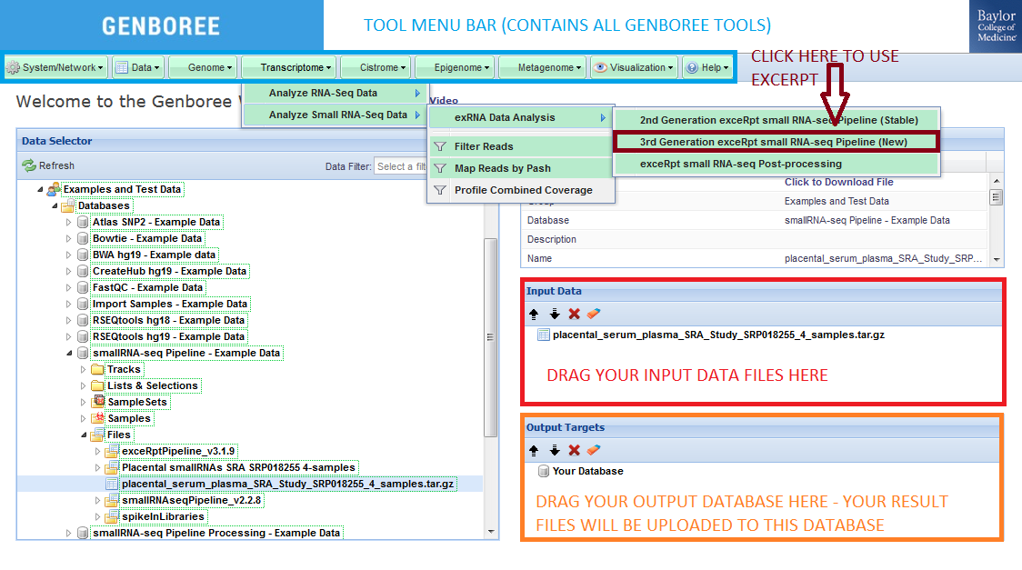
exceRpt v3.1.9 in Genboree Workbench
Group
Database
Files
Tool Settings
Provide 3’ adapter sequence, if known
Set options for random barcodes – length and location
Upload custom oligo sequences or use previously uploaded oligo sequences
Select endogenous libraries for mapping
Change order of endogenous libraries
Set mapping options – mismatches, bowtie seed length
Choose exogenous library alignments

Slide 19
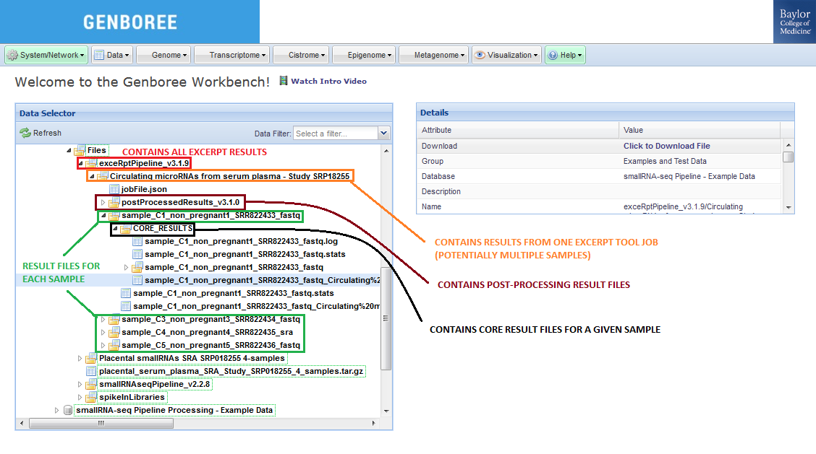
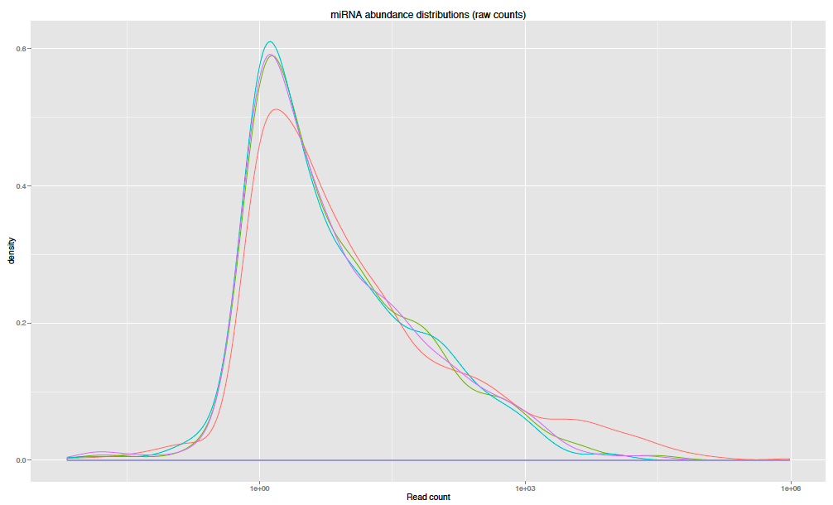
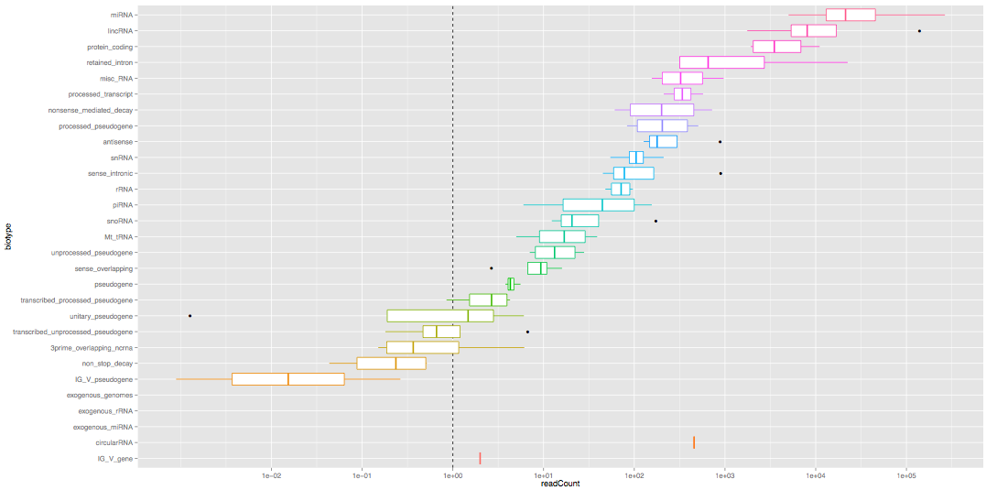
exceRpt v3.1.9 in Genboree Workbench

Slide 20
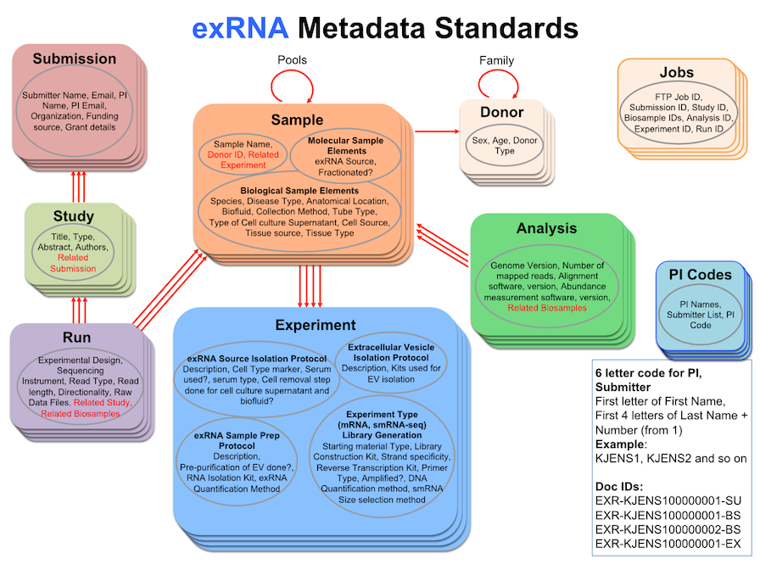
Metadata for exRNA-seq

Slide 21
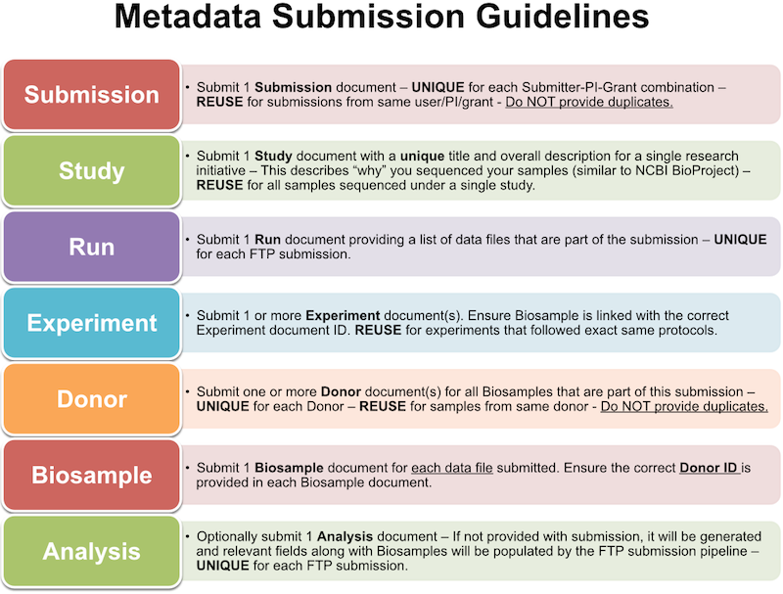
exRNA Metadata

Slide 22
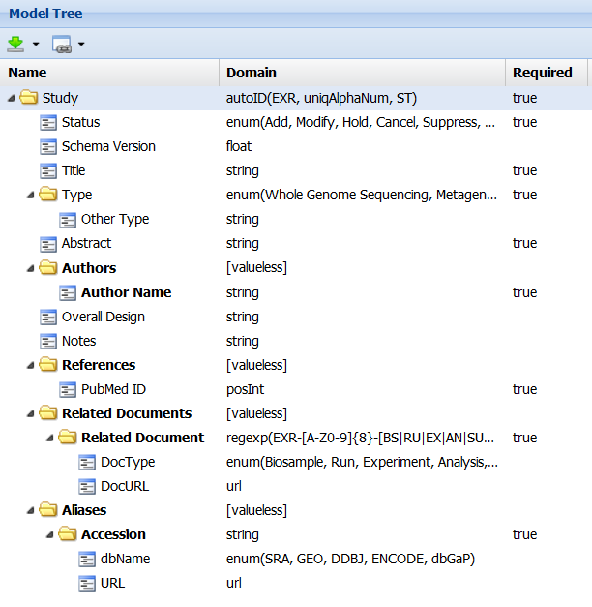
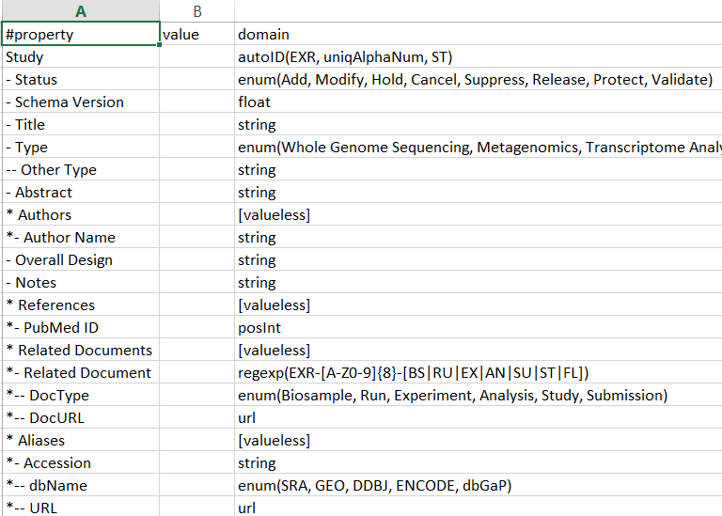
exRNA Metadata in GenboreeKB UI
Nested tabbed spreadsheet format
Metadata Data Model in UI

Slide 23
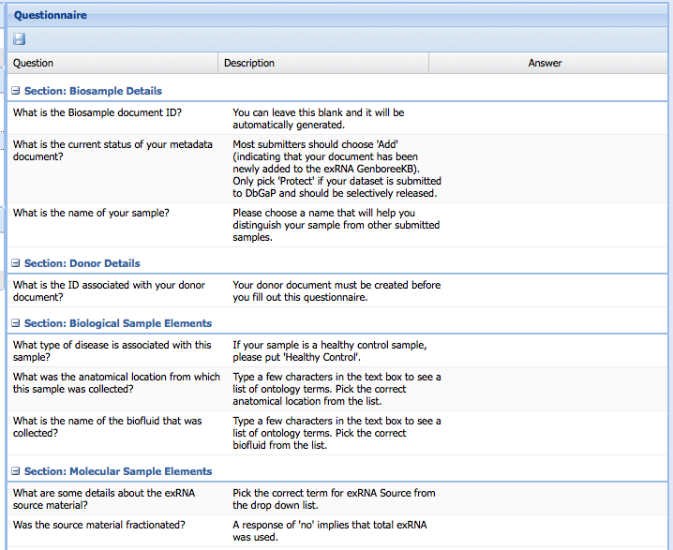
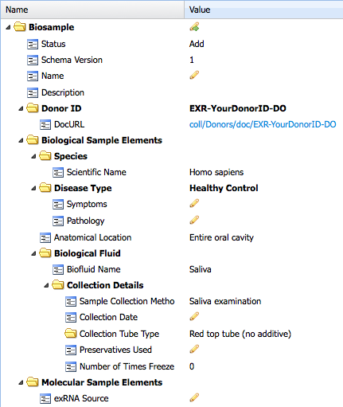
Metadata Entry in GenboreeKB UI
Questionnaire
Metadata Template
Edit these fields
Answer these questions

Slide 24
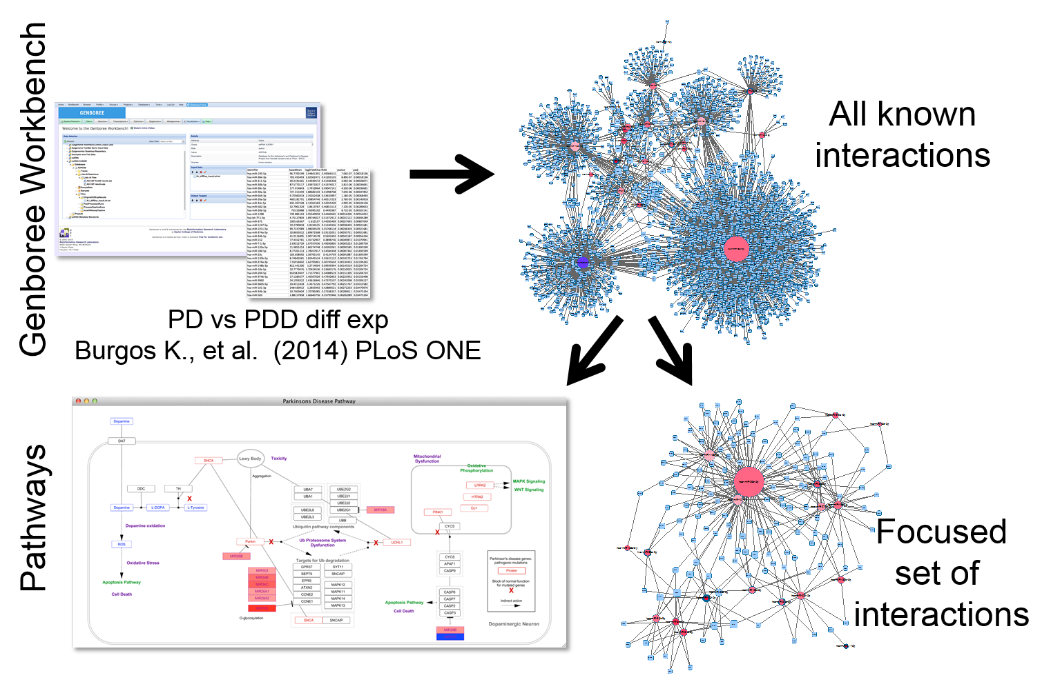
Pathway analysis in Genboree Workbench

Slide 25
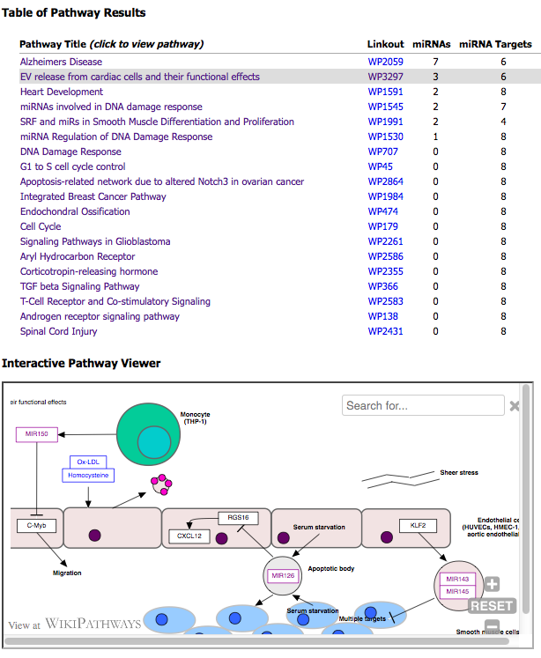
Pathway analysis in Genboree Workbench

Slide 26
Useful Links
exRNA Portal
  http://exrna.org
exRNA Portal Software Resources
  http://exrna.org/resources/software
exRNA Atlas
http://genboree.org/exRNA-atlas/index.rhtml
Data Coordination Center Wiki
  http://genboree.org/theCommons/projects/exrna-mads/wiki
exRNA Data Analysis Tools Wiki
  http://genboree.org/theCommons/projects/exrna-tools-may2014/wiki

Slide 27





Acknowledgements
Baylor College of Medicine, Houston, TX
Aleksandar Milosavljevic, Director
Matthew Roth, Co-Director
Elke Norwig-Eastaugh
Genboree Dev Team at Baylor
Andrew Jackson
Sameer Paithankar
Sai Lakshmi Subramanian
Neethu Shah
William Thistlethwaite
Aaron Baker
Yale University, New Haven, CT
Mark Gerstein
Joel Rozowsky
Rob Kitchen
Fabio Navarro
Gladstone Institutes, San Francisco, CA
Alexander Pico
Anders Riutta
Kristina Hanspers
Pacific Northwest Diabetes Research Institute, Seattle, WA
David Galas
Roger Alexander
Sponsored by:
Grant 1U54DA036134 from the NIH Common Fund, through the Office of Strategic Coordination/Office of the NIH Director

