Slide 1


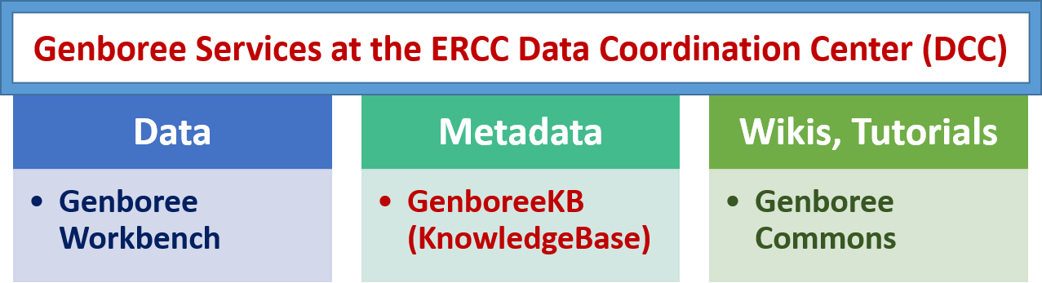
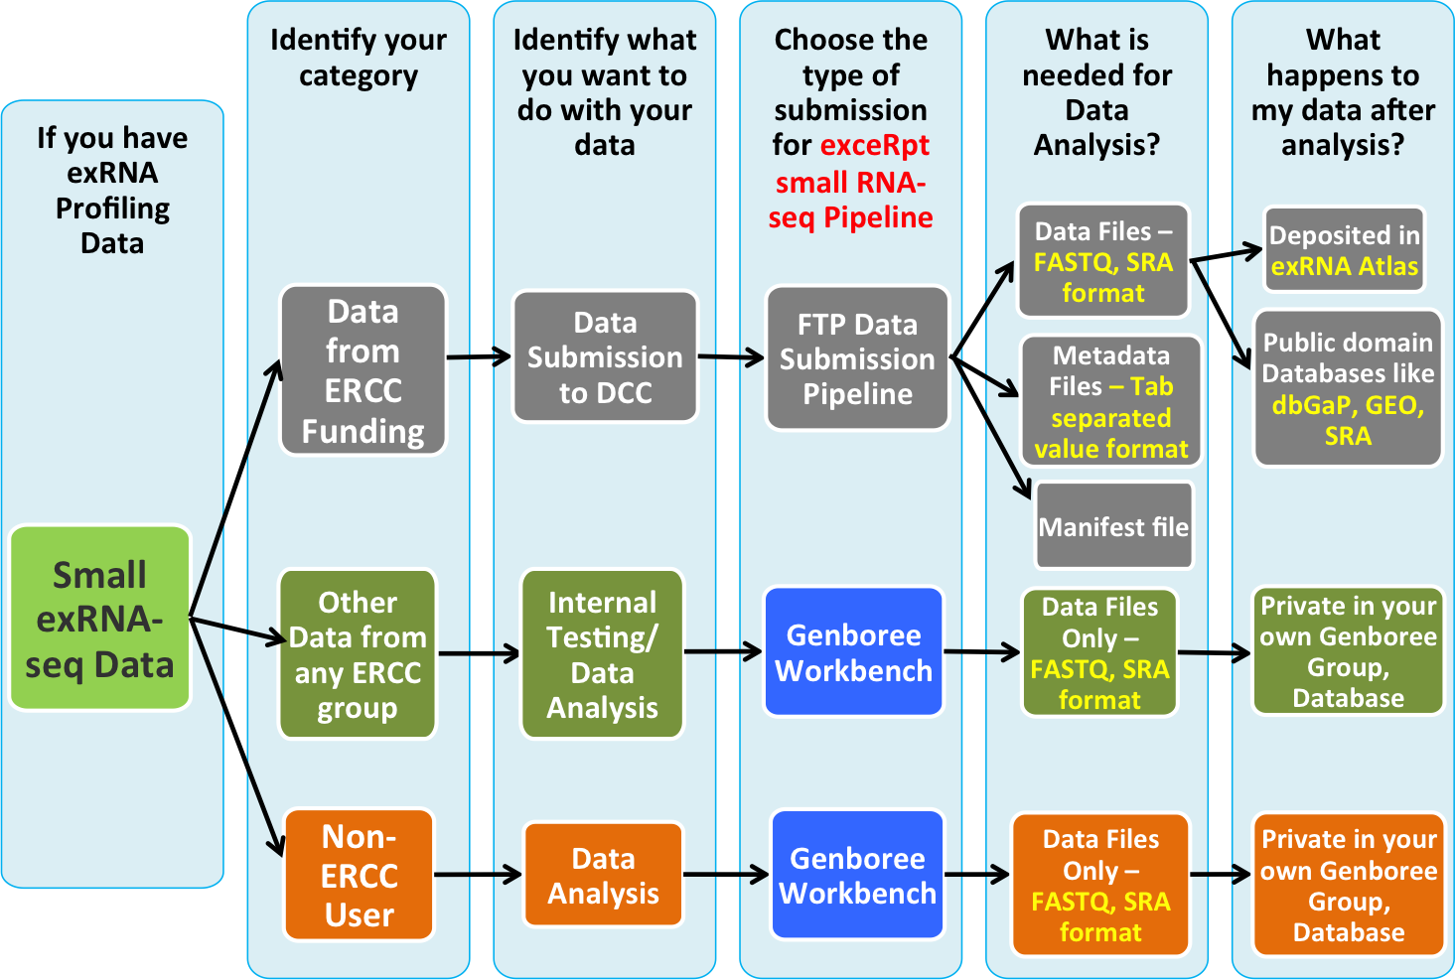
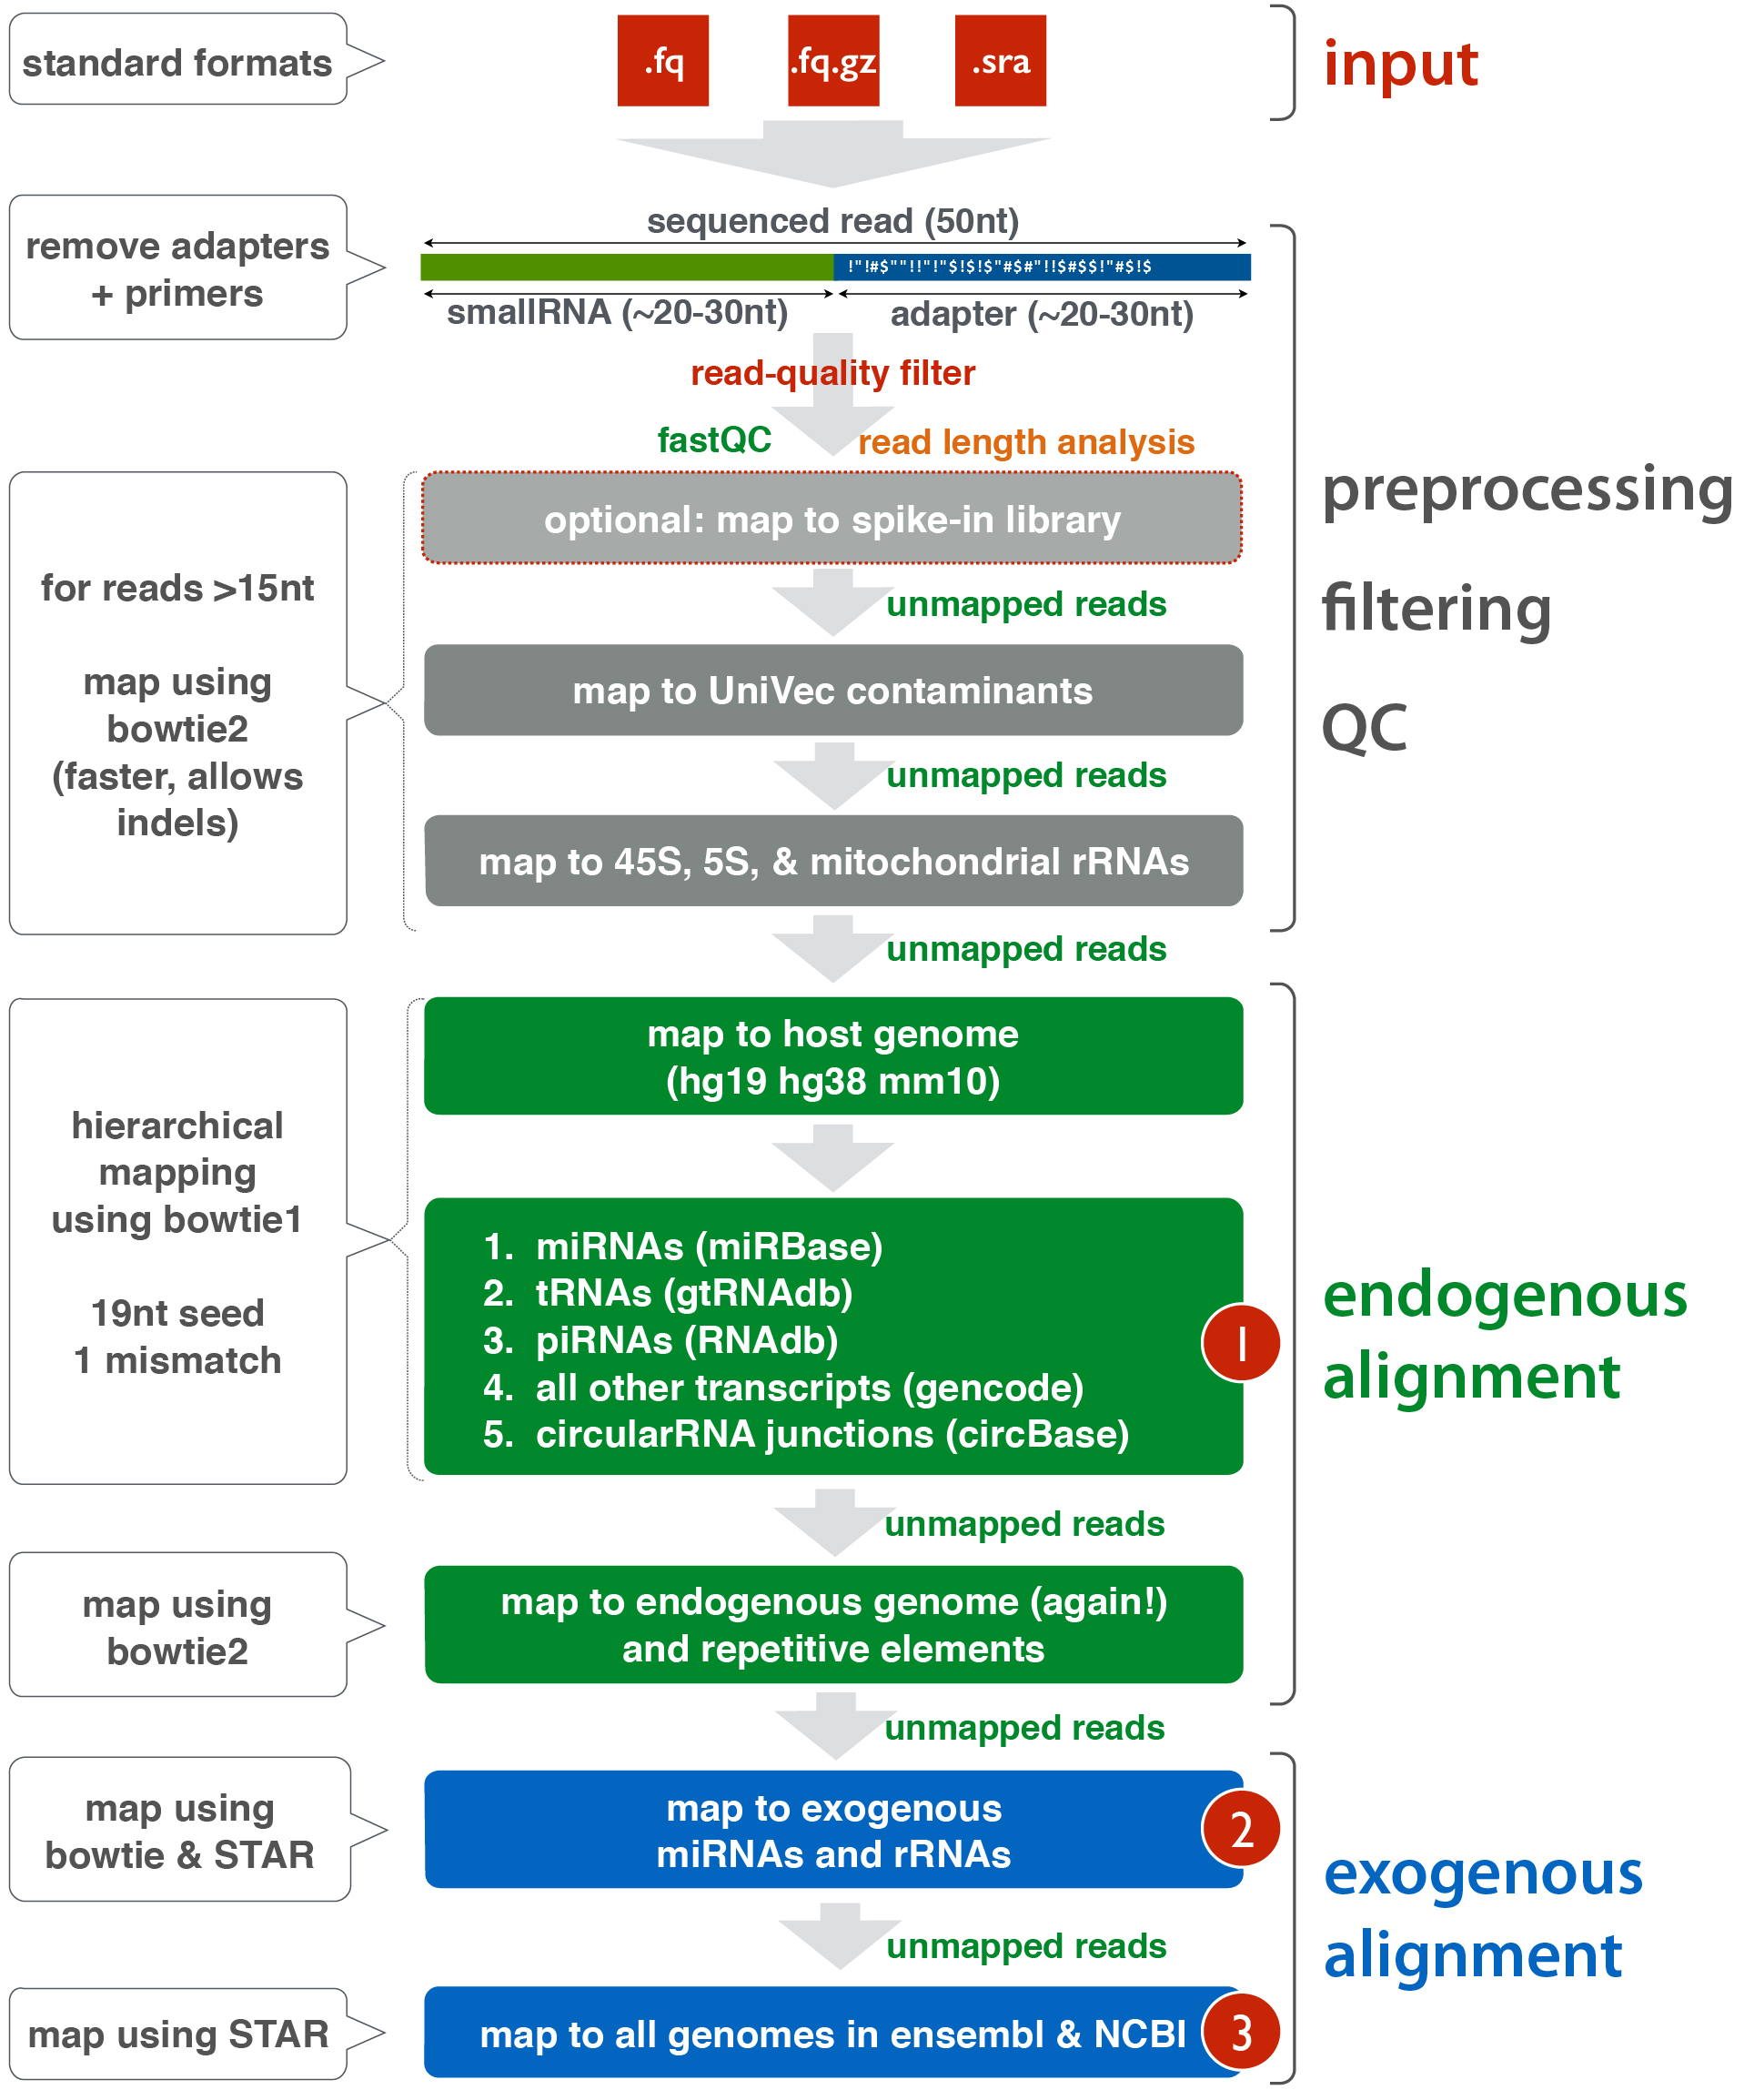
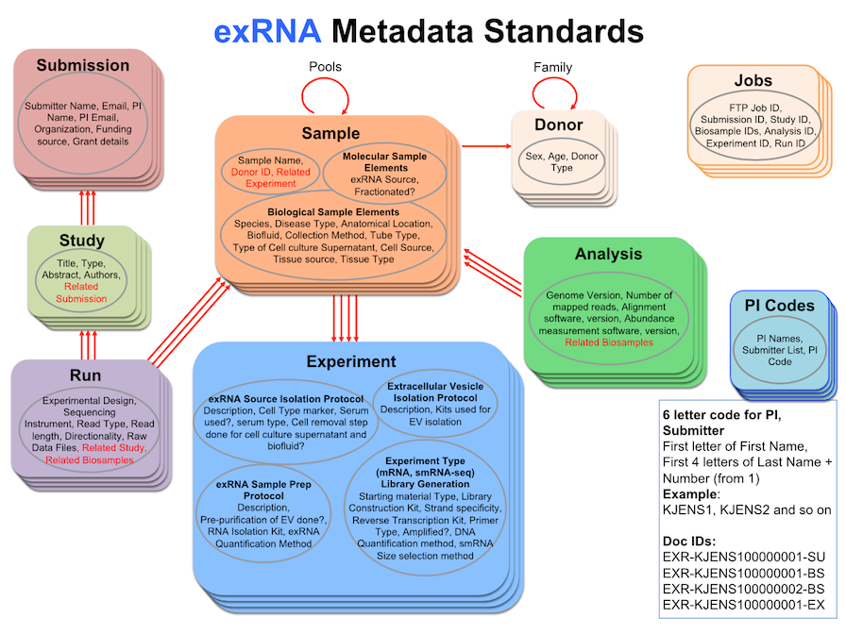
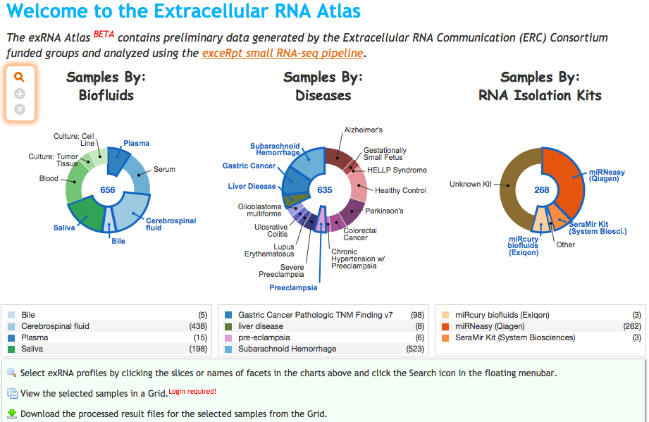
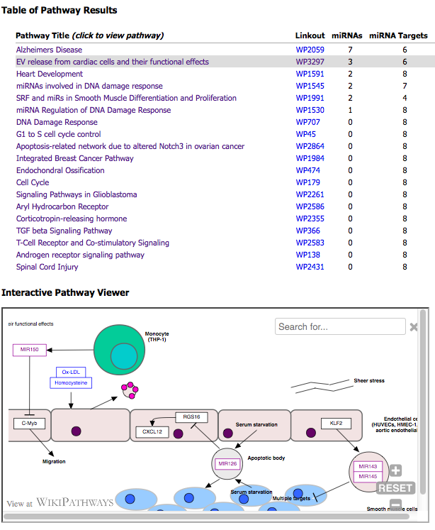
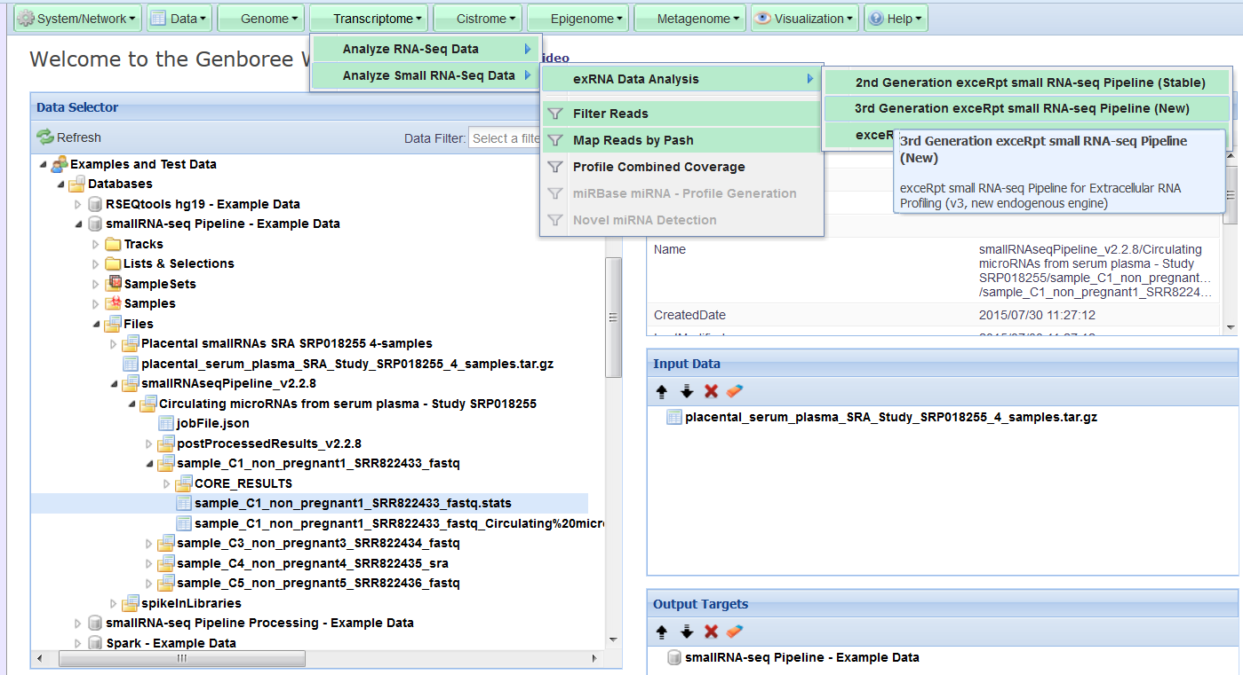
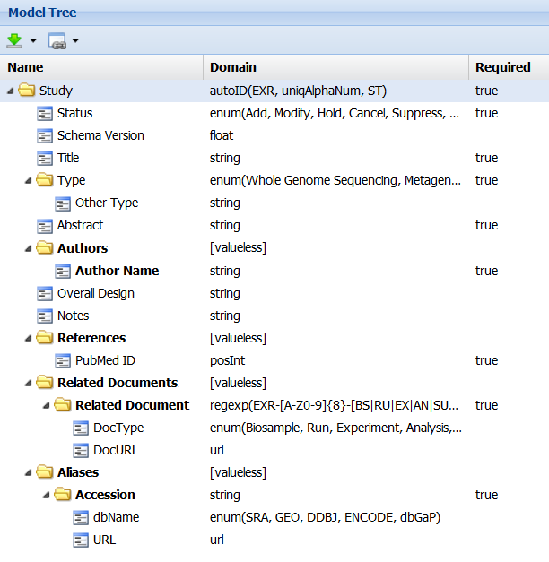
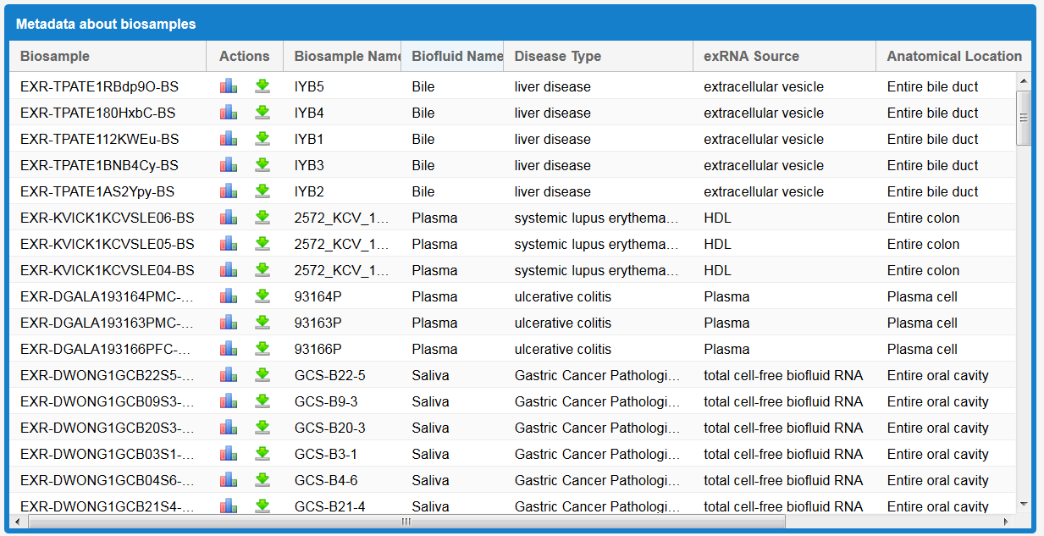
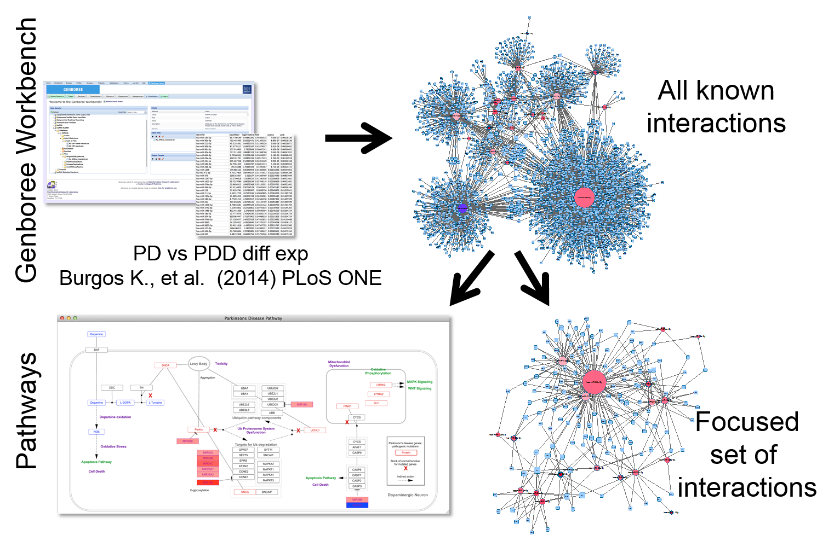
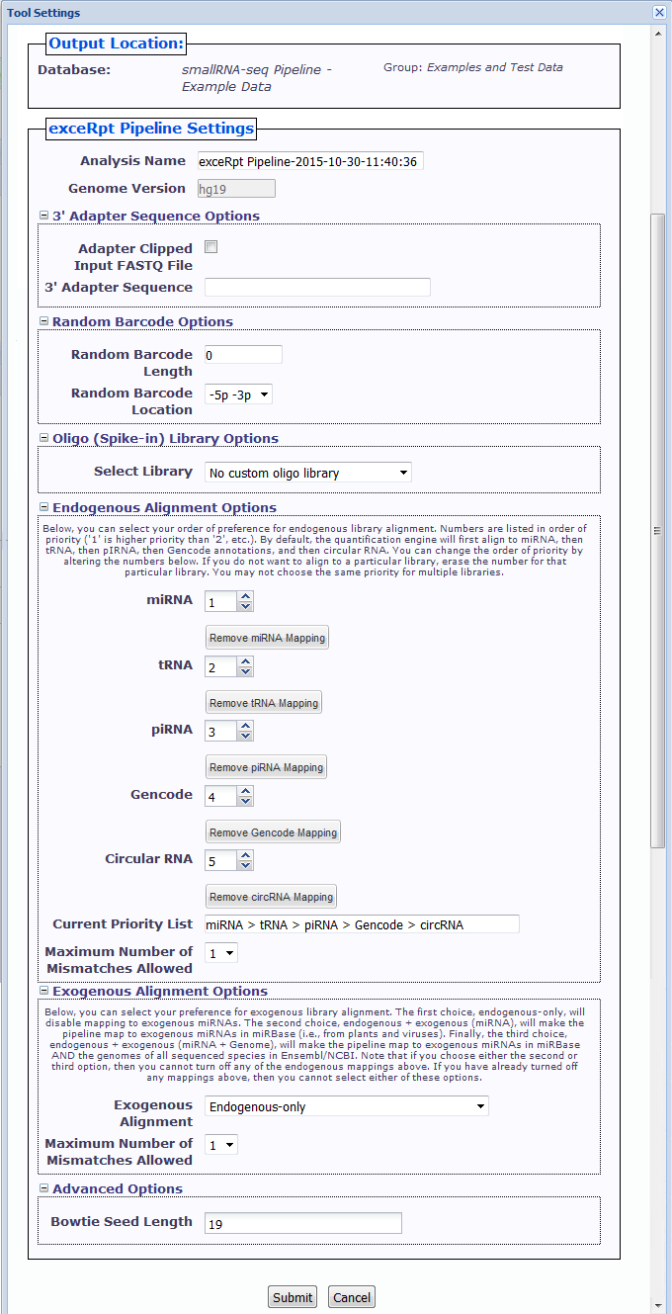
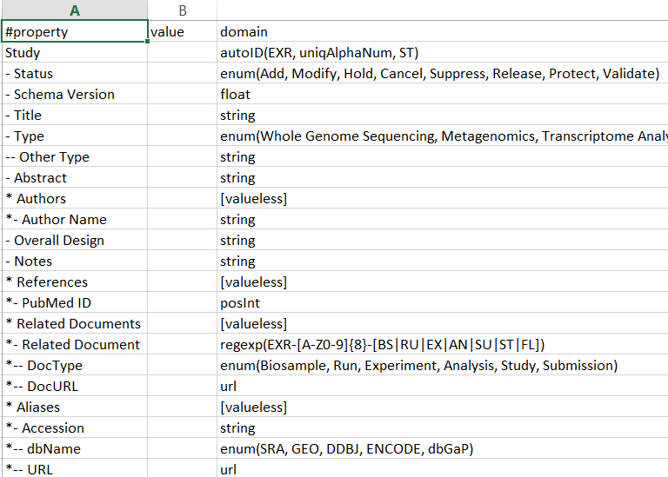
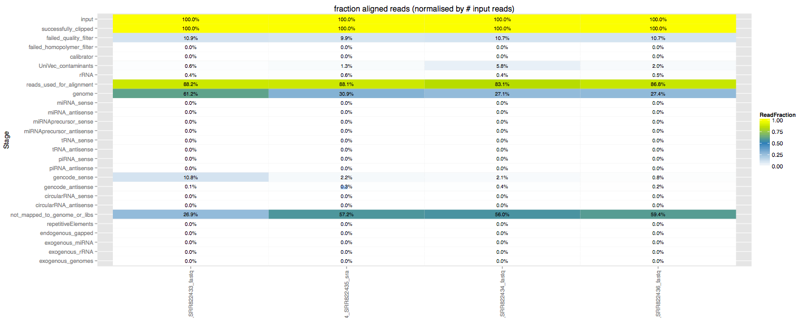
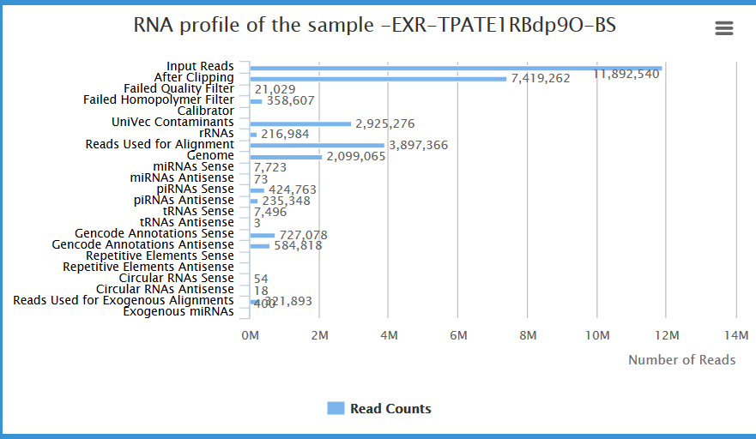
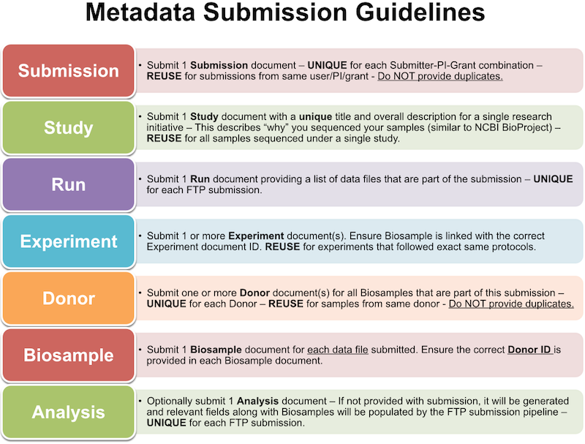
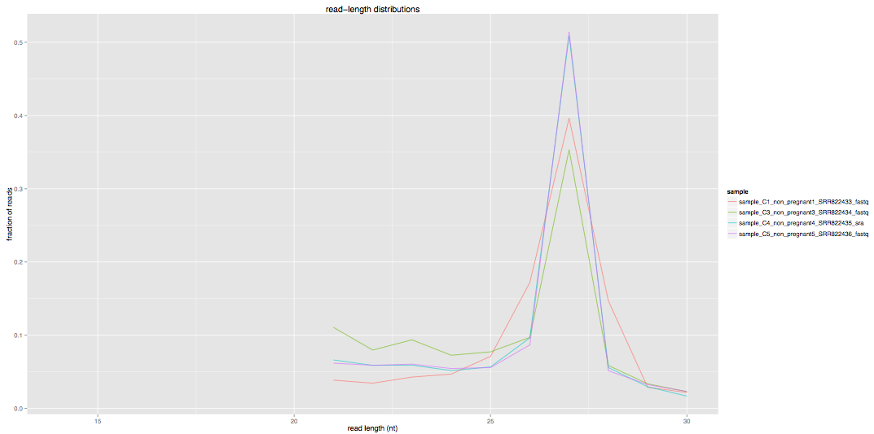
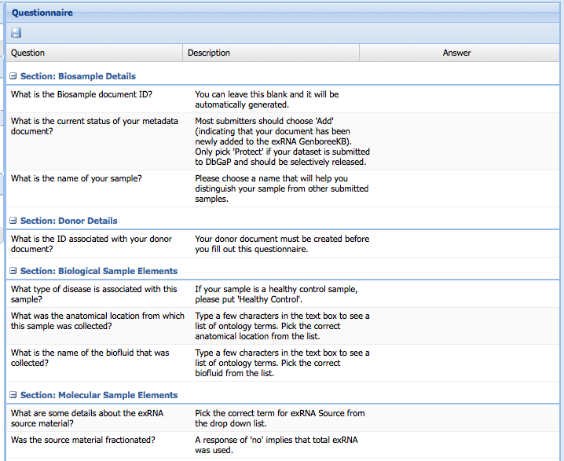
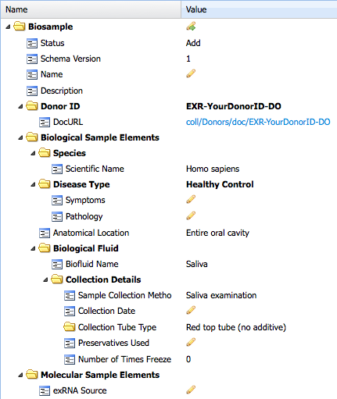
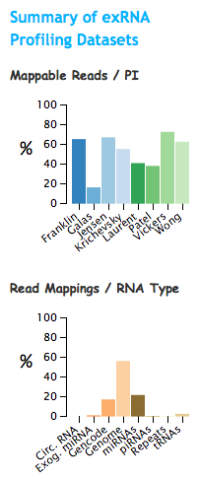
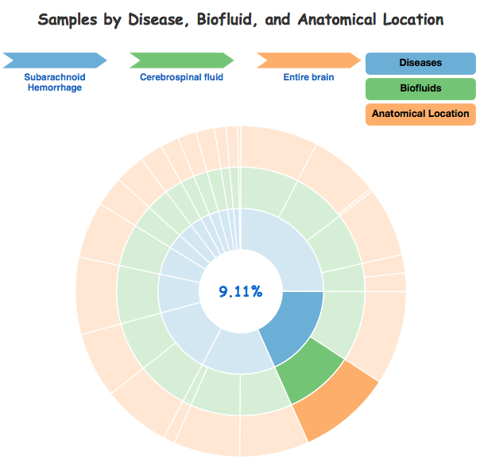
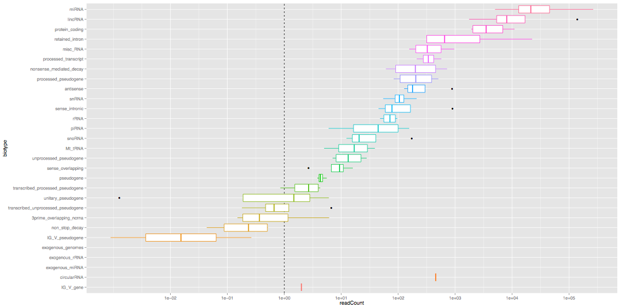
exRNA Profiling Data Submission & Analysis Infrastructure for the ERC Consortium
Sai Lakshmi Subramanian¹, William Thistlethwaite¹, Robert Kitchen², Fabio Navarro², Joel Rozowsky², Alexander Pico³, Roger Alexander⁴, David Galas⁴, Matthew E. Roth¹, Mark Gerstein², Aleksandar Milosavljevic¹
1 Baylor College of Medicine, Houston, TX; 2 Yale University, New Haven, CT; 3 Gladstone Institutes, San Francisco, CA; 4 Pacific Northwest Diabetes Research Institute, Seattle, WA;
Tools Available at the Data Management and Resource Repository (DMRR) for Integrative Analysis of exRNA Profiling Data
To support the research activities and goals of ERC Consortium members, we provide three categories of tools at the DMRR for submission and analysis of exRNA profiling data, all of which have been built using the Genboree framework. These include Data Submission Pipelines for submission of exRNA profiling datasets to the DCC. The submitted data is processed using the Data Analysis Pipelines, and the metadata is stored in the GenboreeKB exRNA Metadata system, both of which are used to build the exRNA Atlas. The exRNA Atlas consists of the exRNA Profiles generated by various consortium funded groups. The Atlas allows sub-selection of samples of interest based on sample metadata, for further downstream analysis.
exceRpt
Workflow
Faceted search of submitted samples
Pathway Finder
If you have exRNA profiling data
  Email DCC (sailakss@bcm.edu) for an account on the FTP server.
Genboree FTP Server
  ftp.genboree.org
  Use your Genboree user name and password
Upload directory
  A dedicated, unique and private directory named “exrna-picode” for your lab/group, shared only by your lab members and/or collaborators.
Data Submission Pipeline
Data Analysis Pipelines
exRNA Metadata Tracking System
Data Repository
Pathway and Interaction Analysis
  FTP submission of small exRNA-seq Data & Metadata
  exceRpt small RNA-seq
  RSEQtools long RNA-seq
  GenboreeKB – small RNA-seq, long RNA-seq assays
  exRNA Atlas
  Target Interaction Finder
  Pathway Finder
Files Needed for FTP Submission
Run exceRpt Pipeline in Genboree Workbench
View of exRNA Metadata in GenboreeKB UI
Sample Sub-selection in exRNA Atlas
Find Pathways & Interactions for Profiled miRNAs
Manifest file
Contains details of your submission
Nested tabbed spreadsheet format
Metadata Data Model in UI
Target Interaction Finder
  FILE EXTENSION - .manifest.json
  FORMAT - JSON format
  REQUIRED - Genboree login name, group name, database name, list all files that are submitted, MD5 checksum, tool specific settings
exceRpt Tool Settings
Data Archive
Contains your input data files
  FILE EXTENSION - _data.zip or _data.tar.gz
  FORMAT – FASTQ/SRA format (can be compressed)
  REQUIRED FILES - .fastq or .fastq.gz or .fastq.zip or .sra
  OPTIONAL FILES – Spike in sequence file in FASTA format.
  No folders are allowed in this archive. Should contain only FASTQ/SRA/FASTA files.
Metadata Archive
Contains metadata about your inputs
Comparison plots from exceRpt
  FILE EXTENSION - _metadata.zip or _metadata.tar.gz
  FORMAT – All metadata files should be in tab separated value format
  REQUIRED FILES - .metadata.tsv files - Submission, Study, Run, Experiment(s), Biosample(s) and Donor(s) documents.
Metadata Template
Drill-down search of submitted samples
Questionnaire
The Target Interaction Finder tool generates miRNA-protein target interaction files for a set of miRNA identifiers, which can be imported into downstream tools, such as Cytoscape, for network analysis and visualization. The Pathway Finder tool performs a search for pathways either containing miRNAs of interest or protein targets of those miRNAs. A table of pathway results and an interactive pathway viewer are displayed. The first column of the table lists a clickable pathway title that updates the viewer. The second column lists pathway identifiers that link to WikiPathways.org. The list is sorted by the number of "miRNAs" (primary) and by "miRNA Targets" (secondary) found on each pathway. The top 20 results are listed.
The FTP data submission pipeline has been implemented for submitting small exRNA-seq datasets (with associated metadata) for processing through the exceRpt small RNA-seq pipeline.
Users submit required files to the shared directory created for their lab on the Genboree FTP server.
After processing these files through exceRpt, results will be deposited in the Genboree Workbench and FTP shared area and will also be accessible through the exRNA Atlas.
Metadata will be stored in GenboreeKB.
Data will be deposited in public domain databases like dbGaP, GEO, and SRA.
Data analysis tools such as the exceRpt small RNA-seq pipeline and the RSEQtools long RNA-seq pipeline are available in the Genboree Workbench.
The exceRpt small RNA-seq pipeline generates a variety of sample-level quality control metrics, produces abundance estimates for various small RNA species, and makes available detailed alignment information for visualization and validation.
The RSEQtools pipeline performs gene-expression quantification, visualization of signal tracks of mapped reads, calculates mapping bias, and computes annotation coverage.
Metadata standards have been defined by the ERC Consortium members to effectively annotate exRNA profiles, ensure reproducibility of experiments and allow data comparisons. The GenboreeKB exRNA Metadata Tracking System allows for submission, tracking, and editing of exRNA metadata for various categories including Biosamples, Donors, Experiments, Runs, Studies, and Analyses.
All metadata submitted through the FTP data pipeline is validated against agreed ontologies, and data domains can be viewed in GenboreeKB by ERCC members.
Templates and questionnaires are available to facilitate metadata entry.
exRNA Atlas contains preliminary data generated by ERC Consortium funded groups that were analyzed using exceRpt pipeline. Data and metadata are displayed in grids or tabular views that aggregate submitted biosamples by biofluids and disease or experiment type. The Atlas allows users to:
browse, filter, search submitted samples across various facets including biofluids, diseases, and RNA isolation kits.
download processed results from datasets of interest.
view summaries of exRNA profiling studies from various labs in terms of reads passing QC, mappable reads, and read mappings per library type.
exRNA Atlas - http://genboree.org/exRNA-atlas/index.rhtml
Software Resources - All links to data analysis tools and learning materials for those tools can be found in the “Software” and “Data” sections under the “Resources” tab in the exRNA Portal: http://exrna.org/resources
Acknowledgements: Genboree Development Team at Baylor: Andrew Jackson, Sameer Paithankar, Neethu Shah, Aaron Baker
© Bioinformatics Research Laboratory, Baylor College of Medicine
This research is supported by the grant 1U54DA036134 from the NIH Common Fund, through the Office of Strategic Coordination/Office of the NIH Director.

