Slide 1
Using the exRNA Atlas to Perform Comparative and Downstream Analysis of exRNA Samples in the Genboree Workbench
William Thistlethwaite
ERC Consortium Data Management & Resource Repository (DMRR)
Baylor College of Medicine, Houston, TX
6th NIH ERCC Investigators’ Meeting
April 17th, 2016
Bethesda, MD

Slide 2
Selecting Samples of Interest
Go to the exRNA Atlas website
  Public:
    http://genboree.org/exRNA-atlas/index.rhtml
  Private (ERCC Only):
    http://genboree.org/java-bin/exRNA-atlas/index.jsp
Use the faceted charts to select your samples of interest.
  Click the appropriate facets and then click the magnifying glass icon to show corresponding samples in a grid.

Slide 3
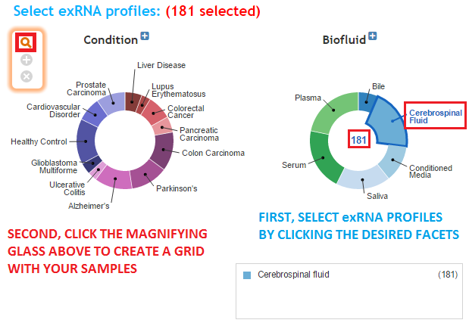
Selecting Samples of Interest

Slide 4
Picking Out Samples for Further Analysis
Pick out the desired samples using the checkboxes to the left of each sample.
  To select all samples, click the checkbox in the upper left corner of the grid.
The different metadata columns (Condition, Anatomical Location, etc.) should help you figure out your samples of interest.
Once you've picked out your samples, click the "Go to Genboree Workbench" button to see available tools.

Slide 5
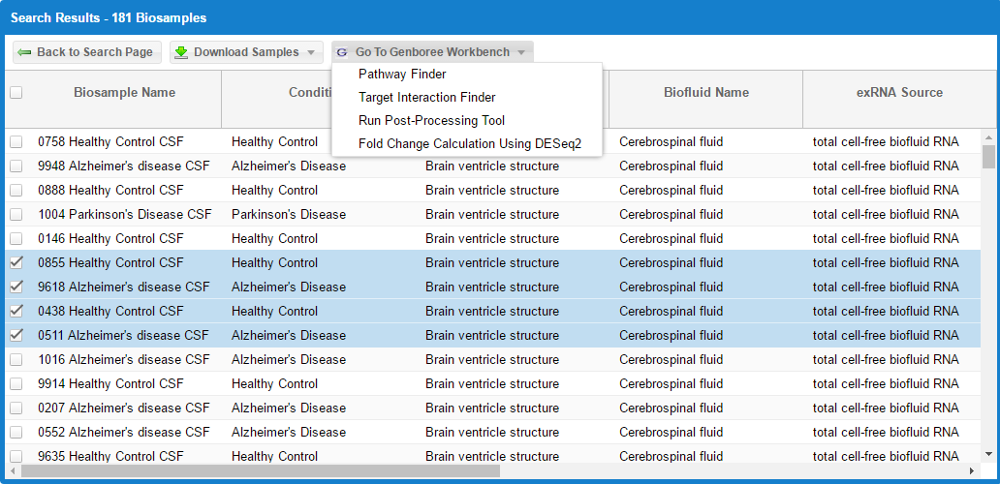
Picking Out Samples for Further Analysis

Slide 6
Going from Atlas to Workbench
Once you've clicked the "Go to Genboree Workbench" button, you can choose a tool to run on your selected samples.
You will be prompted to log into the Genboree Workbench once you choose a tool. This means that you must have a Genboree account to use the tools.
  If you have an account already, you can fill in your login information and then click the "Login" button.
  If you don't have an account, you can click the "Register here" link to create one.
  Once you've logged in, you won't need to log in again for that Atlas session.

Slide 7
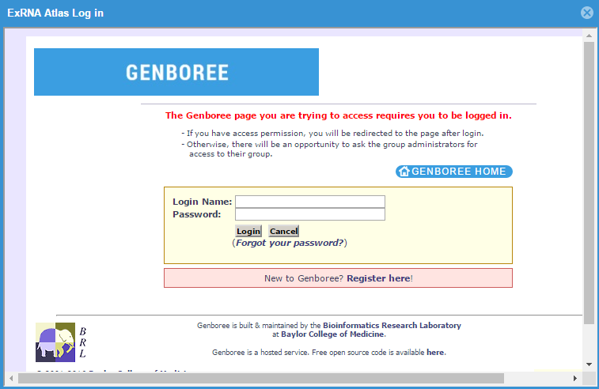
Going from Atlas to Workbench

Slide 8
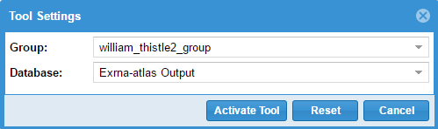
Going from Atlas to Workbench
After you've logged in, you'll be able to select the Group and Database which you want to use to store your output files for that tool run.
  Each Genboree account starts out with a Group (named after your username), but you will need to create a Database in order to run any tools.
  If the group you select doesn't have a Database, we will offer to create a Database for you (named "Exrna-atlas Output").
  Pathway Finder does not require a Database to run.

Slide 9
Going from Atlas to Workbench
  Once you click "Activate Tool", you will be taken to the Genboree Workbench.
  Your Input Data panel and Output Targets panel will be filled out automatically by the Atlas.
  You can then select your tool of interest, fill out the appropriate settings, and then launch a tool job.
  We will now go into more depth on each of the available tools.

Slide 10
Pathway Finder and Target Interaction Finder
Pathway Finder takes a column of miRNA identifiers (in a text file) and searches for pathways either containing the miRNAs or protein targets of the miRNAs.
Target Interaction Finder takes a column of miRNA identifiers (in a text file) and generates miRNA-protein interaction files in both .CSV (Excel) and network .xgmml format.
We will not focus on either tool because both tools work best with smaller lists of miRNAs.
We will work on "bridging the gap" between the Atlas and these tools so that users can select a smaller list of miRNAs from the list generated by exceRpt.

Slide 11
Run Post-Processing Tool
The post-processing tool will take results from any number of exceRpt small RNA-seq pipeline runs and will condense valuable information into an easy-to-read format.
  Instead of looking at read counts from 400 different files (each generated by a different sample), look at 1 file that contains all of the most important information!
  The tool also generates useful plots and histograms for comparative analysis.

Slide 12
Run Post-Processing Tool
In order to run the tool, select "Run Post-Processing Tool" from the Atlas and choose your Group and Database.
Then, choose the post-processing tool in the tool menu:
  Transcriptome -> Analyze Small RNA-Seq Data -> exRNA Data Analysis -> exceRpt small RNA-seq Post-processing
Finally, fill out your Analysis Name (used for organizing your results on the Workbench) and click "Submit".
You can follow the progress of your Job using the "Job Summary" tool (found under System/Network -> Jobs).

Slide 13
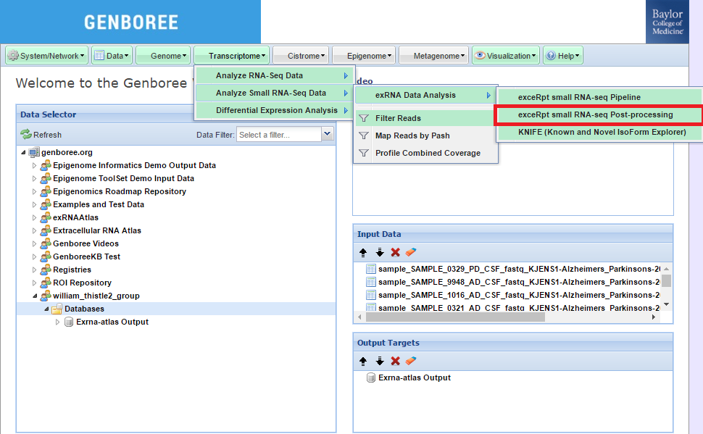
Run Post-Processing Tool

Slide 14
Outputs from Post-Processing Tool
Once your job has completed, you can download the result files from the Workbench, using the Data Selector Panel.
You should navigate to the Group and Database you chose earlier in the Atlas.
Then, navigate to the following directory:
  Files -> postProcessedResults_v3.1.0 -> [Your Analysis Name]
In order to download a given file, click on it in the Data Selector panel and then click the "Click to Download File" link in the Details panel.

Slide 15
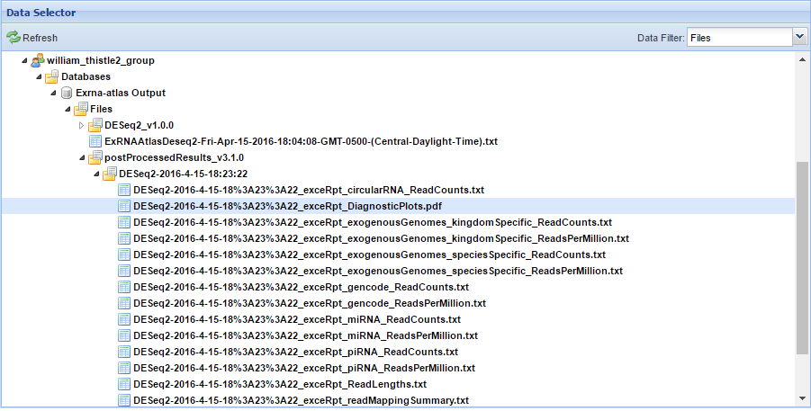
Outputs from Post-Processing Tool

Slide 16
Fold Change Calculation Using DESeq2
This tool will test exRNA samples for differential expression of miRNAs using DESeq2 (version 1.6.3).
Currently, the tool allows you to test a given factor (disease, for example) across two different factor levels (Alzheimer's disease versus control, for example).
We will continue to develop this tool and will add new features (like allowing analysis over multiple factors) in the coming months.

Slide 17
Fold Change Calculation Using DESeq2
In order to run the tool, select "Fold Change Calculation Using DESeq2" from the Atlas and choose your Group and Database.
Then, choose the DESeq2 tool in the tool menu:
  Transcriptome -> Differential Expression Analysis -> Fold Change Calculation Using DESeq2

Slide 18
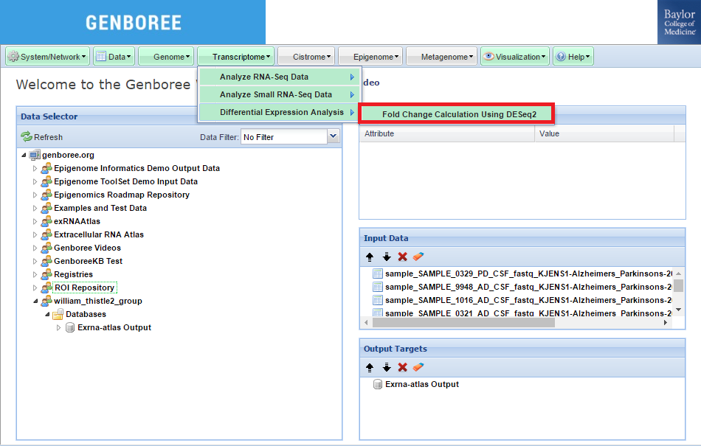
Fold Change Calculation Using DESeq2

Slide 19
Fold Change Calculation Using DESeq2
After choosing DESeq2, you will need to fill out your tool settings in the dialog box that pops up.
You can use the Atlas grid to choose your factor name / factor levels.
  Factor name is column name (Condition or Biofluid Name for now)
  Factor levels can be found within those columns (Alzheimer's Disease, Healthy Control, etc.).
Second factor level is used as base level (should probably be your control).

Slide 20
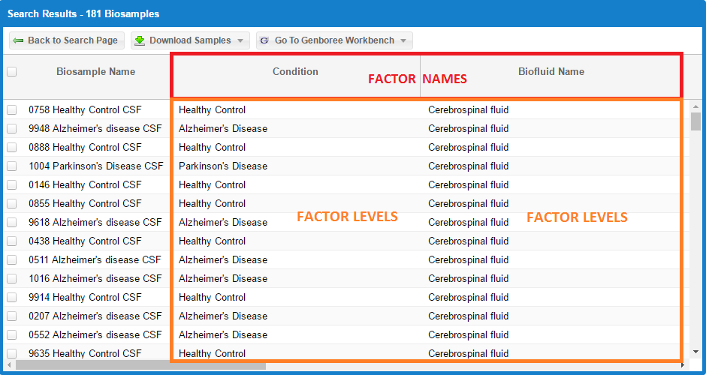
Fold Change Calculation Using DESeq2

Slide 21
Fold Change Calculation Using DESeq2
If you are an ERCC member, you should also fill out the ERCC Submission Options section.
  This section helps us keep track of tool usage, and we can use the information to improve the tools and get valuable user feedback.
Finally, you can choose to have your results uploaded to our FTP server via the "Remote Storage Area" option in the "Advanced Options" section. To learn more, follow this link:
  http://genboree.org/theCommons/projects/exrna-tools-may2014/wiki/Using_Remote_(FTP)_Storage_for_exceRpt

Slide 22
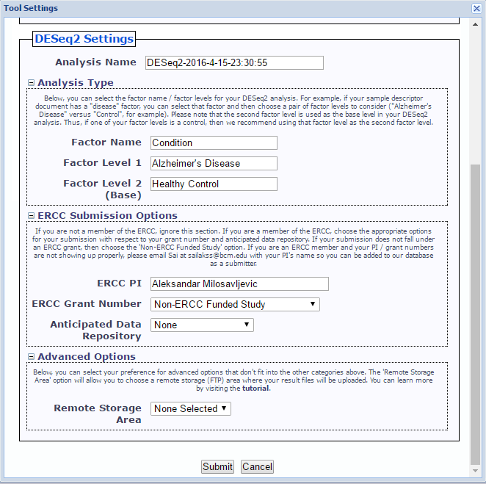
Fold Change Calculation Using DESeq2

Slide 23
Outputs from DESeq2
Once your job has completed, you can download the result files from the Workbench, using the Data Selector Panel.
You should navigate to the Group and Database you chose earlier in the Atlas.
Then, navigate to the following directory:
  Files -> DESeq2_v1.0.0 -> [Your Analysis Name]
In order to download a given file, click on it in the Data Selector panel and then click the "Click to Download File" link in the Details panel.

Slide 24
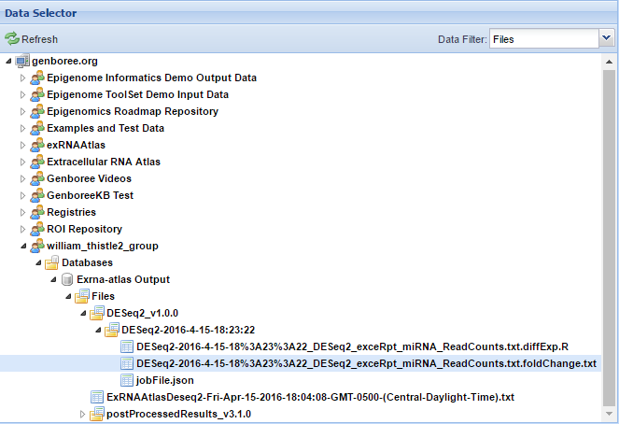
Outputs from DESeq2

Slide 25
Useful Links
exRNA Portal
  http://exrna.org
exRNA Portal Software Resources
  http://exrna.org/resources/software
exRNA Atlas
http://genboree.org/exRNA-atlas/index.rhtml
Data Coordination Center Wiki
  http://genboree.org/theCommons/projects/exrna-mads/wiki
exRNA Data Analysis Tools Wiki
  http://genboree.org/theCommons/projects/exrna-tools-may2014/wiki
General Information about the Genboree Workbench
http://genboree.org/theCommons/ezfaq/index/public-commons

Slide 26





Acknowledgements
Baylor College of Medicine, Houston, TX
Aleksandar Milosavljevic, Director
Matthew Roth, Co-Director
Elke Norwig-Eastaugh
Genboree Dev Team at Baylor
Andrew Jackson
Sameer Paithankar
Sai Lakshmi Subramanian
Neethu Shah
William Thistlethwaite
Aaron Baker
Yale University, New Haven, CT
Mark Gerstein
Joel Rozowsky
Rob Kitchen
Fabio Navarro
Gladstone Institutes, San Francisco, CA
Alexander Pico
Anders Riutta
Kristina Hanspers
Pacific Northwest Diabetes Research Institute, Seattle, WA
David Galas
Roger Alexander
Sponsored by:
Grant 1U54DA036134 from the NIH Common Fund, through the Office of Strategic Coordination/Office of the NIH Director

